Slide 1

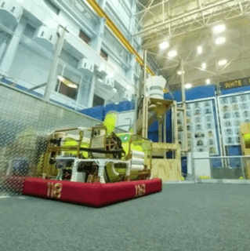
| INDEXERS
Hoppers
Ball Tunnels
Spindexers
Stackers
Other Indexers
INDEXERS
FIRST® Robotics Competition games sometimes allow robots to possess multiple scoring elements at once. Whether the quantity of scoring elements is limited to a certain quantity or unlimited, indexers are a key component to receiving scoring elements from an intake system, storing and organizing them, and passing them to a scoring mechanism. When designing an indexer, ask:
How many scoring elements (game pieces) can the robot possess at once?
How does the size, shape, and flexibility of the scoring element impact the design?
How will the scoring elements interact with each other in the indexer?
How will the indexer interact with other mechanisms in the robot?

Slide 2
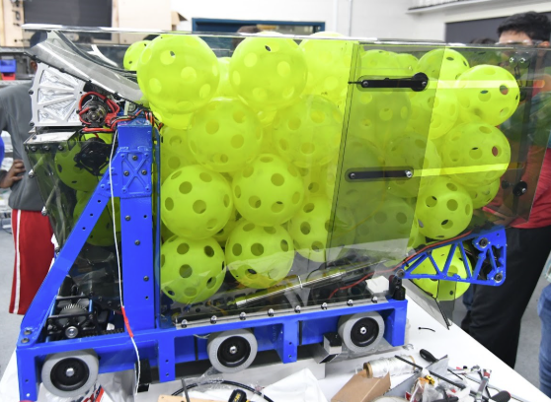
| INDEXERS
Hoppers
Ball Tunnels
Spindexers
Stackers
Other Indexers
A hopper is a large open area that acts as a storage bin for large numbers of game pieces. Typically, game pieces are loaded into the top of the hopper and exit through the bottom into the scoring mechanism or goal.
Key Components of a Hopper
Walls – The walls of the hopper are typically designed to maximize storage space and are often made of clear polycarbonate for visibility.
Hopper Floor – The hopper floor often acts as an indexer, guiding game pieces into the robots’ scoring mechanism or goal.
  Sloped floor – Uses gravity to passively guide game pieces
  Conveyor/Agitator – Creates a “moving floor” or jostling effect to guide game pieces and prevent jams.
Pros and Cons
PROS: Simple to build, lightweight, high storage capacity
CONS: Not ideal for non-spherical scoring elements. Passive systems are prone to jams
2017 – Team 254 – The Cheesy Poofs
Hopper Tips and Techniques
Useful for games that allow robots to possess unlimited game pieces such as LUNACY (2009) and STEAMWORKS (2017).
Works best with spherical scoring elements such as balls.
Avoid jams and dead spots by actively guiding scoring elements using belts or conveyors and avoiding sharp corners.

Slide 3
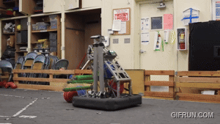
| INDEXERS
Ball Tunnels
Hoppers
Spindexers
Stackers
Other Indexers
Ball tunnels are linear pathways that guide game pieces single-file from the indexer to the scoring mechanism, typically using rollers or belts.
Ball Tunnel Key Components
Centering/Serialization – Scoring elements must be fed into the ball tunnel one at a time.
Structure – Typically built out of polycarbonate walls, aluminum tube, or a combination of both.
Rollers/Belts – Rollers or belts guide scoring elements through the ball tunnel and into the scoring mechanism
  Belt and Wall – Use a single belt allowing the ball to roll across the opposite wall. Simple, but can cause jams if balls contact each other.
  Multiple Belts/Rollers – Typically on both sides or top/bottom. Often paired with belts or polycord to maintain constant compression.
2022 Reveal Video – Team 1678 Citrus Circuits
Ball Tunnel Tips and Techniques
Ball Tunnel Pros and Cons
PROS: Consistent feeding, relatively simple to build, multiple belt systems don’t often jam, sensor integration can allows for potential of advanced features.
CONS: Limited capacity, may require multiple rollers to maintain compression, requires sensors to detect scoring elements and maintain spacing effectively.
Build in adjustable compression, especially with inflatable game pieces.
Use grooved channels for round polycord. Use crowned pulleys (often 3D printed) for flat belts.
Use sensors (i.e. beam break, color sensors, etc.) to detect and process scoring elements. The example above shows color sensors used to eject unwanted game pieces.
Eliminate dead-spots and compression issues by using multiple rollers.

Slide 4

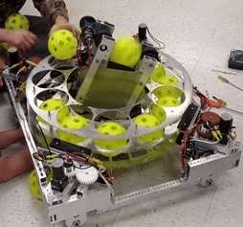
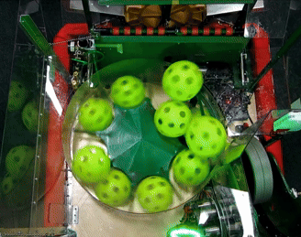
| INDEXERS
Spindexers
Hoppers
Ball Tunnels
Stackers
Other Indexers
Spindexers use a rotating carousel with compartments or a central spinning wheel to direct game pieces into the scoring mechanism.
Spindexer Key Components
Rotating Carousel – Rotating device with dividers or pockets designed to hold one ball or game piece in each.
Diverter – Typically wheels or guides that divert balls into the scoring mechanism.
Spindexer Pros and Cons
PROS – Fast feeding of one game piece at a time. Works well with hoppers, adjustable feeding speed.
CONS – Large footprint can cause more difficult packaging. Can be harder to recover from jams. Not ideal for non-spherical objects. Can be challenging to fabricate.
Spindexer Tips and Techniques
Experiment with different speeds to make sure feeding and scoring mechanisms can keep up without losing accuracy.
Develop a method for clearing jams early and iterate designs to determine the cause and avoid them.
Experiment with pocket designs and guides
Test with accurate wear, as scuffed balls may behave differently than non-scuffed ones.
MARSWARS Team 2614 2017 Prototype
Titanium 1986 –2017 Reveal Video

Slide 5
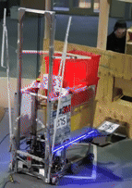
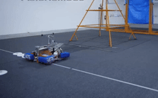
| INDEXERS
Stackers
Hoppers
Ball Tunnels
Spindexers
Other Indexers
Stackers vertically stack scoring elements either from the bottom upward or top downward before releasing one at a time or as a stack.
Types of Stackers
Bottom-up stackers push new pieces upward using a lifting mechanism; older pieces remain at the top.
Top-down stackers allow gravity to assist feeding, with the intake loading from the top and the scoring mechanism pulling pieces from the bottom.
Pros and Cons of Stackers
PROS: Maintains order of object, good for non-spherical scoring elements, small vertical footprint (depending on size of scoring elements)
CONS: Intake system needs to be higher off the ground for top loading stackers. Can jam if tolerances are loose.
Examples of Stackers
Bottom-up stackers were very often used in the 2015 game Recycle RushSM to lift and stack tubs, scoring the entire stack.
Top-down stackers were commonly used in the 2013 game Ultimate AscentSM to stack frisbees loaded from the human player station, then launched one at a time from the bottom.
Fighting Calculators – 2175 Robot Reveal 2015
Code Orange 2013 Robot Reveal

Slide 6
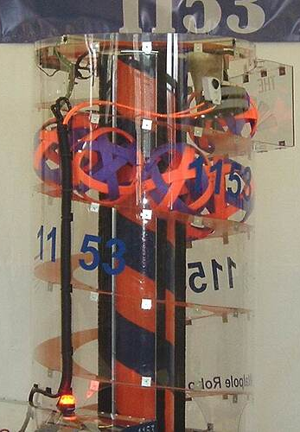
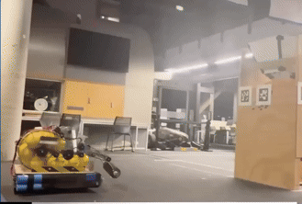
| INDEXERS
Other Indexers
Hoppers
Ball Tunnels
Spindexers
Stackers
Helix/Spiral - Typically uses a spiral shaped guide system with a spinning central column, often with brushes or flexible flaps, that pushes spherical game pieces up the spiral and into the scoring mechanism.
Multi–Path Indexers – Uses sensors to direct scoring elements down multiple paths typically with a diverter wheel or guide. For example, this system could be used to eject unwanted scoring elements (i.e. opposing alliance balls in 2022) or divert scoring elements to different mechanisms such as a specialized end game scorer (i.e. scoring the trap in 2024).
2009 – Team 1153
U or S Shaped Indexers – A version of a ball tunnel that directs spherical scoring elements along U or S shaped paths using belts or rollers. Able to store more game pieces than a linear path. Can be oriented vertically or horizontally.
2026 FUN Ri3D Top 20

