Slide 1


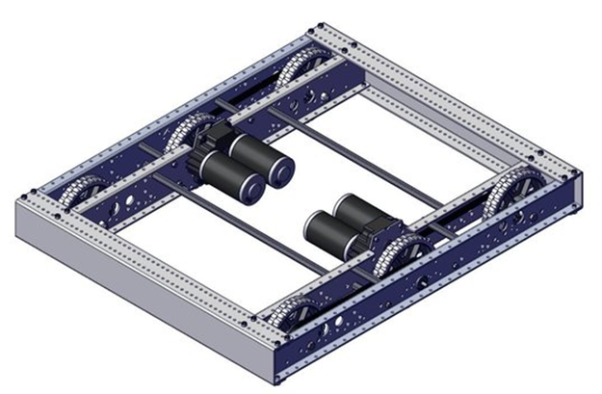
| ROBOT CHASSIS AND DRIVETRAIN
Frame
Bumpers
Tank Drive
Holonomic Drive
Belly Pans
ROBOT CHASSIS AND DRIVETRAIN
The robot chassis is the structural component of a robot that provides a foundation for the robot’s drivetrain and other mechanisms. When designing a robot chassis, it is important to ask several questions:
What size will the frame be?
How will the bumpers and other robot components attach to the frame?
Which drivetrain will the robot have?
Will electronics be located in a belly pan, or elsewhere?
AndyMark 2024 Kit of Parts Chassis

Slide 2
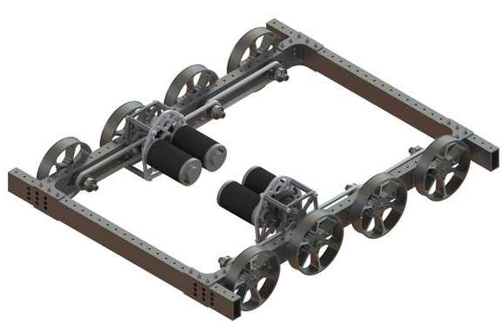
| ROBOT CHASSIS AND DRIVETRAIN
Frame
Bumpers
Tank Drive
Holonomic Drive
Belly Pans
The frame is a critical part of your robot structure. Important parts of the robot will attach to the frame, so it must be strong and robust.
Parts of the Frame
Drive Rails - The sides of the robot where the drive wheels and gearboxes are located.
Cross Members or Ladder Bars – Usually 2x1 aluminum box tube, which connect to the drive rails at the front and back of the robot.
Frame Size and Shape
Frames can be different shapes and sizes, however the frame perimeter often cannot exceed 120.” Make sure to check your season’s Game Manual for season specific details.
Frame Tips and Tricks
Use 1/8” thick Box Tube for durability.
Smaller robots are more maneuverable, but make packaging mechanisms and electronics more challenging.
A robot will not pass inspection if it exceeds the frame perimeter size in the Game Manual.
  AndyMark West Coast Drive
Frame Materials and Resources
Aluminum Box Tube. Examples include:
    REV MAXTube
    AndyMark Structure
    West Coast Products
    ThriftyBot Structure
Sheet Metal. Examples include:
    AndyMark Kit Bot

Slide 3
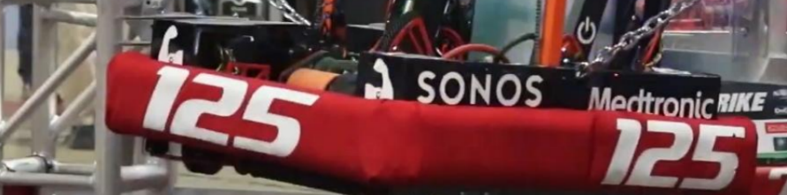
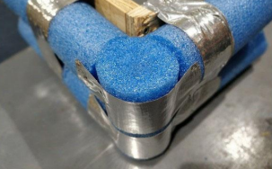
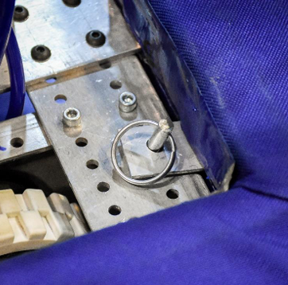
| ROBOT CHASSIS AND DRIVETRAIN
Bumpers
Frame
Tank Drive
Holonomic Drive
Belly Pans
Bumpers protect the frame perimeter and feature the team’s number on all sides of the robot. Teams will need blue bumpers and red bumpers. Check each season’s Game Manual for details.
Parts of a Bumper
Wood Backing – Typically ¾” thick, 5” tall plywood
Pool Noodles – Check the Game Manual for specifics
Gaffers or Duct Tape – To attach pool noodles to the wood
Red and Blue Fabric – Similar in color to the FIRST ® logo
Numbers - Check the Game Manual for specifics, but numbers are typically white, 4” tall, and clearly readable from 60 feet away.
Hardware – Brackets, bolts/nuts, pull pins, staples, etc.
Bumper Tips and Tricks
Don’t wait until the last minute to construct bumpers. Poorly constructed bumpers can cost a team matches and create headaches during competition.
Make your bumpers sturdy, durable, and easy to remove and re-attach.
During matches, bumpers must be firmly attached to the frame, typically with brackets, in at least two spots per side.
Numbers are often applied before the fabric is put on the bumpers, which takes planning and precision.
Bumper Materials and Resources
The FIRST® Robotics Competition Bumper Guide is an excellent resource with links for materials and steps for construction.

Slide 4

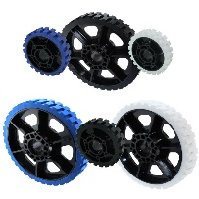
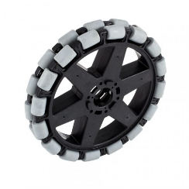
| ROBOT CHASSIS AND DRIVETRAIN
Tank Drive
Frame
Bumpers
Holonomic Drive
Belly Pans
One type of FIRST ® Robotics Competition drivetrain is Tank Drive, which includes traction wheels powered on each side by a single gearbox connected by chains located inside, or outside, of the box tube.
Types of Tank Drives
West Coast Drive – Has cantilevered wheels that stick out from the frame rather than be contained within it.
4-Wheel Drive, 6-Wheel Drive, or 8-Wheel Drive
Tank Drive Advantages
Simple to build and program
Good pushing power and traction
Generally easy to maintain
Tank Drive Weaknesses
Can’t drive sideways (strafe)
Turning issues (skid steer) can cause too much friction and brownouts when turning if not built properly
Design Fixes to Skid Steer Issues
Tank Drive Materials and Resources
Tank Drive Kits. Examples include:
  AndyMark 2024 KitBot Chassis
  AndyMark West Coast Drive Kit
WPI Lib includes tutorials for programming
Wheels are offered by many vendors:
  WestCoast Products
  REV ION
  AndyMark
Drop Center - Center wheel(s) are slightly lower (1/16” – 3/16”) to make turning easier.
Omni Wheels - Omni Wheels can be used at the front and/or back to help with turning

Slide 5
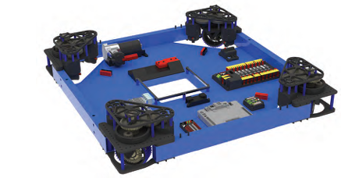
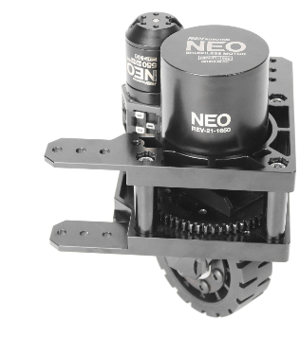
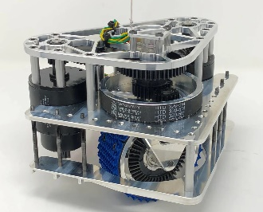
| ROBOT CHASSIS AND DRIVETRAIN
Holonomic Drive
Frame
Bumpers
Tank Drive
Belly Pans
Another type of FIRST ® Robotics Competition drivetrain is Holonomic Drive, which allows for omni-directional driving including spin, strafe, and diagonal driving. Swerve Drive is a popular holonomic drivetrain.
Types of Holonomic Drives
Swerve Drive – Allows for an optimal combination of speed, pushing power, and maneuverability and is quickly becoming a gold-standard for drivetrains.
Mecanum/Omni Drive - Maneuverable, but lacks pushing power compared to tank and swerve drives.
Swerve Drive Advantages
Excellent maneuverability and speed
Good pushing power
There are a variety of Commercial Off-the-Shelf (COTS) swerve modules and products
Swerve Drive Weaknesses
Expensive
Complex to assemble
Heavier than most Tank Drives
Each wheel requires two motors, which can drain a battery faster
Can be challenging to code, but code libraries are available
  Team 254 Technical Binder 2022
Swerve Drive Materials and Resources
COTS Swerve Drive Modules:
  REV Robotics
  Swerve Drive Specialties
  AndyMark
  ThriftyBot

Slide 6
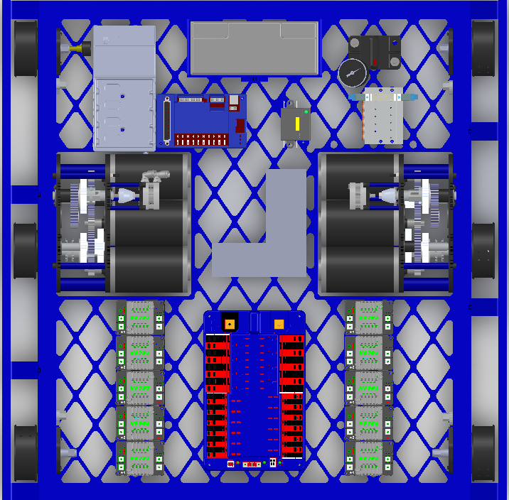
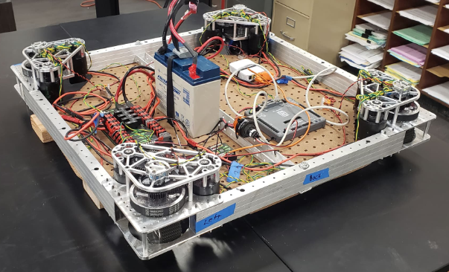
| ROBOT CHASSIS AND DRIVETRAIN
Belly Pans
Frame
Bumpers
Tank Drive
Holonomic Drive
Some teams use a belly pan at the bottom of the robot, which connects the drive rails and ladder bars. A belly pan can be used as a spot to mount the electronics, battery, compressor, and other robot mechanisms.
Belly Pan Advantages
Provides needed structural support to the robot frame. Robots without a belly pan often need cross supports for the frame.
Commonly made out of ¼” - ½” plywood, 1/16”-1/8” aluminum, or 1/8” perforated polycarb.
Provides a mounting location for electronics and other components
Belly Pan Weaknesses
Adds weight to a robot
Can make some electronics difficult to access, depending on the design of the robot and its mechanisms.
Be cautious if attaching a belly pan to tank drive rails that have a chain-in-tube drivetrain. Rivets could hit and damage the chain inside the box tube.
FRC Team 254 West Coast Drive with Belly Pan
FRC Dark Matter 2643 Swerve Drive with Belly Pan
Belly Pan Materials and Resources
COTS Materials:
  AndyMark Perforated Polycarbonate Sheet
  Aluminum Perforated Sheet
  Plywood or Sheet Metal can be purchased at many hardware stores

