Slide 1


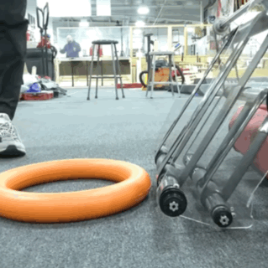
| SCORING ELEMENT INTAKES
Intake Arms
Roller Claws
Intake Wheels
Belts
Passive Intakes
SCORING ELEMENT INTAKES
The intake is the mechanism that allows robots to acquire and possess scoring elements (game pieces). The goal for an intake is “Touch it, own it.” Consider these questions when designing an intake:
Where will the robot intake a scoring element: from the floor, a human player station, and/or another location?
How does the size and shape of the scoring element impact the design of the intake?
If the intake extends outside of the frame perimeter of the robot, what will its starting configuration look like?
How will the intake interact with other mechanisms in the robot?
How will the intake avoid damage and penalties if it collides with another robot or field element?
  Cranberry Alarm Ri3D CRESCENDO 2024

Slide 2
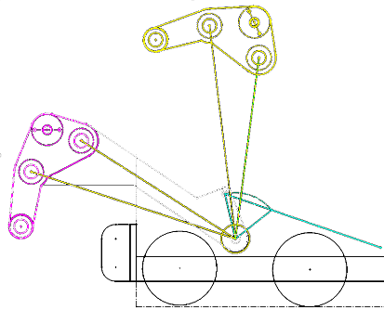
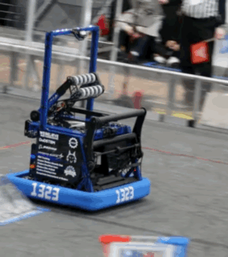
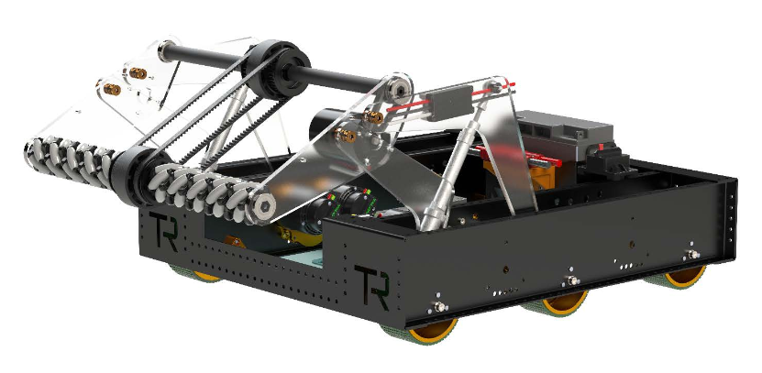
| SCORING ELEMENT INTAKES
Intake Arms
Roller Claws
Intake Wheels
Belts
Passive Intakes
An intake arm is a common mechanism. Intake arms often start inside the robot frame, then extend over the bumper.
Intake Arm Mechanics
4-Bar Linkages - Many over-the-bumper arms use four-bar linkages, which are examined later in this lesson.
Slap Down - Other arms are designed to “slap down” from a pivot point inside the robot frame.
Slap Down Intake & Arm Design
Parts Often Used on an Intake Arm
Wheels –See the Intake Wheels tab for more information.
Belts –See the Belts & Tubing tab for more information.
Rollers – Rotating aluminum or polycarbonate tubes, sometimes with grip material applied to them are common.
Hex Shaft – Wheels, belts and/or rollers are often located on one or more axles, typically made from ½” Hex Shaft.
Team Rembrandts 2022 4-Bar Linkage Intake
FRC 1323 Madtown 2023 Robot
Arm Examples and Resources
Polycarbonate or Lexan. Examples include:
  Local Hardware Stores and Vendors
  Online Vendors
Hex Shaft. Examples include:
  AndyMark
  WestCoast Products
Rollers. Examples include
  McMaster-Carr
  AndyMark Roller Intake Kit
Intake Arm Tips and Tricks
Consider using polycarbonate for the sides of the arm to make the arm flexible, strong and lightweight. DO NOT use Acrylic – it can shatter on impact.
Design the arm to move back inside the frame perimeter when not picking up a scoring element. This will decrease the chance of damage to the arm from collisions with field elements or robots.

Slide 3
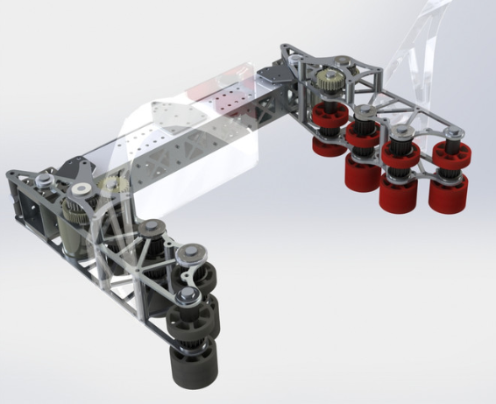
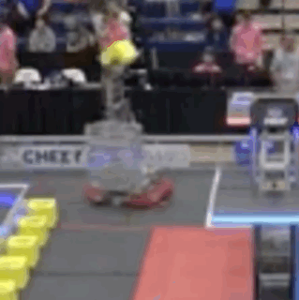
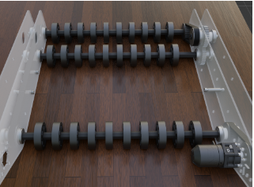
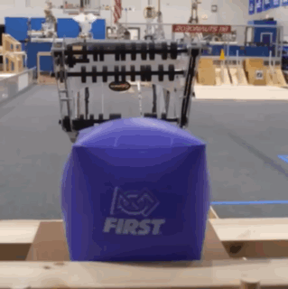
| SCORING ELEMENT INTAKES
Roller Claws
Intake Arms
Intake Wheels
Belts
Passive Intakes
Roller Claws are mechanisms that can intake a scoring element, and if the motors for the wheels or belts are reversed in direction, can also launch or place a scoring element.
Types of Roller Claws
Side-to-Side – This intake is good for picking up box-shaped scoring elements, since it can grab a scoring element from both sides. It often uses compliant wheels.
Top-and-Bottom – This intake typically features
rotating wheels or belts that draw in a scoring element
from the floor or another flat surface.
Parts Often Used on Roller Claws
Wheels –See Intake Wheels tab for more information.
Belts – See Belts & Tubing tab for more information.
Roller Claw Tips and Tricks
Make sure the scoring element is secure within the claw, even when the robot travels at high-speeds, turns quickly, or takes a hit.
Some roller claws also open and close to pinch the scoring element tighter between the rollers. This may or may not be necessary, depending on the scoring element.
Even slight changes to the wheels or shape and angle of the claw can make a big difference in effectiveness.
FIRST Robotics Team 1678 – Citrus Circuits - 2018
FIRST Robotics Team 118 – Robonauts: Everybot 2023

Slide 4
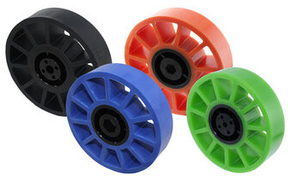
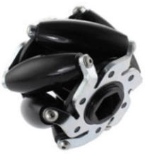
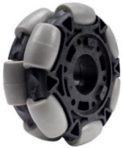
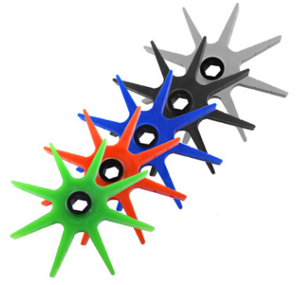
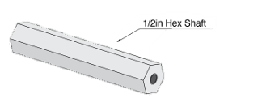
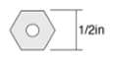
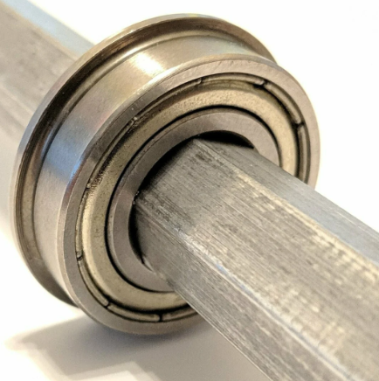
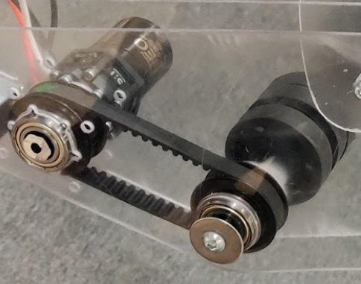
| SCORING ELEMENT INTAKES
Intake Wheels
Intake Arms
Roller Claws
Belts
Passive Intakes
Wheels are used on both intake arms and roller claws, helping to intake a scoring element and release it as well.
Compliant Wheels
Mecanum
Wheel
Omni
Wheel
Types of Intake Wheels
Compliant – Compliant wheels provide grip and come in a variety of durometers. Durometer measures how “squishy” a compliant wheel is. The lower the durometer, the squishier the wheel.
Mecanum – Used to center an object for indexing.
Omni – Also used to center an object for indexing.
Stars – Used for their ability to sweep in a scoring element.
What is Bore?
Bore refers to the size of the hole in the center of the wheel.
Axles, such as a Hex Shaft, should match the diameter of the bore. ½” is a common size for a Bore and Hex Shaft. A Hub can be attached to a wheel to change the size of the bore.
Bearings and Intake Wheel Mechanics
Spacers and Shaft Collars hold wheels in place on an axle.
Axles that spin must be supported in at least 2 places by either a motor with a gearbox or a bearing.
Bearings are metal components that allow the inside portion that contains the axle to rotate smoothly and independently from the outside part that is mounted to the robot.
One motor can power multiple axles of intake wheels if they are connected by belts, gears, or chains.
Intake
Stars
Bearing and Hex Shaft
Intake Wheel Examples and Resources
REV Robotics
AndyMark
West Coast Products
ThriftyBot

Slide 5
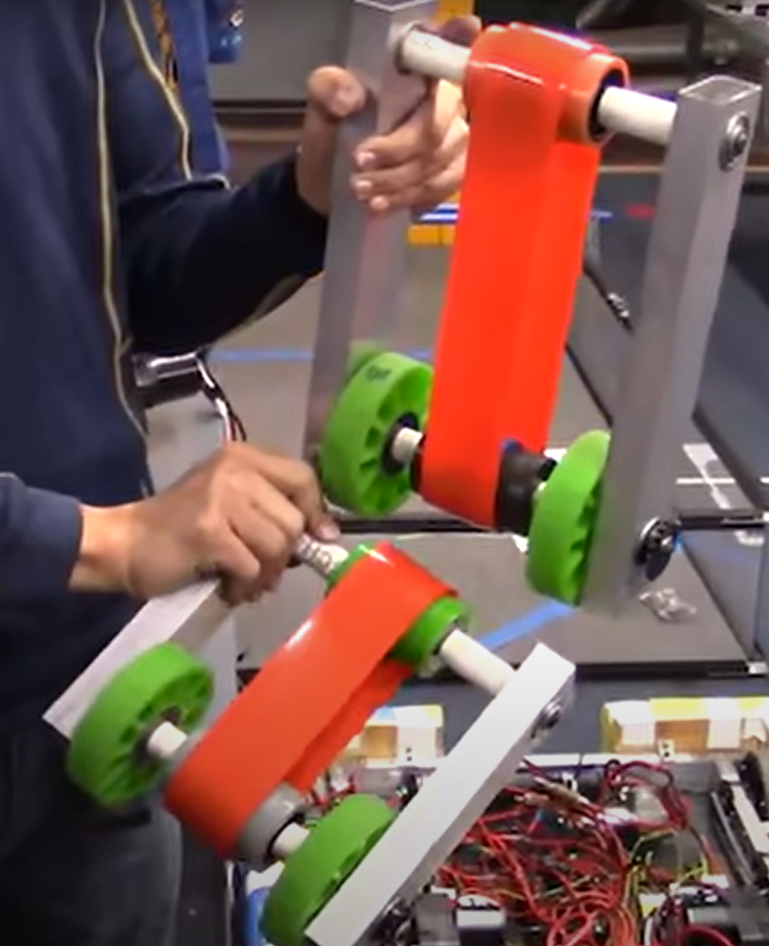
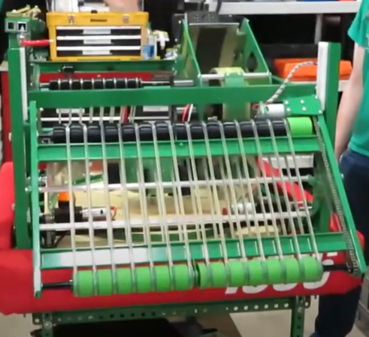
| SCORING ELEMENT INTAKES
Belts
Intake Arms
Roller Claws
Intake Wheels
Passive Intakes
Some intakes use flat belts or round belts to draw a scoring element into the robot, as well as index or load the scoring element into another mechanism.
Flat Belt Mechanics
Polyurethane flat belts or “Polybelts” are typically 1-2 inches wide and roll on crowned pulleys to keep them in place. Belts can be cut and “welded” together with heat to make loops.
Crowned pulleys have a raised center that keeps flat belts centered on a roller.
Timing belts use toothed pulleys to prevent slipping, but cannot be re-sized and have a specific center to center distance.
Round Belt Mechanics
Polyurethane round belts look like tubes and run on rollers with channels to keep the belts in place.
Solid round belts can be “welded” together to make a loop.
Hollow round belts use small metal connectors to attach the two ends instead of welding them together.
Welding Polyurethane Belts
Belts need to be partially melted with either a heat gun or a hot knife, then clamped together to “weld” them into a loop.
Make belts about 10% smaller than the needed length to make sure they remain tight on the rollers.
Flat Pulley Belting Transfer System
Round Belting Transfer System
Belt Examples and Resources
How Do I Use Polybelt?
Heat Gun – Available at most hardware stores
Clamp tool and Hot Knife
Flat Belts
  AndyMark – also has Crowned pulleys
  WCP - Timing Belts and Pulleys
Round Belts
  McMaster-Carr

Slide 6
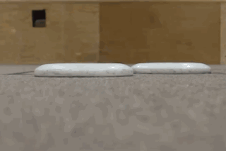
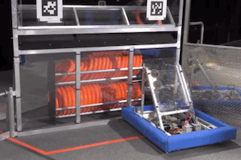
| SCORING ELEMENT INTAKES
Passive Intakes
Intake Arms
Roller Claws
Intake Wheels
Belts
Some teams use a passive intake: one that does not require motors or mechanisms to function. A passive intake can be combined with motorized mechanisms as well.
Dust Pans and Shovels
Dust Pans are thin pieces of material that move along the floor or carpet to scoop up scoring elements, particularly with flat scoring elements. Mechanized rollers are sometimes added for indexing.
Shovels are a simple way to move scoring elements along the floor, often to assist alliance partners to “feed” them scoring elements to score.
Ramps and Slides
Ramps and Slides are sometimes used as a way to gather scoring elements from a Human Player Station, depending on the game.
Typically, a robot aligns its ramp or slide with the station, then Human Player pushes a scoring element through the field element, where it slides directly into the robot.
The 2024 KitBot featured a passive intake which loaded the scoring element into a motorized launching mechanism.
FIRST Robotics Team Titanium 1986 - 2013 Reveal
2024 FIRST Robotics Competition KitBot Reveal

