Slide 1


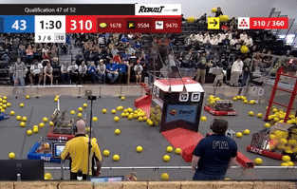
| LAUNCHERS AND PLACERS
Single-Wheel Hooded Launcher
Multi-Wheel Launchers
Reverse
Roller Claw
Catapult
Linear Punch
LAUNCHERS AND PLACERS
FIRST ® Robotics Competition games are often either Launch games, where a scoring element (game piece) shoots out of the robot and into a goal, or Pick-and-Place games, where a scoring element is placed onto a field element to score points. Before deciding on the type of mechanism used to Launch or Place scoring elements, ask:
How many scoring elements can the robot possess at one time?
How does the size, shape, and flexibility of the scoring element impact the design?
Where does the scoring element need to land in order to score?
How will the launcher or placer interact with other mechanisms in the robot?
  2026 Half Moon Bay District Qualifier – Match 47

Slide 2
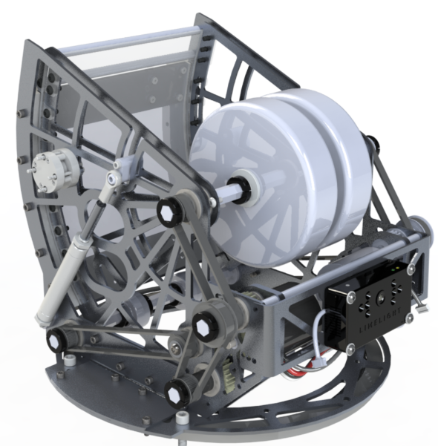
| LAUNCHERS AND PLACERS
Single-Wheel Hooded Launcher
Multi-Wheel Launchers
Reverse
Roller Claw
Catapult
Linear Punch
A single-wheel launcher is often used when a robot needs reliable, repeated shots in quick succession. These mechanisms are often called Flywheels or Hooded Launchers due to their components.
Parts of a Hooded Flywheel Launcher
Launcher Wheel –A variety of wheels are used, depending on the scoring element and its ability to be compressed.
Inertia Wheel (Flywheel) – Flywheels help solve a problem: When a scoring element goes through the launcher, the shooter wheel slows down, which can cause the next shot to be inaccurate. A flywheel adds inertia, which helps keep the wheel turning at a more consistent speed.
Hood – The hood provides direction and compression on the scoring element, allowing it to have consistent contact with the launching wheel.
Turret – A turret is sometimes added to Flywheel Launchers to allow the mechanism to rotate. Other teams prefer to turn the robot to aim.
Hood
Launcher Wheel
Hooded Flywheel Launcher Tips and Tricks
Be careful! Flywheels often spin at several thousand RPM. Make sure to secure loose items (scarves, ties, lanyards, etc.) and keeps hands away.
Hooded flywheel shooters create backspin on a scoring element.
A shot’s trajectory can be adjusted by changing the speed of the wheel or the geometry of the hood. Some teams design an adjustable hood that can extend or retract to adjust distance and trajectory
A hood that wraps further around the wheel will result in a lower, flatter trajectory, while a hood that does not wrap very far around the wheel creates more of a lob shot.
FIRST Robotics Competition Team 8 – Paly Robotics
Flywheel Materials and Resources
Flywheels and Launchers. Examples include:
  West Coast Products
  AndyMark
Turrets. Examples include:
  Armabot
  Commercially available Lazy Susan

Slide 3
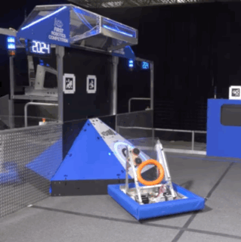
| LAUNCHERS AND PLACERS
Multi-Wheel Launchers
Single-Wheel Hooded Launcher
Reverse
Roller Claw
Catapult
Linear Punch
Multi-Wheeled Launchers are designed in a variety of ways, depending on the scoring element.
Types of Wheeled Launchers
1-Sided – Wheels are on one side, while a piece of aluminum or other material provides compression on the other side. Good for launching disks or rings, creating spin that adds stability and accuracy to the flight of the scoring element.
2-Sided – Wheels are located on both sides, compressing the scoring element between them. Good for creating a shot without backspin.
Top-and-Bottom – Wheels are located on the top and bottom, compressing the scoring element between them.
Wheeled Launcher Tips and Tricks
The type of wheel used matters! If the scoring element is hard, consider using compliant or pneumatic wheels. If the scoring element is malleable, consider using harder wheels.
Velocity, trajectory and spin are can be adjusted based on compression, speed that the wheels rotate, and type of wheel.
Wheels may be programmed to rotate at different rates to provide different spin on the scoring element.
If possible, make the launcher adjustable to vary compression and angle. This allows teams to tune their design for accuracy and repeatability.
2024 FIRST Robotics Competition KitBot Reveal
Launcher Examples and Resources
NASA Robotics Alliance Project: Robotics Design Guide
FRCdesign.org CAD Launcher Designs
Ri3D Stronghold Ball Launcher Tutorial

Slide 4
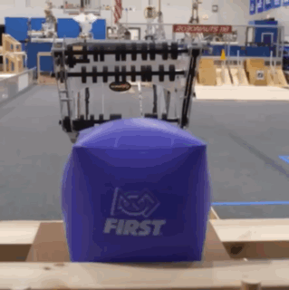
| LAUNCHERS AND PLACERS
Reverse
Roller Claw
Single-Wheel Hooded Launcher
Multi-Wheel Launchers
Catapult
Linear Punch
By reversing the direction that the wheels spin on a roller claw intake, it can become a launcher or placer. Designing mechanisms to complete more than one action has several benefits.
Roller Claw Mechanics
Roller Claws can be similar in design to Multi-Wheel Launchers.
Roller Claws are used more commonly in Pick-and-Place games, where the scoring element doesn’t need to travel very far.
See the Intakes slide deck for more information.
Benefits of a Multi-Purpose Mechanism
Saves weight. Fewer mechanisms often means a lighter robot, helping to keep the robot within weight limits.
Less to repair. Fewer mechanisms on a robot can mean fewer
parts that could break or need repairs during a competition.
Elegance in design. Designing a mechanism with many functions, efficiently packaged to save power and weight, is one way to create simple but effective robot design.
Challenges of a Multi-Purpose Mechanism
If the mechanism breaks mid-match, that means there are multiple actions on the field that the robot can no longer perform.
If possible, have back-ups of all components of key mechanisms to make repairs easier at competitions.
FIRST Robotics Team 118 - Robonauts Everybot 2023

Slide 5
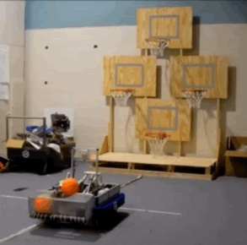
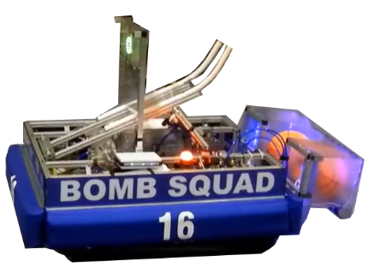
| LAUNCHERS AND PLACERS
Catapult
Single-Wheel Hooded Launcher
Multi-Wheel Launchers
Reverse
Roller Claw
Linear Punch
Catapults are good at launching one scoring element at a time, but not in rapid succession.
Parts and Mechanics of Catapults
Catapult Arm – If considered as a simple machine, a catapult arm is a lever connected to another mechanism that pulls back and releases the arm.
Pull Back & Release Mechanism – A variety of mechanisms can be used to pull the arm back and release it. These include belts and bands, pneumatics, drop cams, and “choo-choo” linkages.
Pros and Cons of Catapults
Catapults can launch irregularly-shaped scoring elements that would be difficult to launch with a wheeled launcher.
Catapults are not efficient at quickly at loading and launching multiple scoring elements, one right after another.
Catapults can vary from quite simple to surprisingly
complex!
FIRST Robotics Competition Team 16 - Bomb Squad 2012
Catapult Examples and Resources
Ri3D 2016: 'Snow Problem - Catapult and Intake
What are Cams?
NASA Robotics Alliance Project: Robotics Design Guide

Slide 6
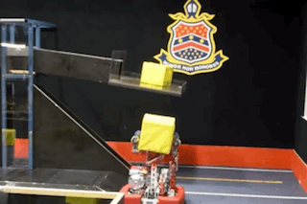
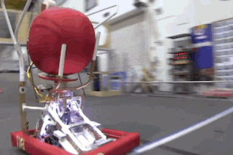
| LAUNCHERS AND PLACERS
Linear Punch
Single-Wheel Hooded Launcher
Multi-Wheel Launchers
Reverse
Roller Claw
Catapult
A linear punch pushes a scoring element, as if it were being punched or kicked. Like a catapult, it requires a pull-back and release mechanism.
FIRST Robotics Competition Team 4613 - Barker Redbacks 2018
FIRST Robotics Competition Team 118 Robonauts 2014
Linear Punch Tips and Tricks
Linear Punch mechanisms can be very effective in both Launch games and Pick-and-Place games due to their high level of repeatability and ability to handle odd shaped scoring elements but can’t launch in quick succession.
Pull Back & Release Mechanism – This mechanism must pull back, build energy, and release in order to provide the punch or kick motion. Pneumatic pistons are the most common form of linear motion mechanisms, but it can also be done with compression springs. Learn more about pneumatics in the Actuators slide deck.

