Slide 1


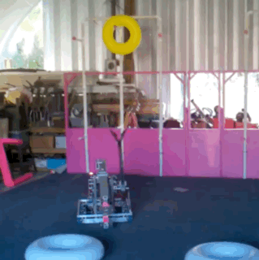
| EXTENDERS: LIFT, REACH AND CLIMB
Elevators
Single-Stage
Elevators
Multi-Stage
Telescoping
Arms
Linkages
Other Mechanisms
EXTENDERS: LIFT, REACH AND CLIMB
Extenders are robot mechanisms that allow a robot to lift up, reach out, and climb. When deciding which type of mechanism to use, ask:
How high will the robot need to lift a scoring element in order to score it?
How far will the robot need to reach outside of its frame perimeter?
Are there height or extension limit rules in that season’s game manual?
If the task is to climb, how will the robot’s center of mass impact how it hangs when it is off the ground?
  FIRST Robotics Competition Team 233 – Pink 2011

Slide 2
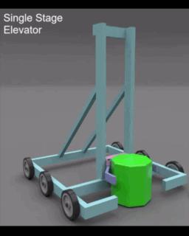
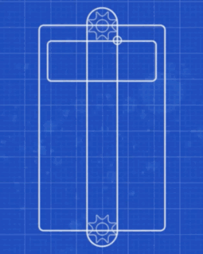
| EXTENDERS: LIFT, REACH AND CLIMB
Elevators
Single-Stage
Elevators
Multi-Stage
Telescoping
Arms
Linkages
Other Mechanisms
A single-stage elevator is a common mechanism which provides linear motion, up and down.
Single-Stage Elevator Mechanics
Carriage – The carriage moves up and down the uprights. The front of the carriage is typically attached to the scoring element manipulator mechanism (such as a claw), while the back side is attached to a pulley system of some sort.
Uprights – Often made out of Box Tubing, the uprights are the bars on either side that support the carriage. Uprights often need a diagonal support that connects to the frame.
Linear Slides or Bearings – Allows the carriage to ride smoothly up and down the uprights.
Pulley System – Chain, belt, string or rope can be used to rig the elevator, allowing the carriage to move.
Single Stage Elevator
  How Do I Use Elevators in FIRST?
Elevator Materials and Resources
Intake Arm Tips and Tricks
Sensors are important to allow the robot to track the position of the elevator. More information on sensors is covered later in this lesson.
Wire Chain helps with wire management, so that the wires can move with the elevator in a safe and reliable manner.
Roller claws are often added to elevators to allow robots to possess a scoring element on the ground and lift it to score.
Linear Slides and Bearings. Examples include:
  Local Hardware Stores and Vendors
  Rev
  AndyMark
Wire Chain. Examples include:
  AndyMark
Elevator Resources. Examples include
  How Do I Use Elevators in FIRST?
  Elevator Overview | Ri3D Redux 2023

Slide 3
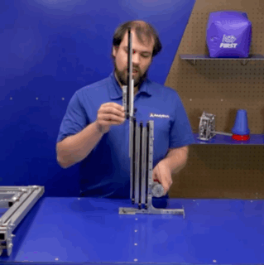
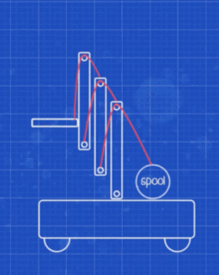
| EXTENDERS: LIFT, REACH AND CLIMB
Elevators
Multi-Stage
Elevators
Single-Stage
Telescoping
Arms
Linkages
Other Mechanisms
Multi-Stage Elevators extend far, but take up less space when not extended. The way each “stage” is lifted depends on the rigging.
Continuous Elevators
One stage moves at a time. The carriage moves to the top of the first stage, then the second stage rises up, and so on.
A motor pulls on a single rope, belt or chain used for the rigging.
Has less tension, but is more likely to jam.
Make sure to keep the rigging away from anything on the robot that is sharp, which might cut or damage the rigging over time.
Cascading Elevators
Each stage moves simultaneously the same amount.
Each stage has its own rope, belt or chain used for the rigging, which makes it less likely to jam, but tension forces are higher.
Note that because more mass is moving at once, the center of gravity changes more rapidly as the elevator goes up, which can make a robot more tippy.
Continuous Elevator AndyMark
Cascading Elevator AndyMark
Multi-Stage Elevator Examples and Resources
How Do I Use Elevators in FIRST?
AndyMark Elevator Bearing and Structure Kits
WestCoast Products Cascading Elevator Kits
FRCdesign.org Continuous Elevators
FRCdesign.org Cascading Elevators
Linear Mechanism Calculator

Slide 4
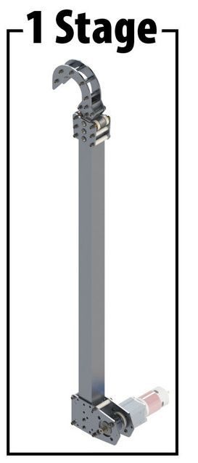
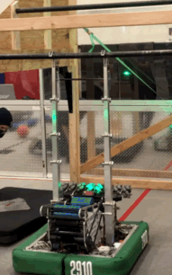
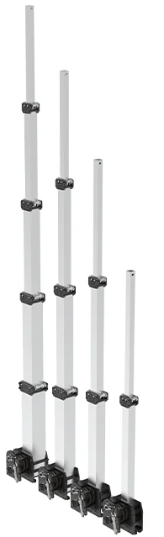
| EXTENDERS: LIFT, REACH AND CLIMB
Telescoping
Arms
Elevators
Single-Stage
Elevators
Multi-Stage
Linkages
Other Mechanisms
Telescoping Arms are frequently used to climb, when a robot needs to reach up to a bar, chain, or other field element and lift itself off the ground. Arms can also be used to reach a scoring element and lift it.
Telescoping Arm Mechanics
Telescoping Arms involve stages, similar to elevators except that the stages nest inside one another, like a telescope, which allows for a compact design.
An active-extension arm extends similar to a Cascading Elevator, with a motor pulling a rope, chain, or belt.
A passive-extension arm uses constant force springs to extend the arm.
4-Stage, 3-Stage, 2-Stage and
1-Stage
Arms
Telescoping Arm Tips and Tricks
Mechanisms or hooks at the end of an arm should be made as durable, but lightweight, as possible.
Space is tight inside a telescoping arm, make sure to leave enough clearance for moving parts
FIRST Robotics Competition Team 2910 – Jack in the Bot 2022
Telescoping Arm Examples and Resources
Telescoping Arm Kits:
  WestCoast Products GreyT Telescope
  Thrifty Bot Telescoping Tube Kit
  AndyMark Climber in a Box

Slide 5
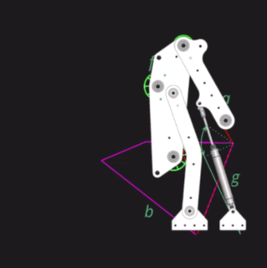
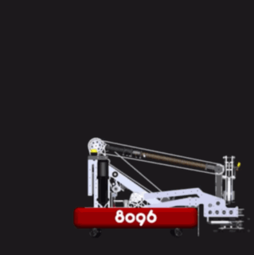
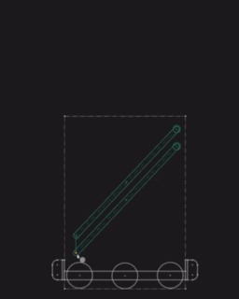
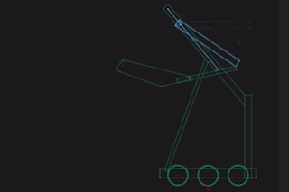
| EXTENDERS: LIFT, REACH AND CLIMB
Linkages
Elevators
Single-Stage
Elevators
Multi-Stage
Telescoping
Arms
Other Mechanisms
Linkages are made up of bars that are connected at rotating joints. Varying the length of the bars and position of the joints creates a wide variety of motions that are excellent for intakes that reach out or up.
Common Types of Linkages
Parallel Four-Bar Linkage - This allows a mechanism to maintain its orientation while moving up and down.
Non-Parallel Four-Bar Linkage – Commonly used on intake arms, its motion allows it to extend outside, and retract into, the frame perimeter.
Scissor-Lift - Uses a series of cross-connected bars.
  Pros: Compact form factor with significant reach.
  Cons: Not great at lifting a heavy amount of weight.
“Virtual” Four-Bar Linkage – Uses chain and a robust sprocket to create the motion of a four-bar linkage.
Linkage Mechanics
Intake Arms with linkages typically have a linkage on each side, connected by cross bars.
Rotating joints are one of the most important features of a linkage. Bearings and shafts are commonly used.
Pneumatic pistons are sometimes used as one of the “bars” in order to power the mechanism.
The 2023 Everybot designed by Team 118 Robonauts used a Non-Parallel Four-Bar linkage as an effective arm design.
FIRST Robotics Competition Team 8096 – Cache Money
Linkages Examples and Resources
Intake and Arm Linkage Design
2023 Everybot Build Manual
Thangs Mechanisms

Slide 6
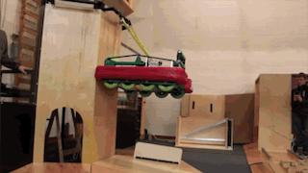
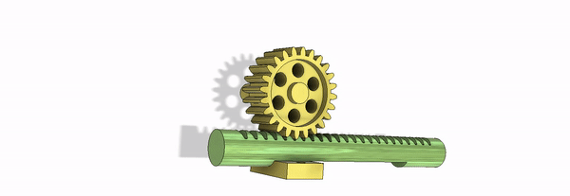
| EXTENDERS: LIFT, REACH AND CLIMB
Other Mechanisms
Elevators
Single-Stage
Elevators
Multi-Stage
Telescoping
Arms
Linkages
There are a wide variety of mechanisms that allow a robot to lift, reach and climb. While there are some common additional mechanisms, there have also been many creative engineering solutions!
Climbing Mechanisms
Winches – Winches wind a rope, belt, strap or other material around a drum. If the material is latched onto a field element by a hook or another method, the robot lifts up as the material coils around the drum.
To reach, the material either must be stiff enough to extend on its own, or be deployed by a mechanism such as an elevator.
Other Extending Mechanisms
Lead Screws – Linear motion used to extend outward with less back driving. Used in some Linear Actuators.
Linear Sliders – Also provide linear motion.
FIRST Robotics Competition Team 1986 Tape Measure and Winch Climber
Additional Examples and Resources
COTS Examples:
  REV Robotics Linear Actuator
  REV Robotics Linear Motion Kit
  AndyMark Climber in a Box Winch Kits
  AndyMark Linear Slide
Explore Mechanisms:
  Project Bucephalus’ The Unofficial FRC Mechanism Encyclopedia
  Spectrum 3847
  FRCDesign.org
Rack and Pinion Gears - Can extend quickly and are easy to control, but tend to be heavy.
Rack and Pinion Gear

