Slide 1


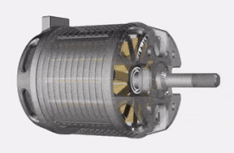
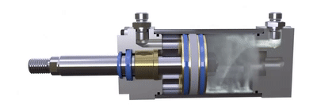
| ACTUATORS: CREATING MOVEMENT
Brushed Motors
Brushless Motors
Gearboxes
Pneumatics
Additional Movement
ACTUATORS: CREATING MOVEMENT
Actuators convert energy (electrical power) from the robot’s 12-volt battery to create movement (mechanical power). When you design a robot, selecting the correct actuator for each mechanism is important. Consider:
Does your mechanism need rotational movement, such as turning a wheel, pulley, gear, or axle?
Does your mechanism need linear movement, such as extending or retracting an intake arm or launcher?
  Brushless DC Motors
How much linear force, torque (turning force), and speed are needed to make your mechanism move?
Pneumatic Cylinder How Does It Work?

Slide 2
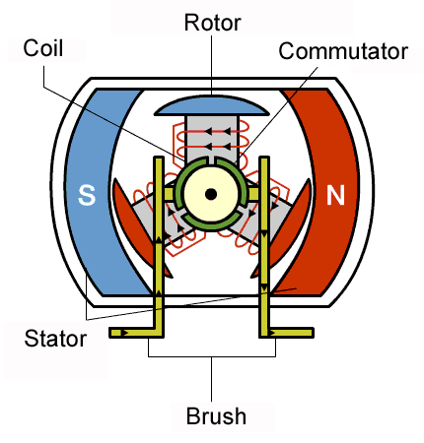
| ACTUATORS: CREATING MOVEMENT
Brushed Motors
Brushless Motors
Gearboxes
Pneumatics
Additional Movement
A brushed motor is a common actuator that provides rotational movement.
Brushed Motor Mechanics
Stator – Stationary, North, and South magnets attached to the motor housing.
Commutator and Brushes – Reverses the polarity of the coils.
Rotor – Rotating electromagnets (armature) with coils that are attracted to the magnet (North or South) on the opposite side of the motor. When the electromagnet gets close to the magnet, the commutator flips the current the other direction, causing the electromagnet to be attracted back to the other side. This happens thousands of times a minute, making the motor spin.
Common Types and Uses of Brushed Motors
Check the season’s Game Manual for a list of legal motors.
CIM – Used on arms and elevators needing power.
775 – Used for higher speeds with intakes and launchers.
Brushed Motors Pros and Cons
Pros: Relatively inexpensive, easy to program, and are easier to use in prototyping since they can be hooked up directly to a battery. No processor is required to get the motor to spin.
Cons: Generally less powerful, larger, and heavier than brushless motors and typically don’t have integrated encoders that track rotation.
Motor Materials and Resources
Resources:
  How Do I Pick a Motor?
  Review of Motors Used for FIRST Robotics Competition Robots
Motors example retailers include:
  Cross The Road Electronics (CTRE)
  REV Robotics
  WestCoast Products
  AndyMark

Slide 3
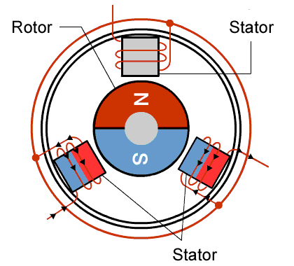
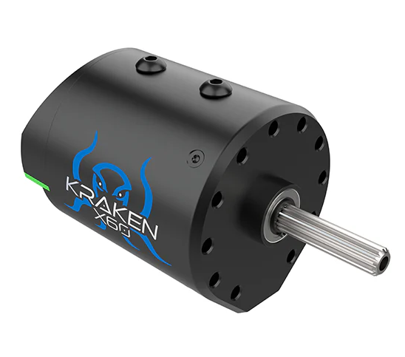
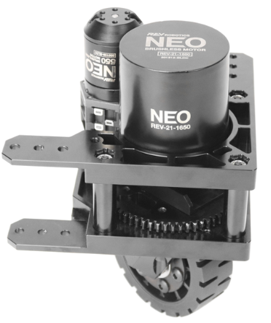
| ACTUATORS: CREATING MOVEMENT
Brushless Motors
Brushed Motors
Gearboxes
Pneumatics
Additional Movement
Brushless motors are popular actuators that also provide rotational movement.
Brushless Motor Mechanics
Rotor – Rotating North and South magnets.
Stator – The armature electromagnets and coils are stationary, attached to the housing of the motor. Their polarity is switched by a controller as the rotor passes by. This happens thousands of times a minute, making the motor spin.
Common Types and Uses of Brushless Motors
Check your season’s Game Manual for a list of legal motors.
NEO – Used for elevators, arms, and drivetrains where torque is needed.
Kraken – Used for high-power applications like drivetrains and elevators.
NEO 550 – Small motor commonly used for intakes, turrets, indexers, and swerve steering.
Brushless Motors Pros and Cons
Pros: Smaller and lighter weight than brushed motors. Durable, more powerful, and feature-integrated encoders to track rotation.
Cons: More expensive than brushed motors, and motor control is more complex, requiring speed controllers, programming, and processing to get them to spin.

Slide 4
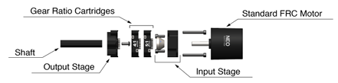
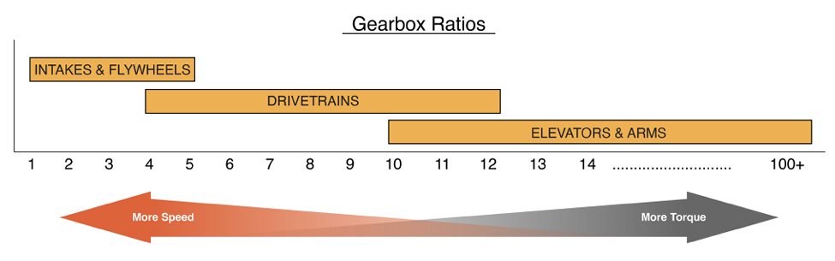
| ACTUATORS: CREATING MOVEMENT
Gearboxes
Brushed Motors
Brushless Motors
Pneumatics
Additional Movement
A gearbox contains a series of gears that are attached to the output shaft of motors, allowing for the exchange between speed and torque.
Gearbox Mechanics
Torque and speed are inverse to each other, meaning when one increases, the other decreases. As the load increases, motors need more current from the battery to increase torque. Increasing torque means the speed decreases, and as more current is drawn from the battery, the battery life decreases.
Some mechanisms need more speed, such as flywheel launchers and roller claw intakes.
Other mechanisms need more torque, like elevators and arms.
REV FRC Robot Basics Guide
Types of Gearboxes
Planetary gearboxes are adjustable, with stages/cartridges of different gear ratios. Torque and speed can be adjusted by configuring different combinations.
Drivetrain gearboxes are typically larger and use spur gears to handle larger forces. Swerve modules have specialized gearboxes since each wheel requires its own gearbox and two motors.
Gearbox Ratios
Gearbox Resources
Calculating Gearbox Ratios
The higher the gear ratio, the slower the output shaft spins, but the more torque (force) it generates.
A motor with a 3:1 gear reduction will have 3x the torque and 1/3 the speed as the same motor with no gearbox.
How Do I Pick a Gearbox for FIRST Robotics Competition?
ReCalc Mechanical Design Calculator
WestCoast Products Gearbox Overview
REV Robot Basics Guide

Slide 5
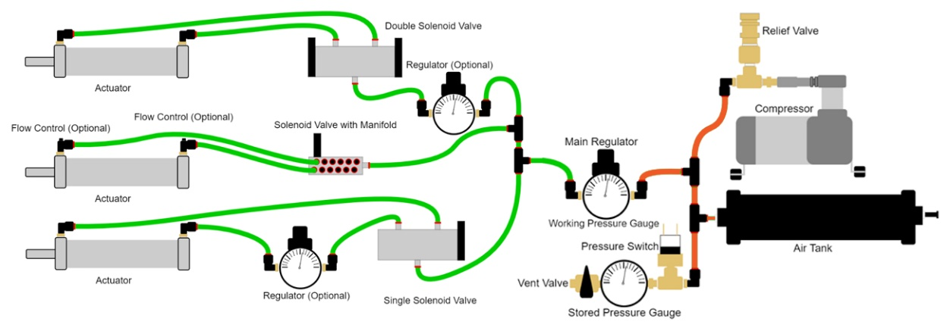
| ACTUATORS: CREATING MOVEMENT
Pneumatics
Brushed Motors
Brushless Motors
Gearboxes
Additional Movement
Pneumatic actuators create linear motion with a piston using compressed air.
Low (Working) Pressure Side
High (Stored) Pressure Side
Pneumatic Mechanics
HIGH PRESSURE SIDE – A compressor takes in air from the environment and forces it into storage tanks on the robot. A stored pressure gauge tells how much pressure there is. A pressure switch automatically shuts off the compressor when it reaches 120 psi.
LOW PRESSURE SIDE – Air from the storage tanks flows through a regulator that reduces the pressure from 120 psi to 60 psi, usable by mechanisms on the robot. A working pressure gauge tells how much pressure there is. Air flows through tubing and fittings to solenoids, which direct the air into one of two ports in the pneumatic cylinder.
ACTUATOR – In the pneumatic cylinder, the air causes a piston to extend or retract, depending on which way the solenoid directed the air.
Pneumatics Tips and Tricks
Use different colors of pneumatic tubing for the high-pressure and low-pressure parts of the system to quickly identify their pressure.
Safety features including the relief valve, vent valve, and pressure switch are required for all pneumatic systems.
Leak prevention is important. To prevent leaks:
  Cut tubes perfectly straight with pneumatic tube cutters.
  Make sure all tubes are firmly secured into the fittings.
  Make sure fittings aren’t cracked, especially plastic ones.
Leak detection is key to maintaining a pneumatic system:
  Listen for a slight hiss coming from any part of the system.
  Use a dropper to place a small amount of soapy water on connections with fittings. If it bubbles, there’s a leak.
  Note: Be careful to not get water on electrical components.
Pneumatics System Resources
FIRST Official Pneumatics Manual
How to Wire Pneumatics
WPILib Pneumatics Guide
How Do I Use Pneumatics Efficiently?
How Do I Prevent Pneumatic Leaks?

Slide 6
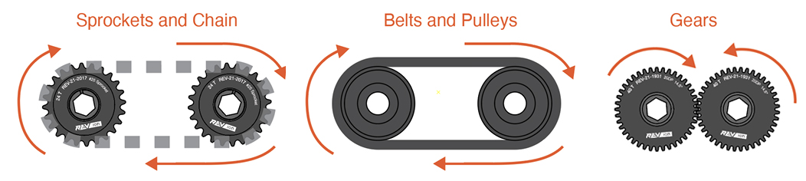
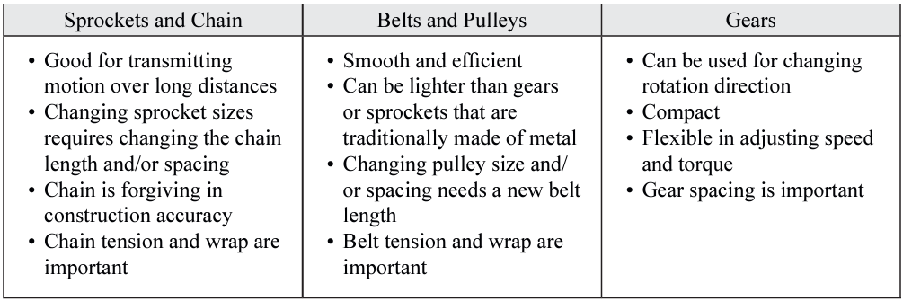
| ACTUATORS: CREATING MOVEMENT
Additional Movement
Brushed Motors
Brushless Motors
Gearboxes
Pneumatics
Robots have a lot of moving parts. Actuators and motion transmission mechanisms all work together create circular and linear movement. Check the Game Manual for a list of legal actuators for each season.
Servos
Servos are small, low-power motors without much torque that are used to actuate small mechanisms.
Used to release latches, move small levers, rotate a camera, adjust the hood on a launcher, etc.
Connected directly to the robot’s processor (brain) or to a servo power module.
Motion Transmission Mechanisms
The motion, speed, and torque created by actuators can be transformed and transmitted into additional motions through a variety of mechanisms.
The three most common motion transmission mechanisms used with motors are:
  Belts and pulleys
  Gears
  Sprockets and chains
Details about these mechanisms are part of Module 8: Design and Mechanical.
REV Robot Basics Guide
Additional Actuator Resources
REV Robot Basics Guide
NASA Robotics Alliance Project Robotics Design Guide
FRCDesign.org

