Slide 1
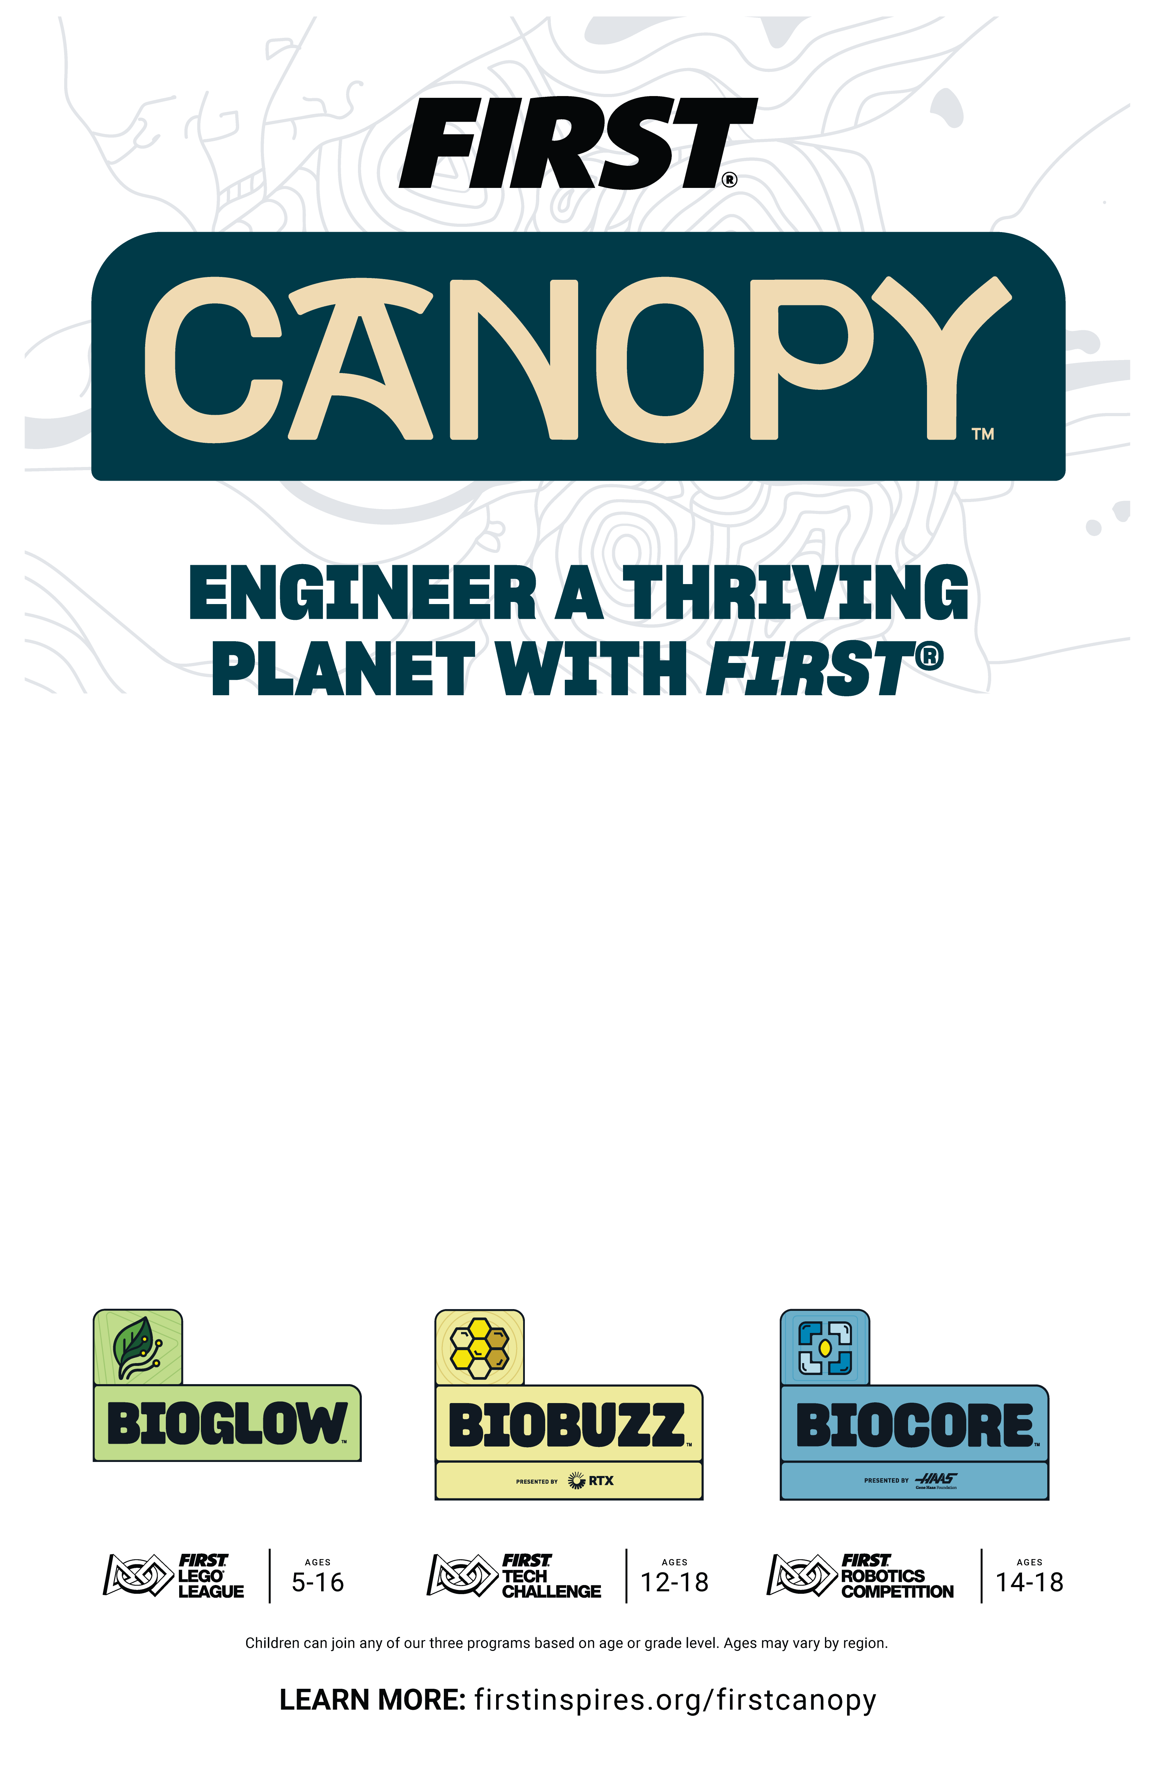
FIRST® is the world’s leading youth robotics community, delivering hands-on STEM learning that inspires innovation, builds confidence, and prepares kids for life. In welcoming, team-based robotics programs, participants work collaboratively to solve an annual, themed robotics challenge — and this season, it's all about biodiversity.
Nothing on Earth thrives alone. Every gene, species, and ecosystem is part of a rich web of biological diversity that powers clean air, fresh water, and food.
With STEM as their tool and nature as inspiration, today's boldest innovators are finding new ways to strengthen the connections that protect our shared home.
Building. Problem solving. Growing stronger through teamwork.
Welcome to our 2026-2027 robotics season, FIRST® CANOPYTM.
FIRST®, the FIRST® logo, FIRST® Robotics Competition, FIRST® Tech Challenge, FIRST CANOPYTM, BIOBUZZTM, and BIOCORETM are trademarks of For Inspiration and Recognition of Science and Technology (FIRST). LEGO® is a registered trademark of the LEGO Group. FIRST® LEGO® League and BIOGLOWTM are jointly held trademarks of FIRST and the LEGO Group. ©2026 FIRST. All rights reserved.

