Slide 1

2026 – 2027 Social Media Toolkit
2027 FIRST® Robotics Competition season BIOCORE™ presented by Haas

Slide 2
Table of Contents
2027 FIRST® Robotics Competition BIOCORE™ presented by Haas
Writing game name
Game hashtag
Gene Haas Foundation social handles
Sample social copy using game name/tags
Sample social copy using game with season name/tags
Social graphic best practices

Slide 3
How to use the season game name when written:
When using BIOCORE™ in text (body copy), adhere to the following style standards:
Always all CAPITAL LETTERS.
BIOCORE should appear as one word.
Include superscripted TM on first mention in headline and first mention in body copy.
Include “presented by Haas” on the first mention in body copy.
Only capitalize the ‘H’ in Haas. Haas must never appear in all caps.
Do not use the wordmark (logotype/art) as a mention in body copy.
Do not distort, alter, or separate any logo elements.
For all FIRST logos and branding guidelines, visit the FIRST Branding Page.
When talking about the season on social media, always use the hashtag #BIOCORE
FIRST Robotics Competition Facebook | FIRST Robotics Competition YouTube

Slide 4
When mentioning Haas in social media posts, please use the following handles:
Facebook: @genehaasfoundation
Instagram: @genehaasfoundation
LinkedIn: @gene-haas-foundation

Slide 5
BIOCORE™ Sample Social Media Copy:
Facebook:
Delve into the heart of what sustains life on Earth in the 2026-2027 FIRST® Robotics Competition season, #BIOCORE presented by @genehaasfoundation #FIRSTCANOPY
Instagram:
Delve into the heart of what sustains life on Earth in the 2026-2027 FIRST® Robotics Competition season, #BIOCORE presented by @genehaasfoundation #FIRSTCANOPY
LinkedIn:
Delve into the heart of what sustains life on Earth in the 2026-2027 FIRST® Robotics Competition season, #BIOCORE presented by @gene-haas-foundation #FIRSTCANOPY
TikTok:
Delve into the heart of what sustains life on Earth in the 2026-2027 FIRST® Robotics Competition season, #BIOCORE presented by Haas #FIRSTCANOPY

Slide 6
Sample social copy for when FIRST® CANOPY and BIOCORE™ are mentioned together:
Facebook:
How will you engineer a thriving planet in #BIOCORE presented by @genehaasfoundation? Learn more about the 2026-27 #FIRSTCANOPY season: [link]
Instagram:
How will you engineer a thriving planet in #BIOCORE presented by @genehaasfoundation? Learn more about the 2026-27 #FIRSTCANOPY season: [link]
LinkedIn:
How will you engineer a thriving planet in #BIOCORE presented by @gene-haas-foundation? Learn more about the 2026-27 #FIRSTCANOPY season: [link]
TikTok:
How will you engineer a thriving planet in #BIOCORE presented by Haas? Learn more about the 2026-27 #FIRSTCANOPY season: [link]

Slide 7


Facebook Graphic Templates
Facebook Cover: canopy_frc_biocore_social_fb_post
Facebook Post
Any additional information should be shared/added in the post’s caption
Do not edit or adjust social graphic
Blank Social Post: canopy_frc_biocore_social_fb_post_blank
Insert text in center of graphic.
Please exclusively use black text
Example text: “Join our Team!”
For specific brand guidelines, please refer to the FIRST CANOPY Brand Guidelines.

Slide 8


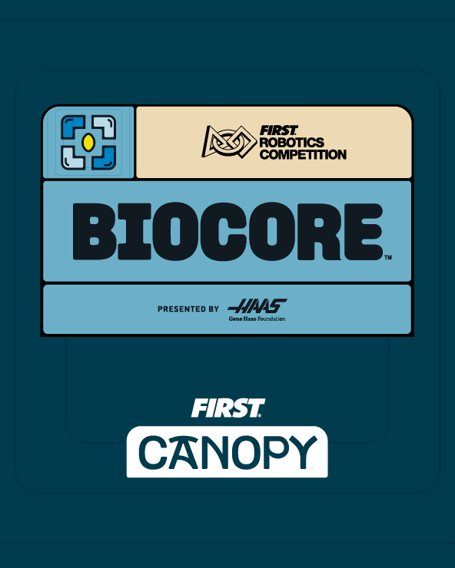
Instagram Post Templates
Instagram Post Customizable: canopy_frc_biocore_social_ig_post_blank_dark canopy_frc_biocore_social_ig_post_blank_light
Use for Instagram post
Insert text in center of graphic
Please exclusively use white text on dark version
Please exclusively use black text on white version
Example text: “Join our Team!”
Instagram Post: canopy_frc_biocore_social_ig_post
Any social platform
Any additional information should be shared/added in the post's caption
Do not edit or adjust social graphic

Slide 9


Instagram Reel:
canopy_frc_biocore_social_ig_reel_blank_dark (Right)
canopy_frc_biocore_social_ig_reel_blank_light (Right)
Use for Instagram reel or story post.
Insert text below BIOCORE presented by Haas lockup to allow correct space.
Please exclusively use white text on dark version
Please exclusively use black text on white version
Example text: “Join our Team!”
For specific brand guidelines, please refer to the FIRST CANOPY Brand Guidelines.

Slide 10

LinkedIn Post: canopy_frc_biocore_social_linkedin_post
LinkedIn Post
Any additional information should be shared/added in the posts caption
Do not edit or adjust social graphic
For specific brand guidelines, please refer to the FIRST CANOPY Brand Guidelines.

