Slide 1

2027 FIRST Robotics Competition
Judge Training

Slide 2
Judge Training Agenda
Introductions
Conflict of Interest form
Why FIRST is important
FRC Game Overview
Award Breakdown
Judge Roles and Responsibilities
How to Engage with Teams
Event Schedule
Judge Room Covenants
Reminders

Slide 3
Introductions
Judge Advisor: [NAME HERE]
  Facilitator
  Not a decision maker
  Oversees script writing
Quick Introduction!
Share:
Name
Company and Position/Affiliation
Number of years involved with FIRST
Judge Advisor Assistant: [NAME HERE]
  Coordinate schedule
  Energize judge panel
  Organizer

Slide 4
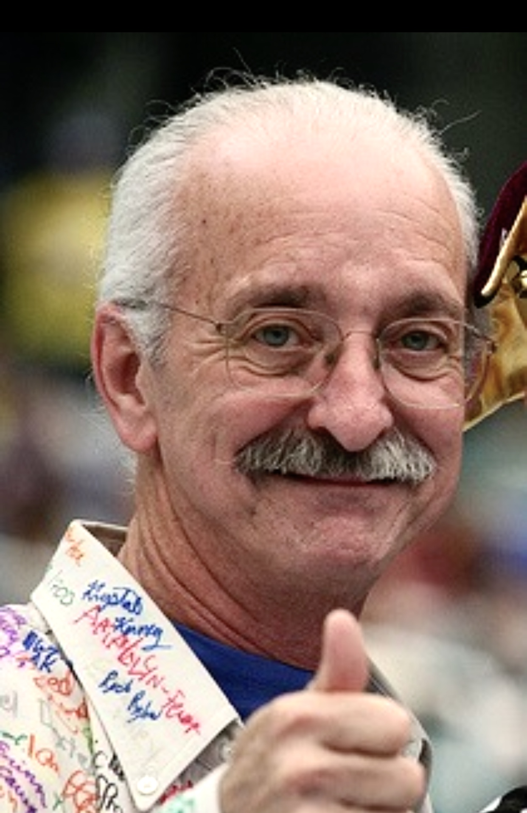
Gracious Professionalism®
Gracious Professionalism is part of the ethos of FIRST. It's a way of doing things that encourages high quality work, emphasizes the value of others, and respects individuals and the community.
Fierce competition and mutual gain are not separate notions. Gracious professionals learn and compete like crazy but treat one another with respect and kindness in the process
They avoid treating anyone like losers. No chest thumping tough talk, but no sticky-sweet platitudes either. Knowledge, competition, and empathy are comfortably blended.
“…Gracious professionalism is part of
pursuing a meaningful life.”
– Woodie Flowers

Slide 5
Stem Skills
Workforce-Ready Skills and Interests
85%+
83%+
Gain an understanding of how science and technology can be used to solve real-world problems
FIRST
helps students gain...
Gain an Understanding of the role of Gracious Professionalism® and FIRST Core Values
80%+
81%+
Gain confidence in approaching problems in math and science
Gain interest in jobs or careers in science and technology
91%+
95%+
Gain coding/programming skills*
Accept input and feedback from others
Future-Ready Skills
92%+
92%+
92%+
92%+
gain teamwork skills
gain leadership skills
gain perseverance skills
gain problem-solving skills
Sources: 2026 FIRST end-of-season surveys for FIRST® LEGO ® League, FIRST® Tech Challenge, and FIRST® Robotics Competition.
*Of students who indicated they participated in coding/programming.

Slide 6


2027 Game - BIOCORE

Slide 7
Two Ways Teams Compete
On-Field Performance
  Points
  Alliances
Judged Awards
  Machine, Creativity, and Innovation Awards
  Team Attribute Awards
  Submitted Awards

Slide 8
Award Breakdown
Machine Attribute Awards
  Autonomous
  Creativity
  Excellence in Engineering
  Industrial Design
  Innovation in Control
  Quality
Team Attribute Awards
  Engineering Inspiration
  Team Sustainability
  Gracious Professionalism
  Imagery
  Judges Award
  Rookie All Star
  Rising All Star
  Team Spirit
Submitted Awards
  FIRST Impact Award
  FIRST Leadership Award

Slide 9
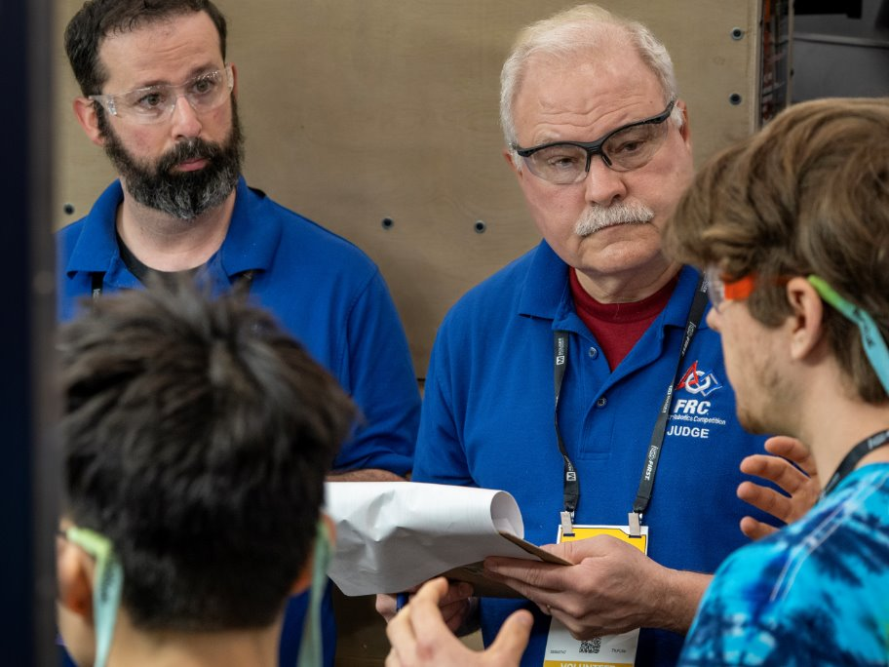
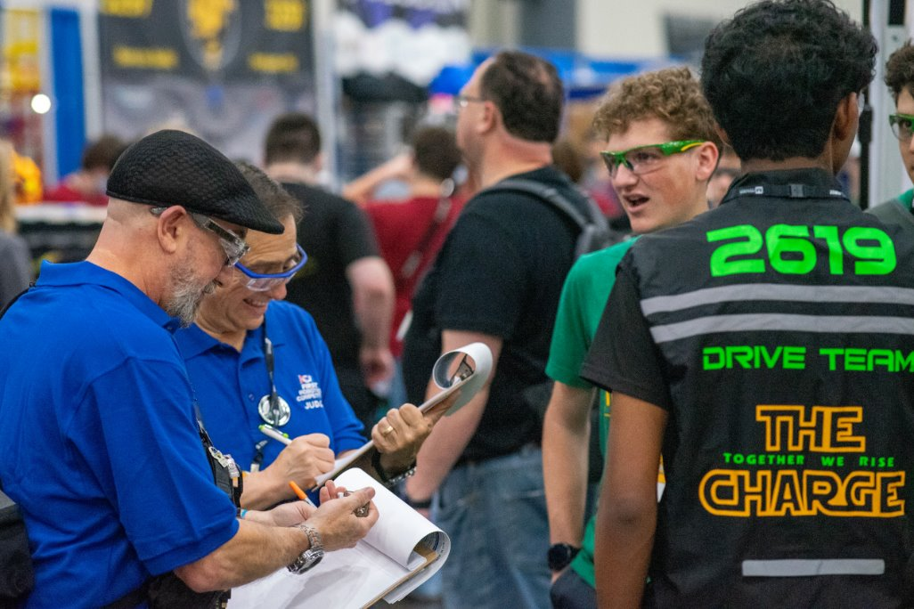
What does a judge do?
Interview and observe teams in the Pit, on the play field, and in other areas
Review team background literature
Participate on Judge Panel to decide team/student awards recipients
Write short awards scripts extolling merits of the winning team
Assist with awards presentations to teams
Act as a role model for students

Slide 10
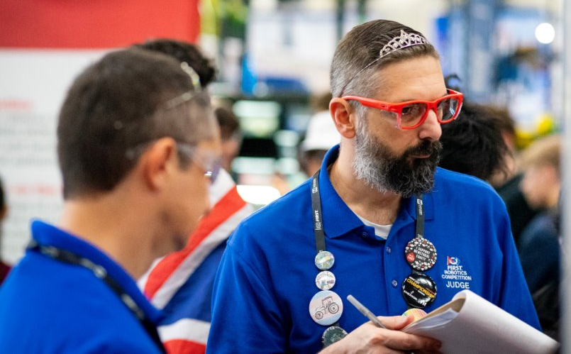
Judge Roles
Ambassador
  A gracious professional, spreading positivity to everyone at the event – students and mentors alike!
Detective
  Sort out facts to discover the teams most deserving of the award.
Reporter
  Take detailed notes to be able to accurately present the teams you're nominating (and to write a great script if they're chosen)!
Role Model
  Someone for students to look up to – but don't forget to show them you're human, too!

Slide 11
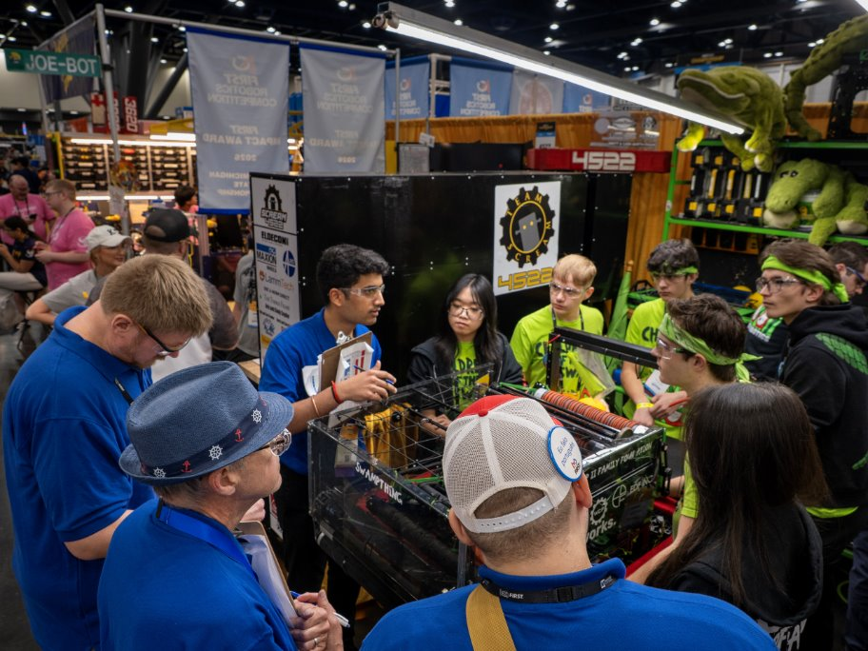
Judging Process
Judges are divided into sets of 2 or 3
Each set of judges is assigned certain teams to interview
  The goal is for each team to have at least 2 sets of judges talk with them.
Judges come back to the room and nominate teams for awards
JA facilitates discussion with judges on best fit to criteria
FIA and FLA judging are separate and are based on interviews.

Slide 12
How to Interact with Students
Keep all your interactions with teams
POSITIVE
Remember that not all students come from the same background
  Physical contact may be uncomfortable for students with certain disabilities
  Some students may be uncomfortable with eye contact and talking to adults they don’t know
Avoid chewing gum, eating, or playing with your phone while interacting with the teams. – Give them your full attention!
Refer to the suggested interview questions in the Judge Workbook
Examples of what NOT to say:
Did you have your mentors build this robot?
Did you work on the robot or did you leave it to the boys?
Can you direct me to someone who knows about the robot?
Hey! We’re considering you for the quality award, what can you tell us about the robot?
I’m in a hurry and don’t have a lot of time, so tell me about your robot real quick

Slide 13
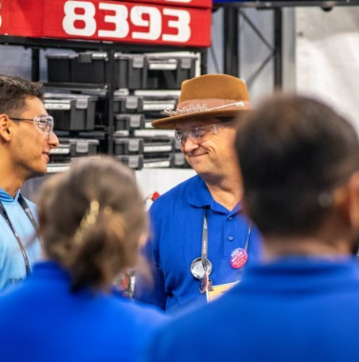
How Do You Start?
Walk up to a team in the pits
Ask:
  "Can you tell me about your team?"
  "Can you tell me about your robot?
Get them talking (talk to students)
Follow up with questions as appropriate to INSPIRE!

Slide 14
Schedule
Insert your schedule here!
  Sample schedule in notes.
Notes:
This is the sample schedule:
7:00am Breakfast
8:00am Pits Open
8:30am Opening Ceremonies
9:30am Begin Interviews
12:00pm Working Lunch
~2:00pm Day 1 interviews complete
Start Day #2 Interviews
Watch Matches
5:45 pm Day 1 Award Ceremony

Slide 15
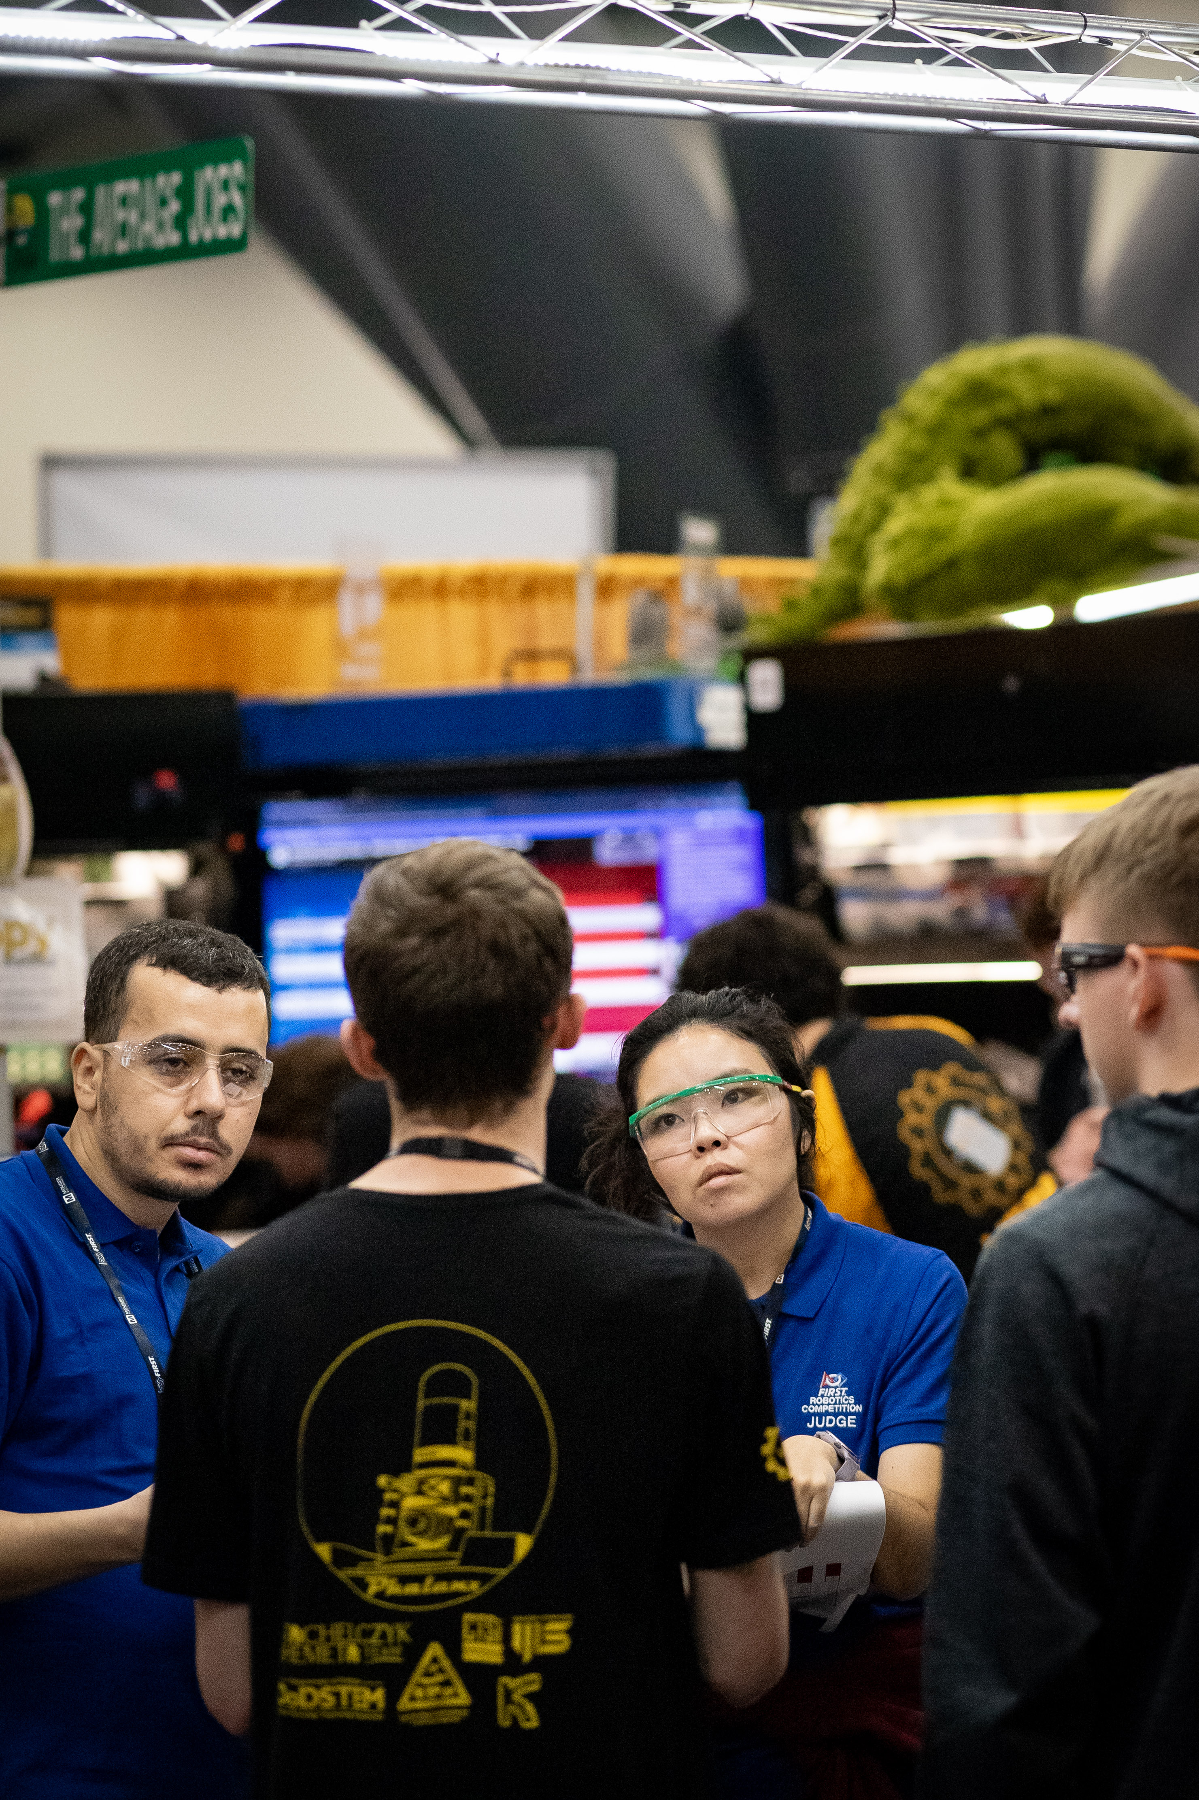
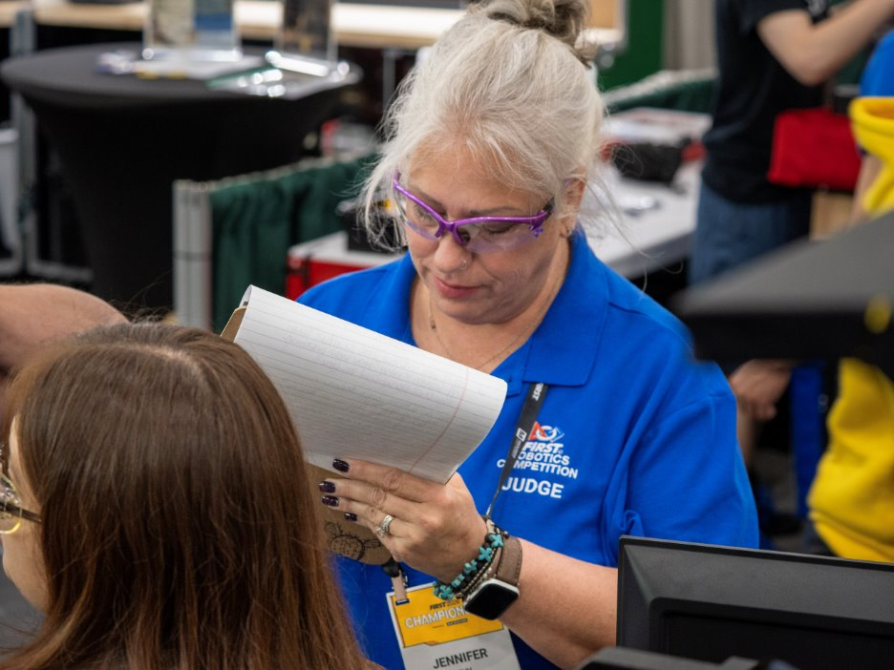
Judge Room Covenants
What happens here, stays here
Treat each other with respect
Communicate honestly
Contribute constructively
There can be several right answers
Work together to reach a consensus
Stay focused and participate
Help keep us on schedule
Listen attentively
Remember the Mission: To Inspire!
Have fun!

Slide 16
Reminders
Be on TIME!
Blue shirt, badge, and safety glasses on at all times in the pit or on the field!
Take lots of notes and USE team numbers.
  Write descriptors for memory joggers and take pictures of the robots!
Remember all teams have a story and are worthy of an award
  BE AN AMBASSADOR to all.
Recognize the unique, not hard luck.
Talk to the kids, not the adults!
FIRST JUDGES ARE NOT REFEREES!

Slide 17
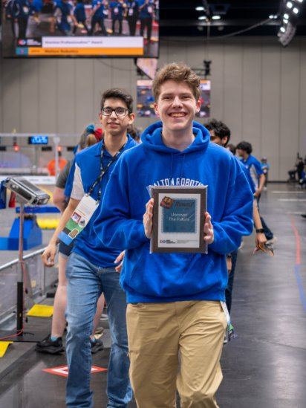
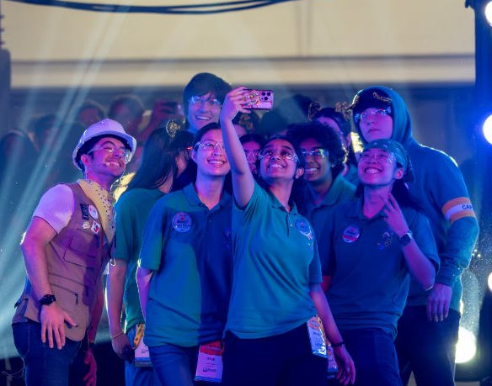
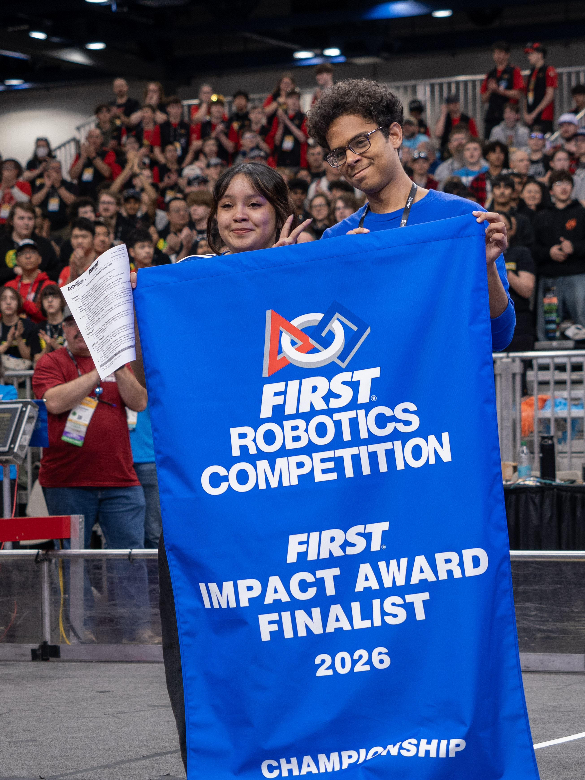
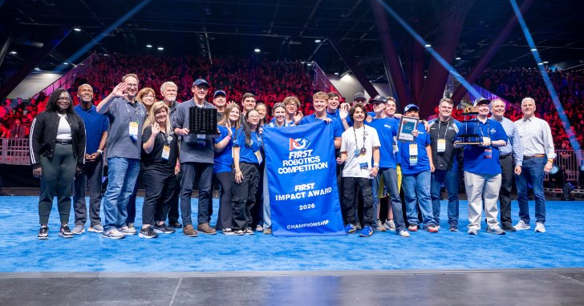
Thank you for your interest, passion, and commitment to creating the next generation of leaders and innovators.

