Slide 1
Thank You for Volunteering!

Slide 2
Agenda
Overview of FIRST
Game Overview
Code of Conduct
Volunteer Rights and Responsibilities
Schedule
Event Specific Information
Volunteer Dress Code
STEM For Everyone™
How to Interact with Teams

Slide 3
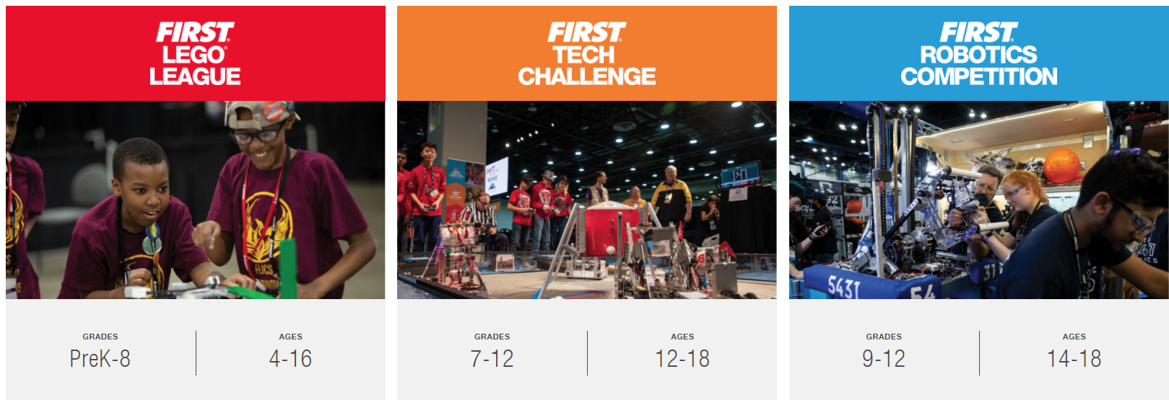
Overview of FIRST
Inspiring youth to become science & technology leaders & innovators, by engaging them in exciting, experiential, Mentor and project-based programs that teach science, technology, engineering, and math (STEM) skills, inspire innovation, and foster well-rounded life capabilities.

Slide 4
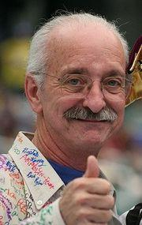
Gracious Professionalism®
“…Gracious Professionalism is part of
pursuing a meaningful life.”
– Woodie Flowers
A way of doing things that encourages high-quality work, emphasizes the value of others, and respects individuals and the community.
Gracious professionals learn and compete like crazy but treat one another with respect and kindness in the process.
Treat your competitors with respect and kindness
  No chest thumping, tough talk or sticky sweet platitudes
  Knowledge, competition, and empathy are comfortably blended

Slide 5
FIRST Core Values
We express the FIRST philosophies of Gracious Professionalism® and Coopertition® through our Core Values:
Discovery: We explore new skills and ideas.
Innovation: We use creativity and persistence to solve problems.
Impact: We apply what we learn to improve our world.
Inclusion: We respect each other and embrace our differences.
Teamwork: We are stronger when we work together.
Fun: We enjoy and celebrate what we do!

Slide 6
2027 Game – BIOCORE™ presented by Haas
Link to game animation

Slide 7
Code of Conduct
The mission of FIRST is to inspire a generation of science and technology leaders who are both gracious and professional. This FIRST Code of Conduct lists some of the basic behaviors mentors, coaches, volunteers, team members, affiliate partners, contractors, staff, and other participants should adhere to while participating in FIRST activities.
Exhibit Gracious Professionalism® at all times. Gracious Professionalism is a way of doing things that encourages high-quality work, emphasizes the value of others, and respects individuals and the community. With Gracious Professionalism, fierce competition and mutual gain are not separate notions.
Ensure the safety of all participants in FIRST activities.
Not engage in any form of bullying, harassment, use of profane or insulting language, or any actual or threatened violence.
Adhere to all FIRST Youth Protection Program (YPP) policies.
Report any unsafe behavior to event or local FIRST leadership.
Persons who do not comply with this Code of Conduct may be barred from participating in FIRST activities.

Slide 8
Volunteer Rights and Responsibilities
It is your right to:
Be treated with Gracious Professionalism®.
Feel valued.
Understand your role.
Expect a safe environment.
Receive fair treatment and inclusion.
Reevaluate your time commitment.
Communicate with your Volunteer Coordinator or your local FIRST leadership about:
  Concerns or limitations that are affecting your volunteer role.
  Any mistreatment towards you or others.
  Contact FIRST directly if you feel that you are being treated improperly and attempts to resolve issues and conflicts at the local level are not successful -volunteer@firstinspires.org
It is your responsibility to:
Treat others with Gracious Professionalism®.
Follow the schedule and the role description provided for your position.
Respect others, treat them fairly and kindly. Be inclusive and follow the non-discrimination policy of FIRST.
Follow safety rules and ensure safety of others. Adhere to all FIRST Youth Protection Program (YPP) policies.
Adhere to the FIRST Code of Conduct.
Have FUN!
See the full Volunteer Rights & Responsibilities

Slide 9
Day 1 Schedule
INSERT YOUR EVENT SCHEDULE HERE

Slide 10
Day 2 Schedule
INSERT YOUR EVENT SCHEDULE HERE

Slide 11
Day 3 Schedule
(If applicable)
INSERT YOUR EVENT SCHEDULE HERE

Slide 12
Event Specific Information
Include things like parking information, what doors are open early for volunteers, what meals are provided (where & when), etc.
Check with your Planning Committee, Program Delivery Partner (PDP) and Event Manager for additional information to share.

Slide 13
Volunteer Dress Code & What to Bring
Volunteers will be provided a volunteer t-shirt and name badge at Volunteer Registration upon arrival.
Please wear comfortable closed-toed shoes
Bring -
  Safety glasses
  A water bottle

Slide 14
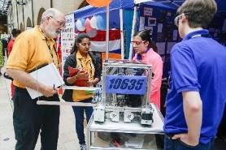
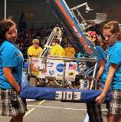
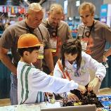
Teams are our Customers!
Volunteers are important role models for teams. They work together to help them throughout events.
Gracious Professionalism® sets the tone for events and provides a positive experience for our customers to be inspired.

Slide 15
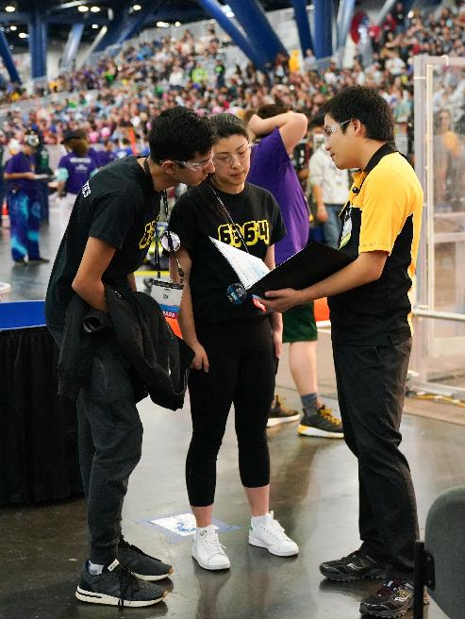
How to Interact with teams
Remember that not all students come from the same background
  Some students may be uncomfortable with eye contact and talking to adults they don’t know
Avoid chewing gum, eating, or playing with your phone while talking to teams. – Give them your full attention!
Be aware that there may be teams you interact with that English is their second language, or they may have a translator.
  Please be patient with these teams
Do not make any comments about appearance or clothing
Keep all your interactions with teams
POSITIVE

Slide 16
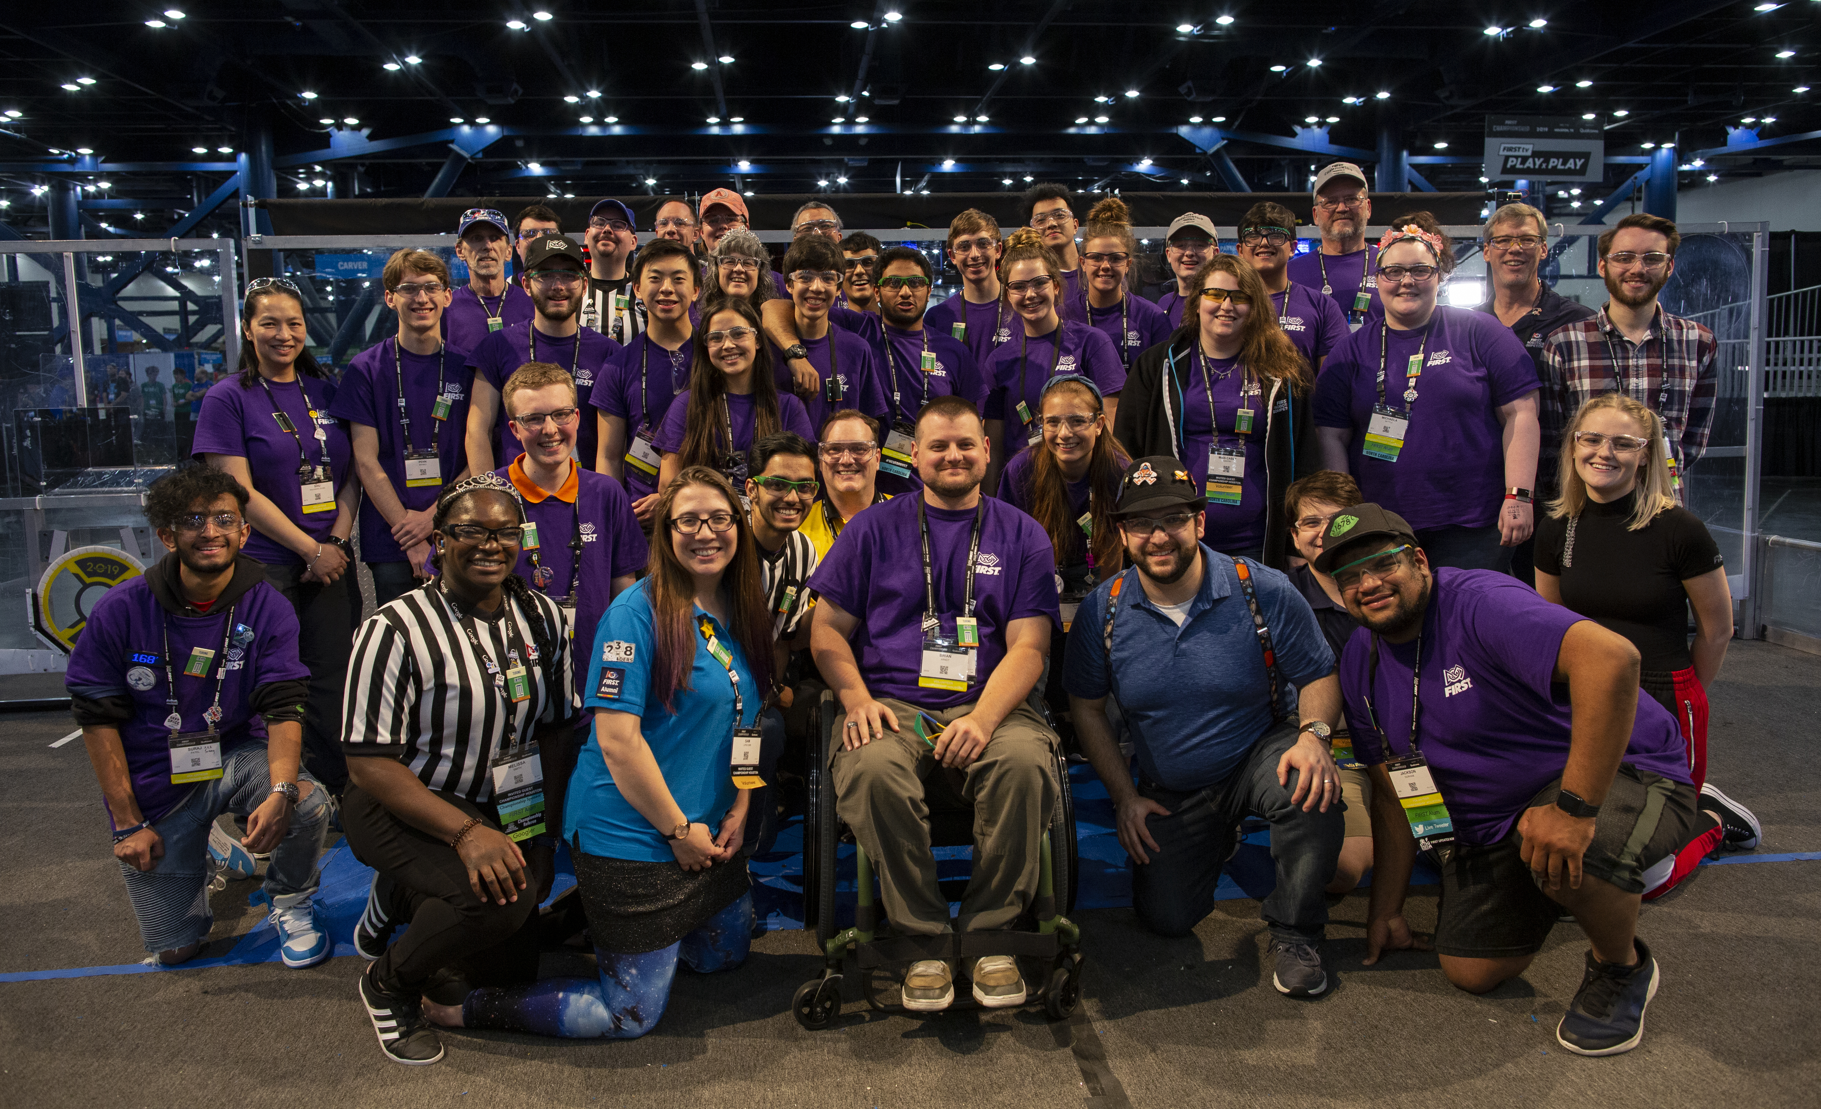
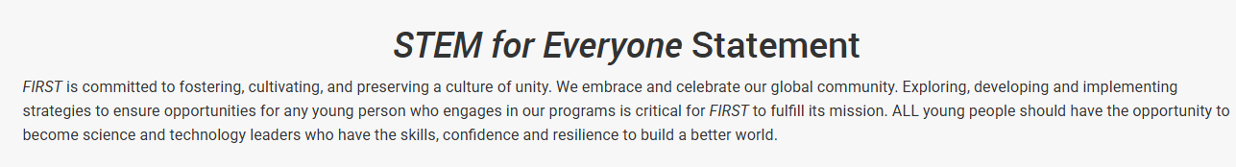
STEM for Everyone™
As part of our commitment to creating a unified community for all our participants, we have partnered with leading organizations to create optional trainings on how you can inspire the youth voice, and build a connected team.
Volunteers may review STEM For Everyone Trainings & Resources.

Slide 17
Thank you for volunteering and have fun!

