Slide 1
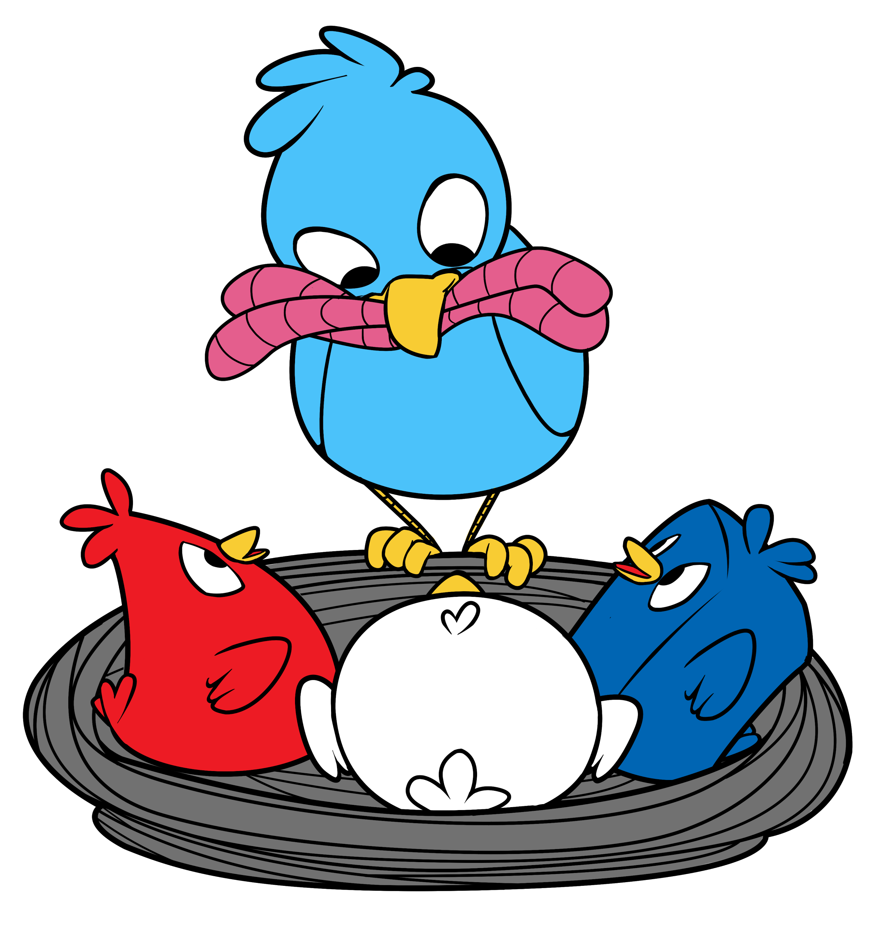
Start a Booster Club!
Presented by
Paul Lake
Teacher Advisor
Team 1671
The Bird Brains
paullake@cusd.com

Slide 2

Today’s Agenda
How our Booster Club began
What our Booster Club does
How our Boosters Communicate and Organize
Suggestions for getting started
Inspiring young minds to spread their wings.

Slide 3
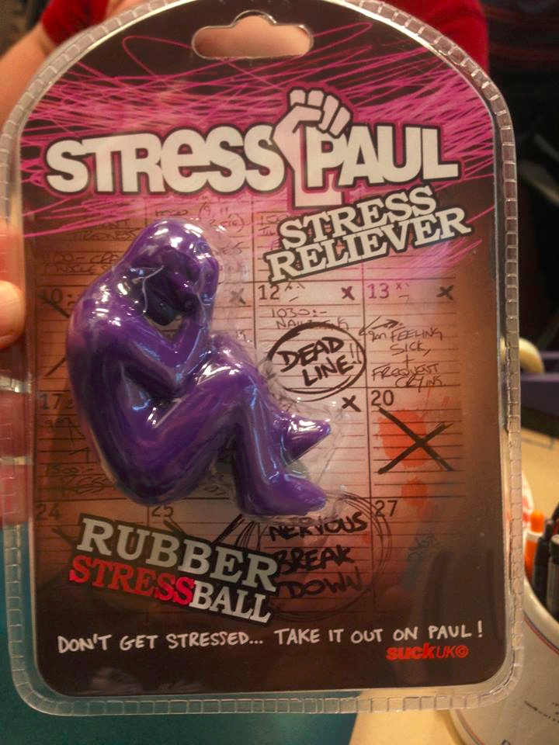
Before our Boosters… I was Stressed Out!
Our team had grown… 60+ students.
More competitions means more money needed.
How do I feed these kids?

Slide 4
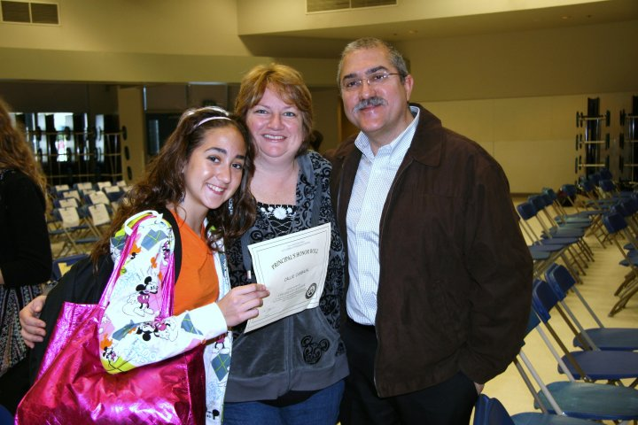
Our Booster Club is Hatched… 2011
Team 1422 Shared our space
Grandmas bringing food
Callie Carbajal joins our team… brings parents along.
Shelly Carbajal assumes leadership.
Inspiring young minds to spread their wings.

Slide 5

Buchanan Bird Brain Boosters, PLEASE….
FEED US!

Slide 6
Bird Feeders During the Build Season
Friday and Saturday nights
Healthy and inexpensive
Time efficient: No more fast food runs!
Inspiring young minds to spread their wings.

Slide 7
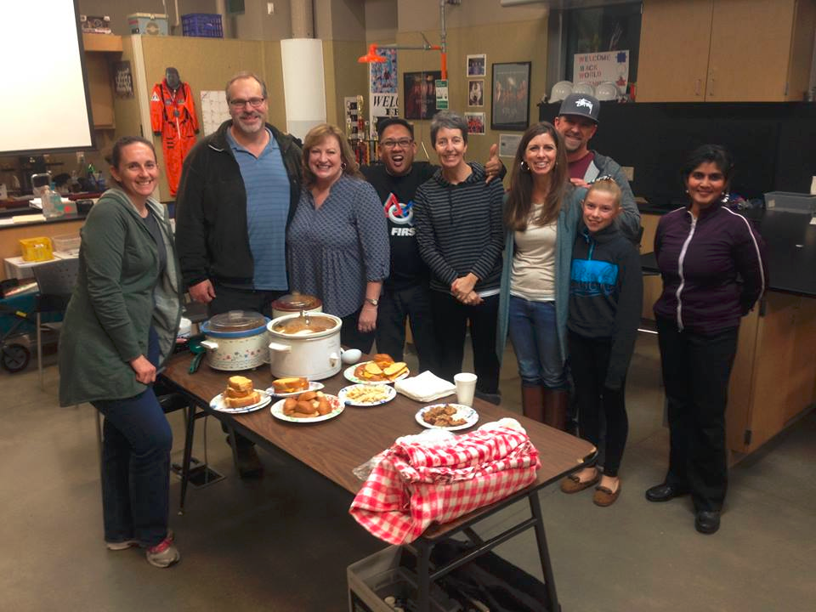

Slide 8
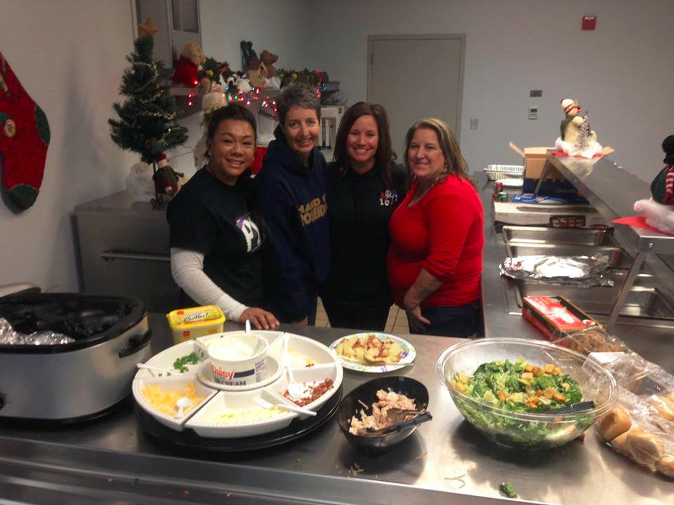

Slide 9
Bird Feeders During the
Competition Season
Travel w/ the Team
Provide food, supervision, transportation
Meals… lunch, sometimes dinner.
Build team spirit… and no fast food runs.
Inspiring young minds to spread their wings.

Slide 10
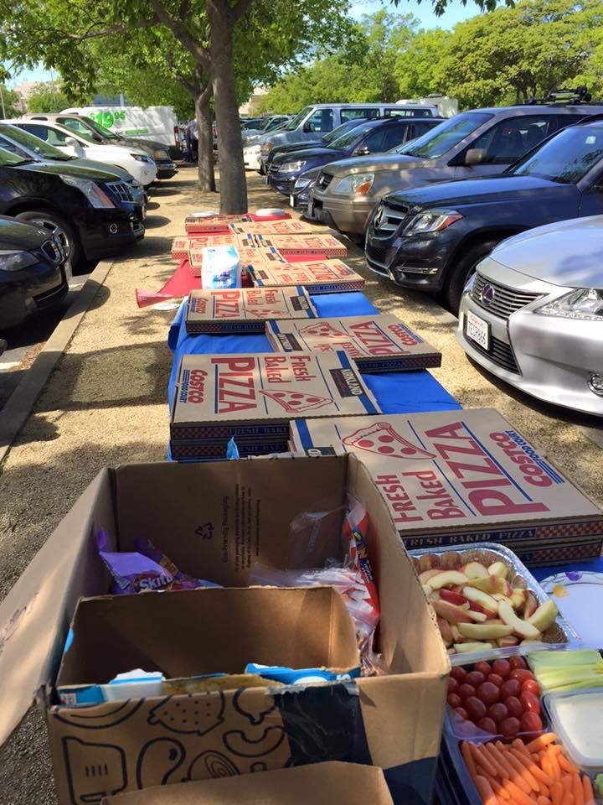
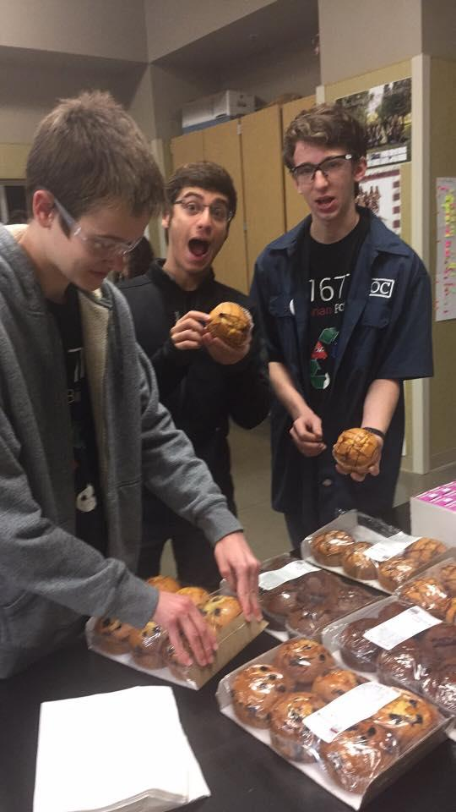
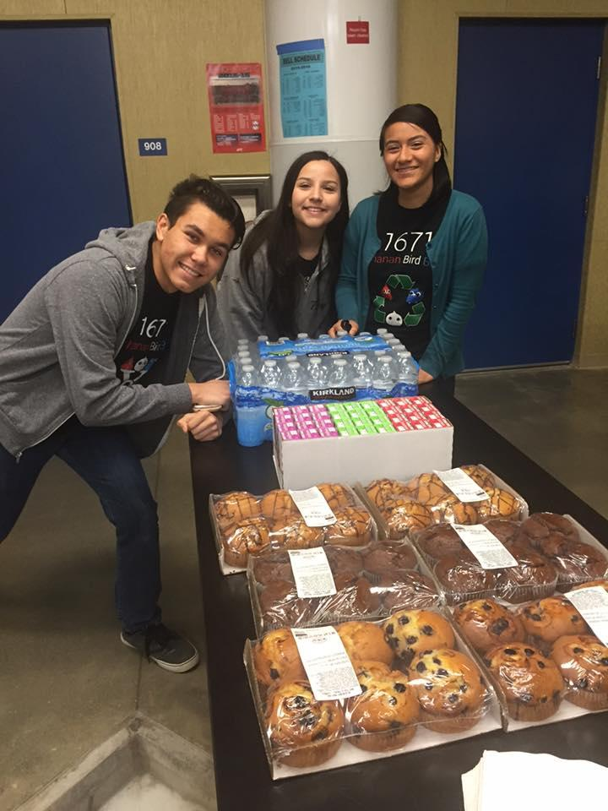
Food… Glorious Food!!!
Inspiring young minds to spread their wings.

Slide 11
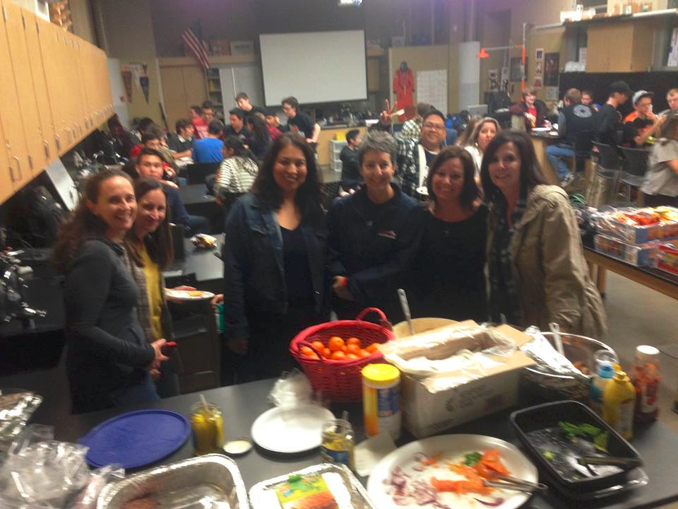
Family Potluck Night was a Blast!
Inspiring young minds to spread their wings.

Slide 12
Bird Brain Boo$ter$ Rai$e Money
Snack Bars (at FLL Competition)
Rummage Sale
Poker Night!
Solicit Financial & Material Donations
Silent Auctions at Team Special Events
Dinner Dance
Inspiring young minds to spread their wings.

Slide 13
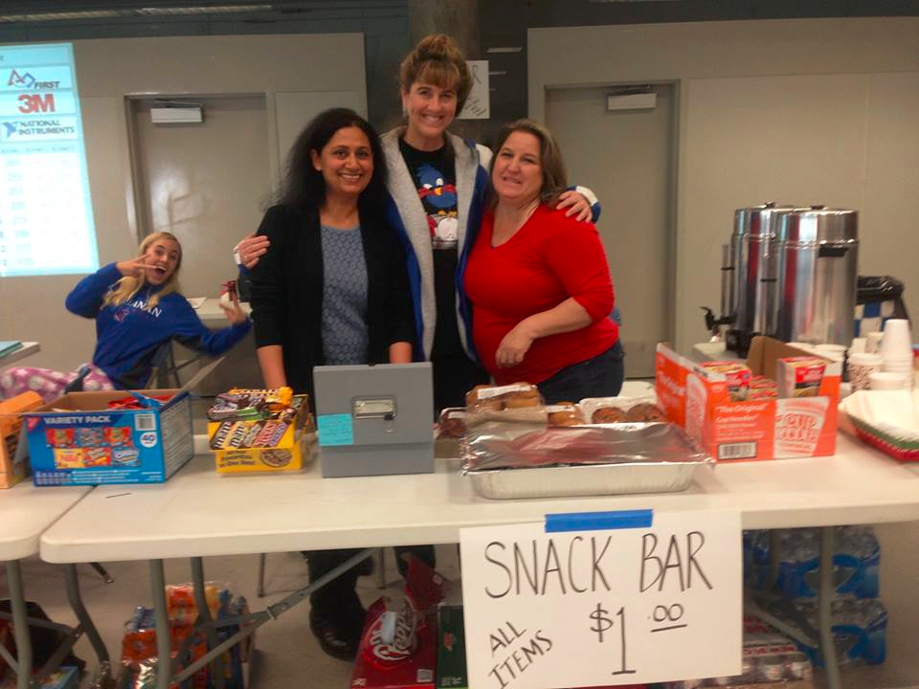
Boosters Running the Snack Bar at an FLL Event

Slide 14
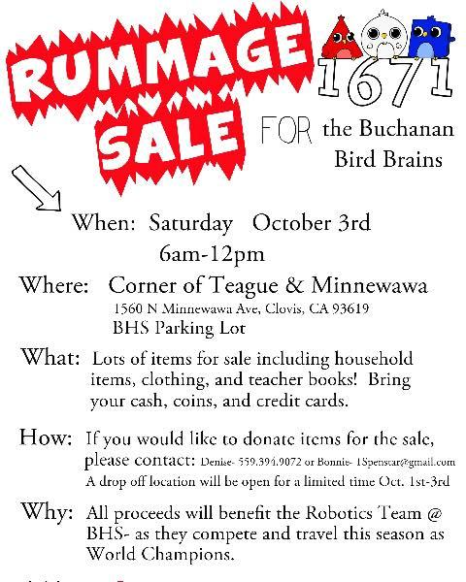
Bird Brain Boo$ter$ Rai$e Money
Rummage Sale
Brought in about $1,400.
Nice!
Inspiring young minds to spread their wings.

Slide 15
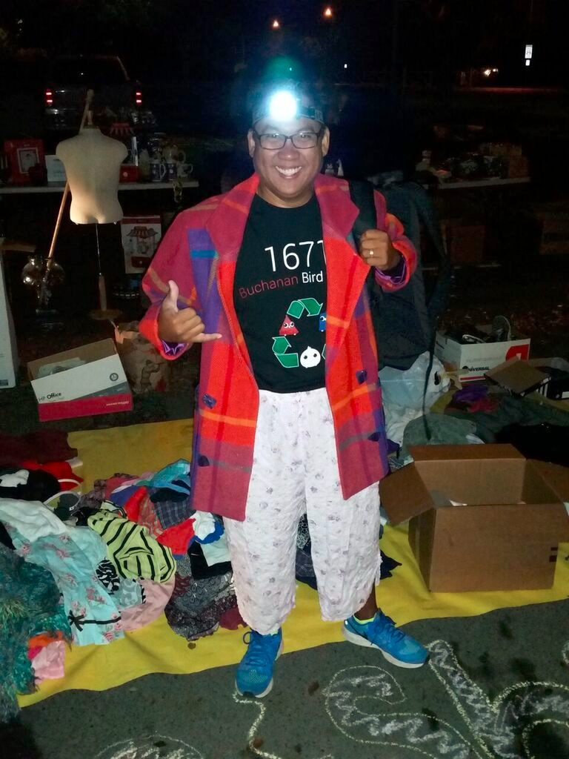
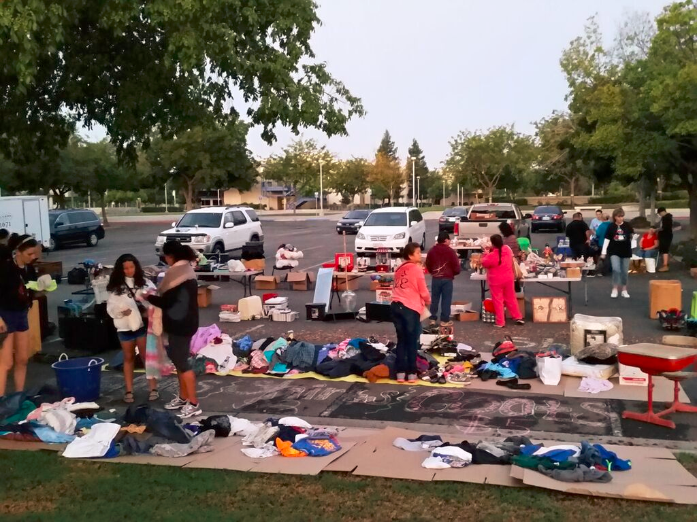

Slide 16
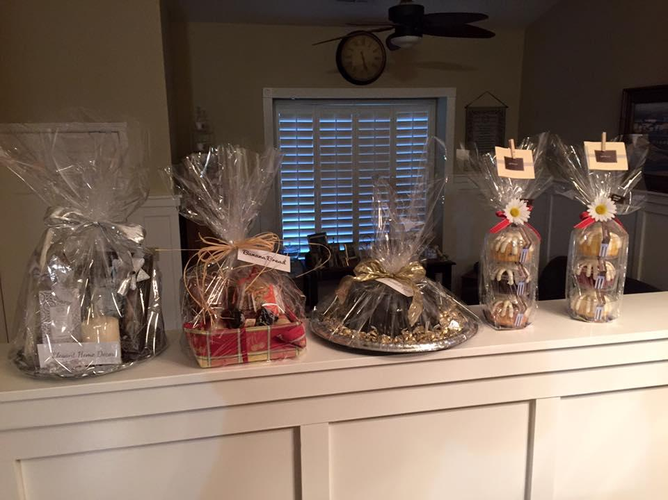
Quiet please, silent auction in progress
Parent Night
Kickoff Event
Open House
Dinner / Dance
Inspiring young minds to spread their wings.

Slide 17

Bird Brain Boo$ter$ Rai$e Money
Raising money can be FUN!
Introducing Joe Baker:
Parent and Card Shark
Inspiring young minds to spread their wings.

Slide 18
What can Boosters Do for You?
In the fall of 2013 the Buchanan Bird Brain Boosters raised the money to buy a much needed trailer.
Inspiring young minds to spread their wings.

Slide 19

Bird Brain Booster Communications
Facebook Group
Signup Genius
Face to Face Meetings
Email… not so much.
Inspiring young minds to spread their wings.

Slide 20
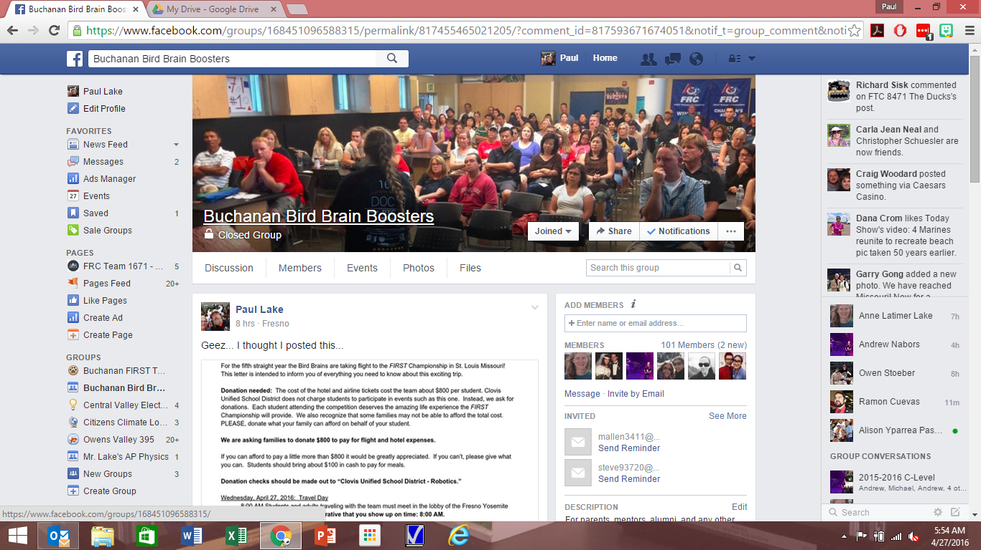
Bird Brain Boosters on Facebook
Facebook is a productive tool!
If you don’t like FB… you could start a fake account.
Link...
Inspiring young minds to spread their wings.

Slide 21

Signup Genius is pure….
So simple and easy to organize volunteers.
It’s FREE….It’s EASY!!!
http://www.signupgenius.com
Inspiring young minds to spread their wings.

Slide 22
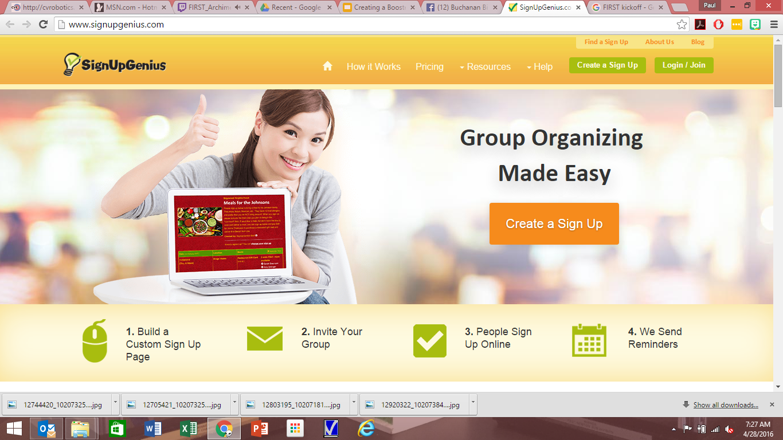

Slide 23
Suggestions for Starting Your Boosters
Recruit active parents
Prepare a 501(c)(3) Foundation Account
Prepare Social Media… Facebook Group
Start small… build experience
Inspiring young minds to spread their wings.

Slide 24
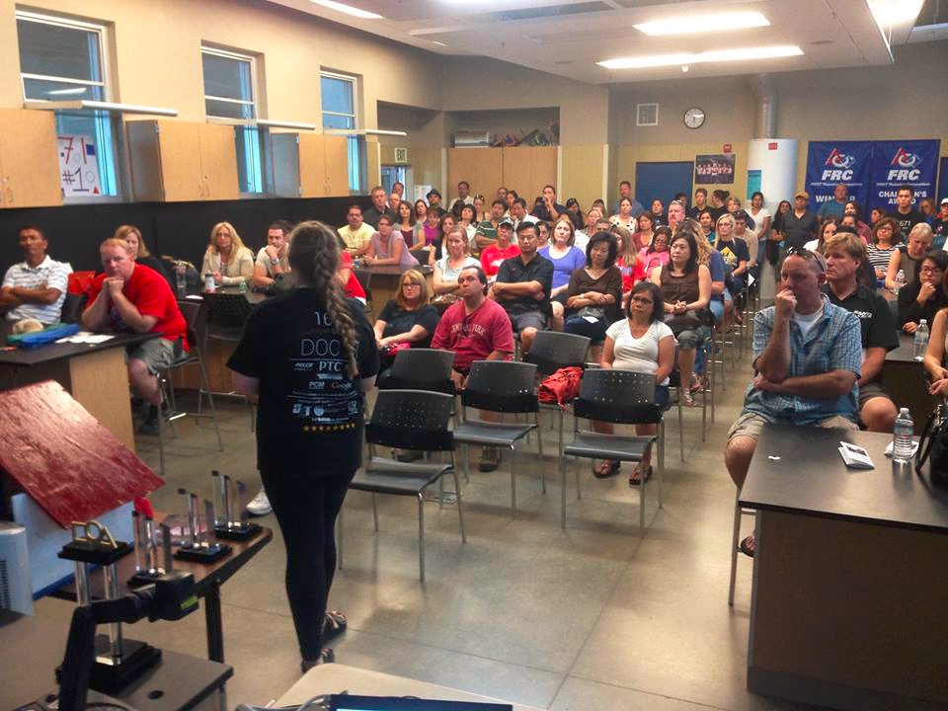
Parent Night!... A great way to recruit.
Parent night is mandatory.
Recruit parents to join your Booster Club
Schedule a follow up meeting
Inspiring young minds to spread their wings.

Slide 25
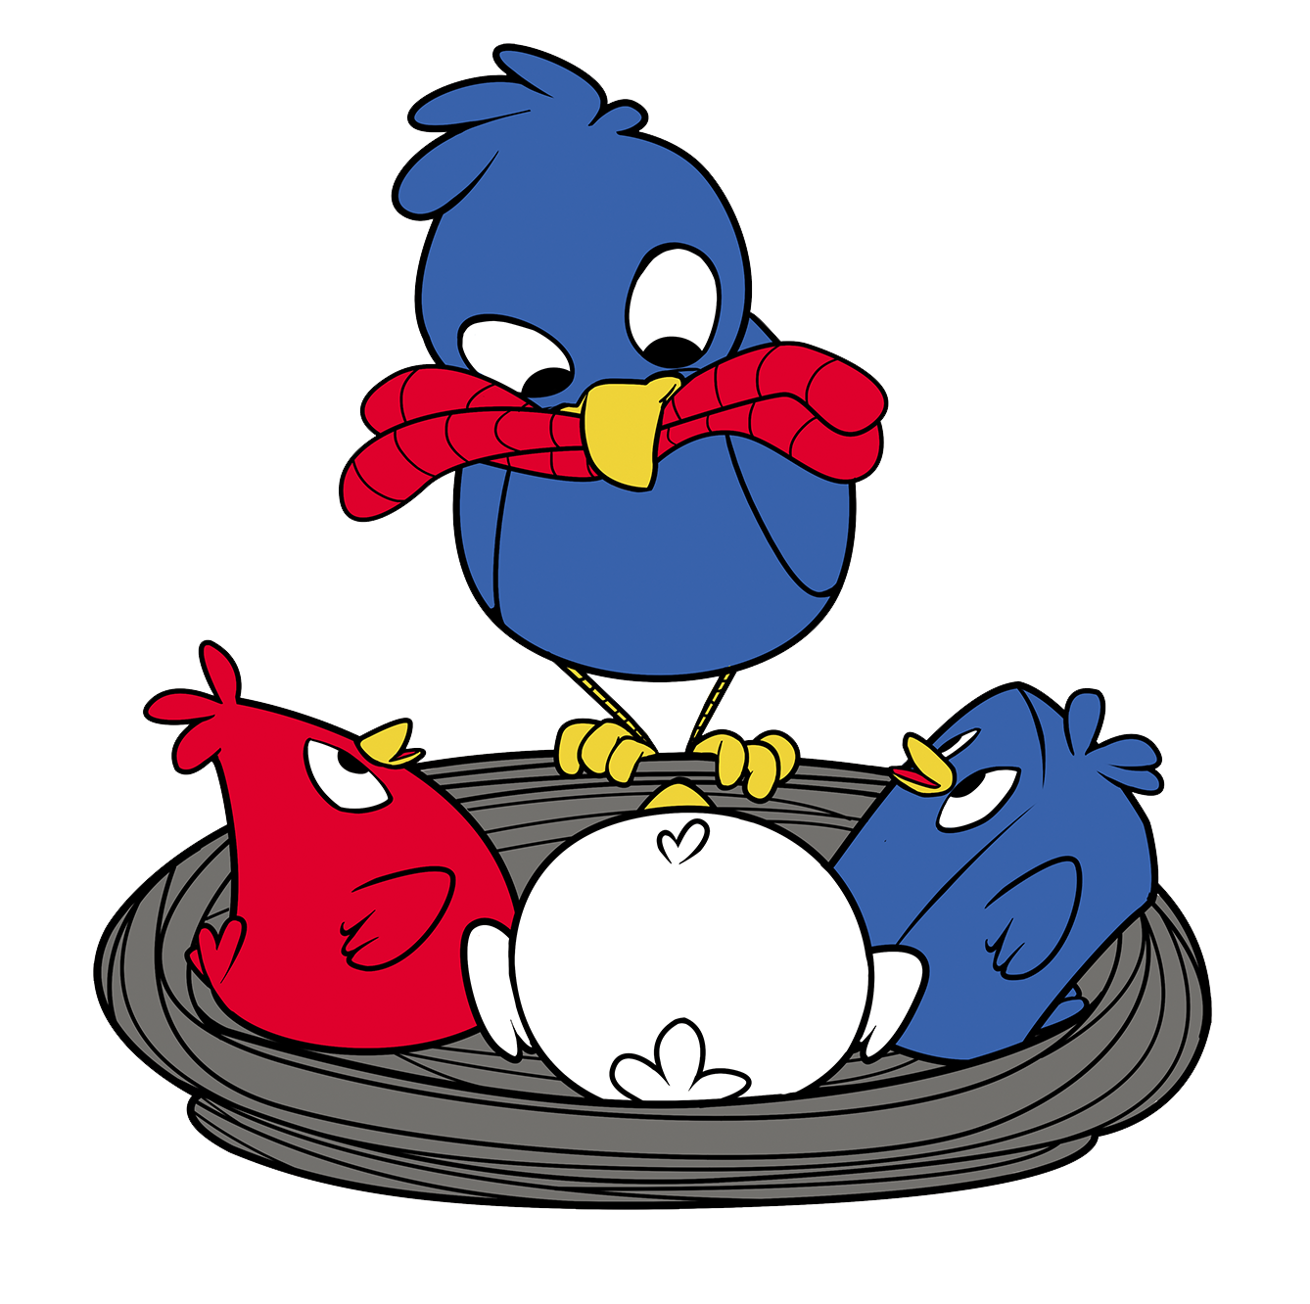
Buchanan Bird Brain Boosters
Facebook - Communicating through Buchanan Bird Brain Boosters
Meals - We will share what we do and how.
Membership Drive - Denise Carranco (559) 394-9072
Want all families to join and support the team. We have envelopes & fliers to hand out.
Bear Bash - Oct. 3rd 50% of auction and ticket sales go to Team 1671. Tickets on sale tonight.
Rummage Sale - Oct. 3rd Proceeds go to Team 1671. Corner of Teague and Minnewawa.
Waste Recycling Fundraiser - October TBA 50% of proceeds go to Team 1671
Build Season Home Meal Coordinators
- Alison Pascual (559) 323-1673
- Angie Person (559) 367-4850
Competition Meal Coordinators
- Bonnie Carlos (559) 970-9485
- Kelly Baker (559) 681-4654
Keep updated on what our team is doing through our Google Calendar and Master Calendar on our team website.
NEXT BOOSTER MEETING - September 9th at Baker house in Clovis. 7-8:30pm Information on flier.

Slide 26
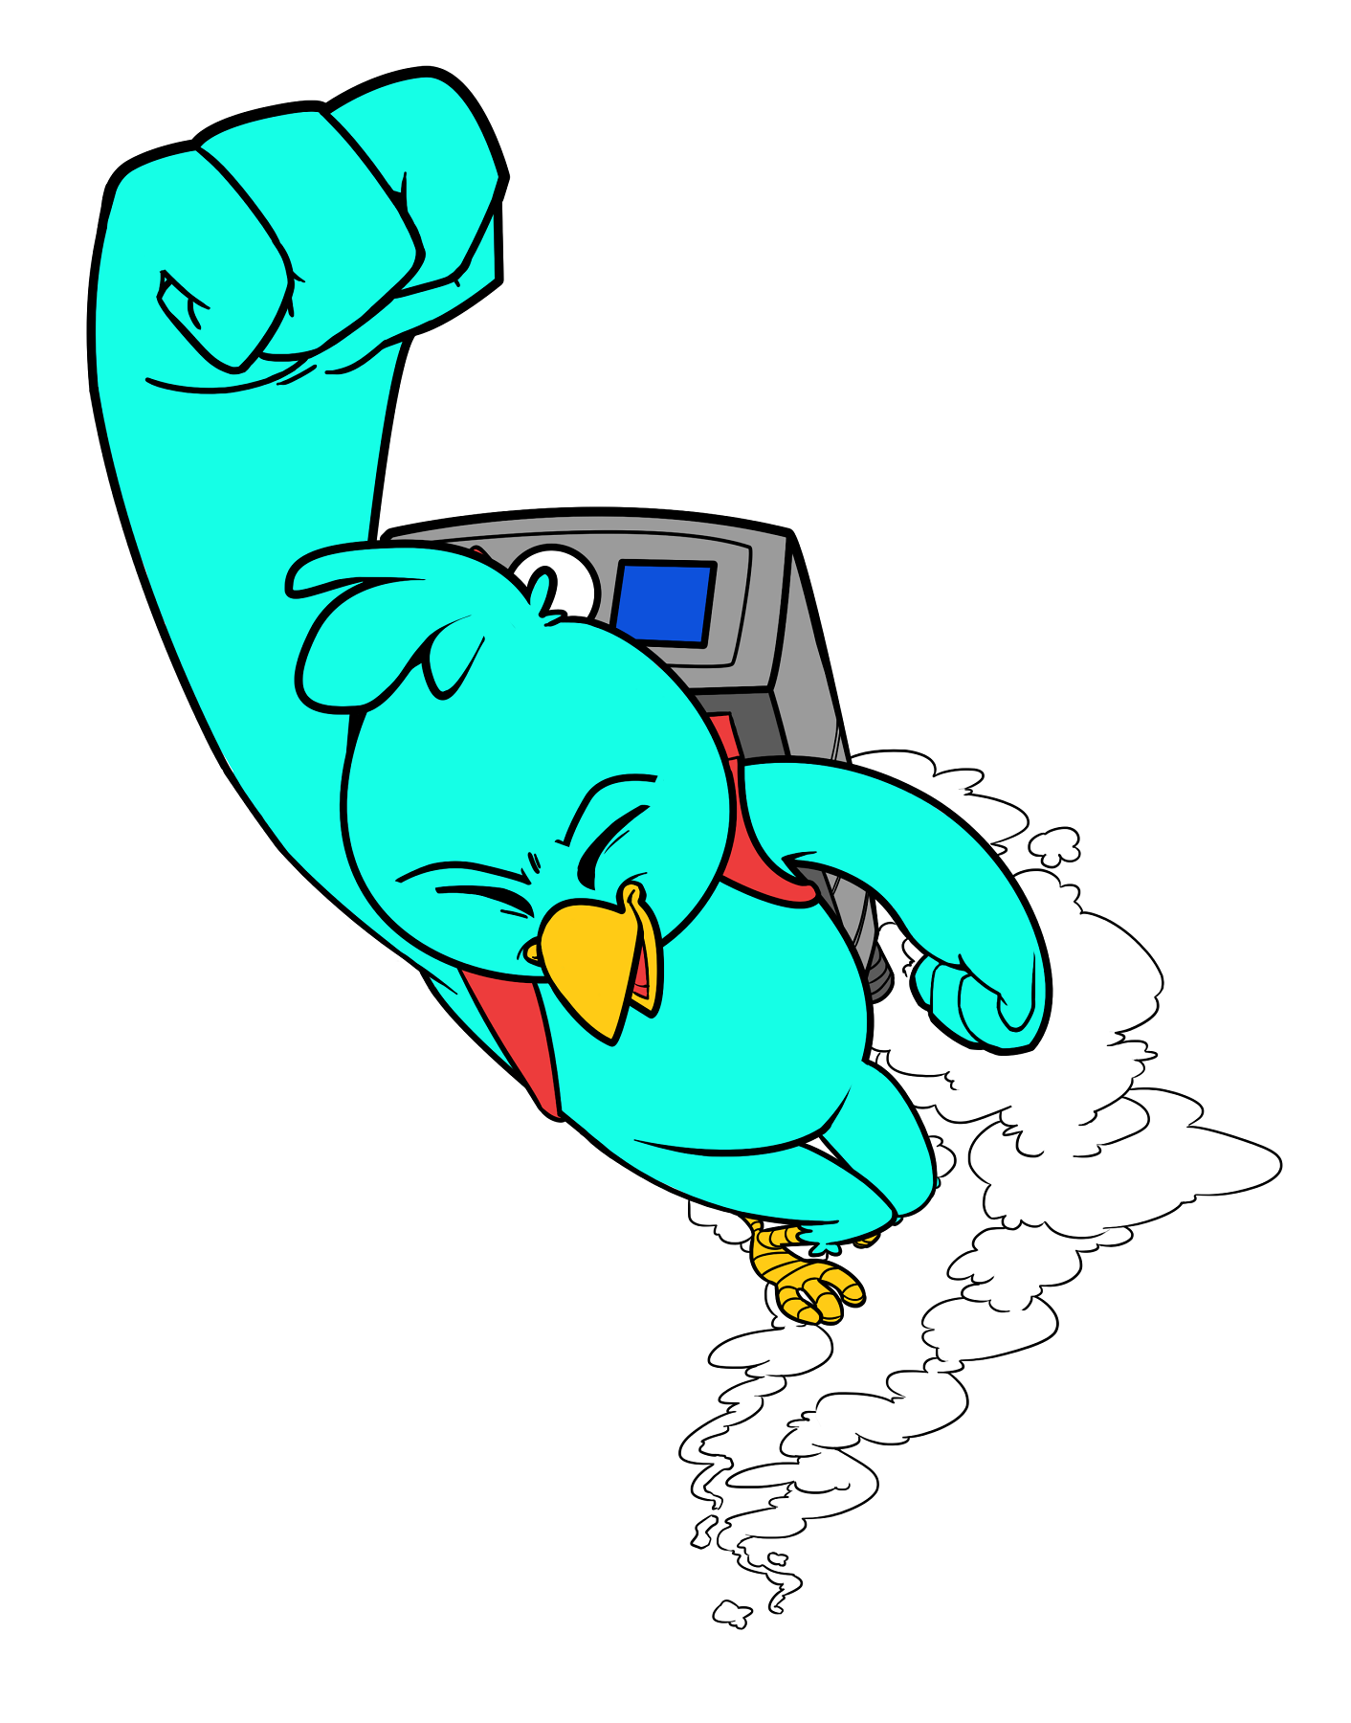
Boost your team to new heights!
Thank you for your attention. Now… let’s share ideas! New slide please!
Inspiring young minds to spread their wings.
Notes:
Robot Demo after ppt.

Slide 27
List new ideas below...

