Slide 2
A Testbed for FTC robot Components
Sig Johnson
April, 2016
Notes:
I’d like to thank you all for coming. Today, I’ll be talking about building a testbed for FTC robot components.

Slide 3
Agenda
-Premise
-Design process
-Building the test bed
-Uses of the test bed
-Findings
-Q&A
Notes:
Today I will be going over the design process I went through to plan the test bed, the process of building it, the uses of the test bed, and the findings of many of the tests, especially pertaining to battery health. After that, I’ll open it up for questions.
If you have questions along the way, please feel free to ask.

Slide 4
Intro
-Sig Johnson
-Junior in high school. 3rd year in FTC
-Team 8923, Swerve Robotics Club, Woodinville, WA (Near Seattle)
-Testbed project mentors: Dr. John Fraser, Alan Johnson, Bob Atkinson, Steve Geffner
Notes:
My name is Sig Johnson. I am a junior at Bothell High School which is in the area of Seattle, WA. This is my third year in FTC. I am part of team 8923, which is one of three teams in Swerve Robotics club.
As I built and used the test bed, I was assisted by a number of mentors in the design, building, and programming of the testbed including help with creating a presentation.

Slide 5
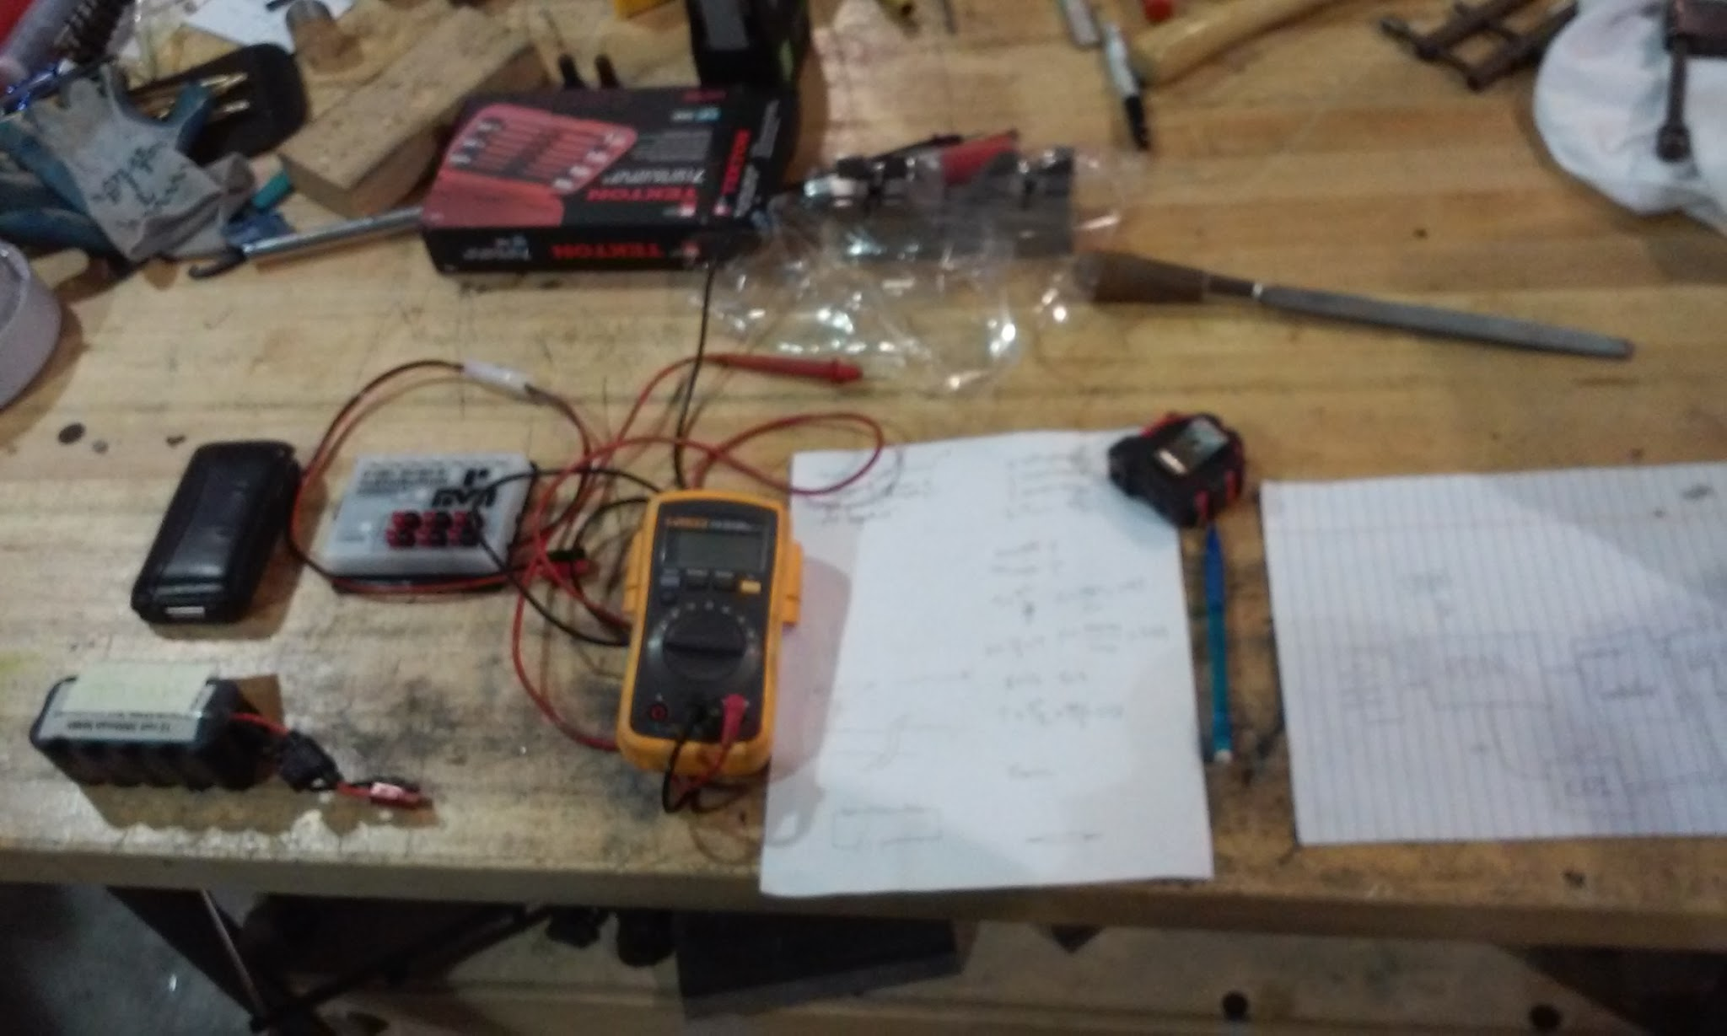
Premise
-Battery health questions
-Learning opportunity for experienced FTC student
-Create a valuable tool for the club
-Project quickly morphed into platform for testing multiple FTC components
Notes:
When this project began, the original goal was to build a battery tester to determine which batteries could reliably last through a match. We could have just purchased an off-the-shelf battery tester to test the health of batteries, but we took the opportunity to build multiple ways to test battery health into a testbed for FTC robot components.
This picture was taken during the early stages of the project.

Slide 6
Testbeds
-Fun, educational project
-Valuable for testing components in isolation
-Is this motor controller working?
-Our phone can’t find the components on our robot. Is it the phone or the components?
-Expandable platform for testing many aspects of a robot
-Common in industry
Notes:
Building this testbed was a lot of fun as well as educational.
Testbeds are common in many industries. They enable components to be tested in isolation, which improves ease of troubleshooting including in the field; they are used for testing prototype components and for validating warranty services. For example, Boeing has a mobile testbed they use to test jet engines.
For us, testbeds are useful for finding out what the real problem is in a multi-component environment. For example, if a phone can’t find a motor controller, is the motor controller not connecting, or is the phone just not seeing it? The testbed contains all known good components, so it can help us make that determination.

Slide 7
What Might We Test?
-Servo Controller
-Core Power Distribution Module
-Battery
-Core Device Interface Module
-Various sensors on module
-Cables and connections
-Motor Controller
-Power draw of a robot
-Game controllers
-Robot Controller Phone and Driver Station Phone
Notes:
We can use the testbed to evaluate many aspects of robot components.
We can test the battery to determine if it is going to reliably last through a match.
We can test servo controllers, motor controllers, and the power distribution module, including whether the app on the phone is seeing them or if they are actually not connecting.
One of the things we have tested in the past is, “is this module leaking power?” One team in our club was losing battery power quickly and wanted to see if their motor controller was the problem.
[Pause]
We can test the core device interface module to see if it connects correctly and we can test anything that is plugged into it, like sensors.
We have also used the testbed to measure how much current a robot draws during certain actions. That allows the team the robot belongs to to make decisions about how they use available power.

Slide 8
Design Precursors
-Learn Ohm’s law
-Review battery and robot motor specs
-Evaluated similar projects from other teams
-Made predictions
Notes:
Before building the testbed, I needed to understand Ohm’s law and the specifications of FTC batteries and motors.
I looked at similar projects other teams had completed, mainly battery testers.
I used Ohm’s law to estimate the sizes of some of the components I would need.
Speaking of Ohm’s law…
[CHANGE SLIDE]

Slide 9
Ohm’s law
Voltage equals amps times resistance
With any two, you can find the third
Used for sizing electrical components
For our battery test load we decided on three one Ohm resistors for battery draining
12 volts and 3 ohms will give us a 4 amp draw
Notes:
When working with electricity, Ohm’s law is important because nearly everything you do can be explained or predicted mathematically.
In this diagram, E is voltage in volts, I is current in amps and R is resistance in Ohm’s.
When you’re thinking about intentionally draining a battery, you need to know how much resistance to use. We wanted to use a static drain, so hook up a battery to a set load and watch what happens to the voltage as it drains. Throughout this presentation, I will refer to that as the “static load test”
There are commercial battery testers available, but mainly for car batteries. There are also testers like the battery beak specifically for Tetrix batteries, but we wanted a tester that gave us the raw data and one that we could easily modify. We also wanted our tester to be able to be used as a testbed for other FTC robot components.
For our static load, we decided on three 25 watt one ohm resistors in series, so 3 Ohms of resistance with a 75 Watt rating, which we know using Ohm’s law, creates a 4-5 amp draw depending on the battery voltage. FTC robots can certainly draw more than four amps during a match, but for our static test, four amps allows the battery to drain fast enough to be observed without taking too long and slow enough so as not to damage the battery or be dangerous.

Slide 10
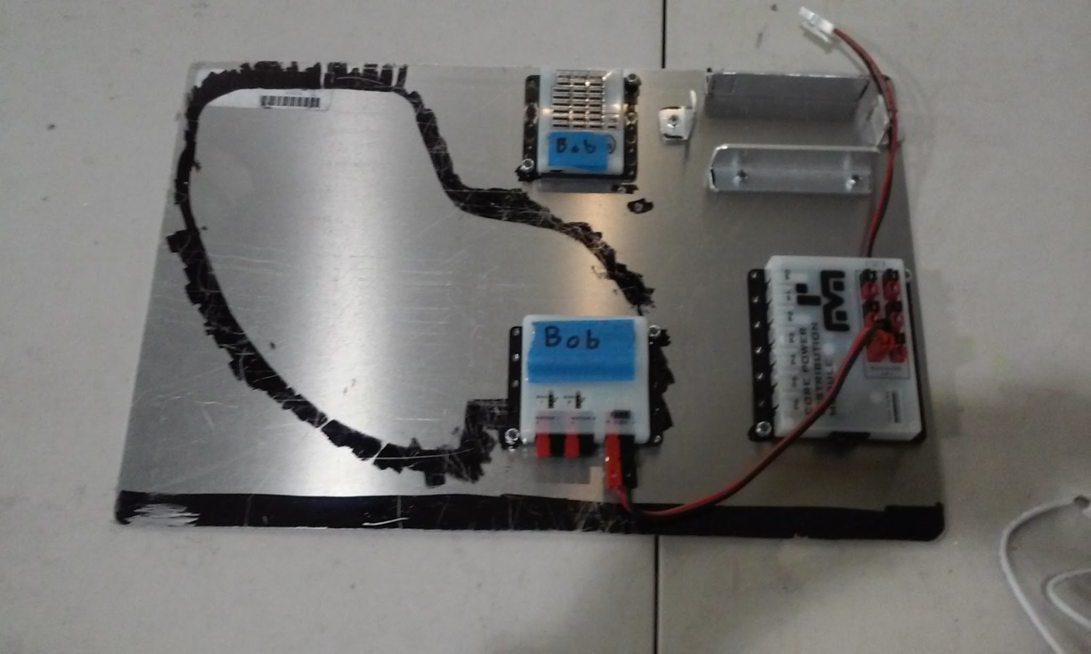
Testbed 1.0
Notes:
After we knew what we wanted our testbed to be able to do, we designed and built the initial version. The black smear is just sharpie on the plastic cover of the aluminum stock we used. I didn’t put it there. You can see here the place to mount the battery, the CPDM, and the motor controller and CDI module plugged into it. As we move along, you will see later versions of the testbed as it gets improved upon.

Slide 11
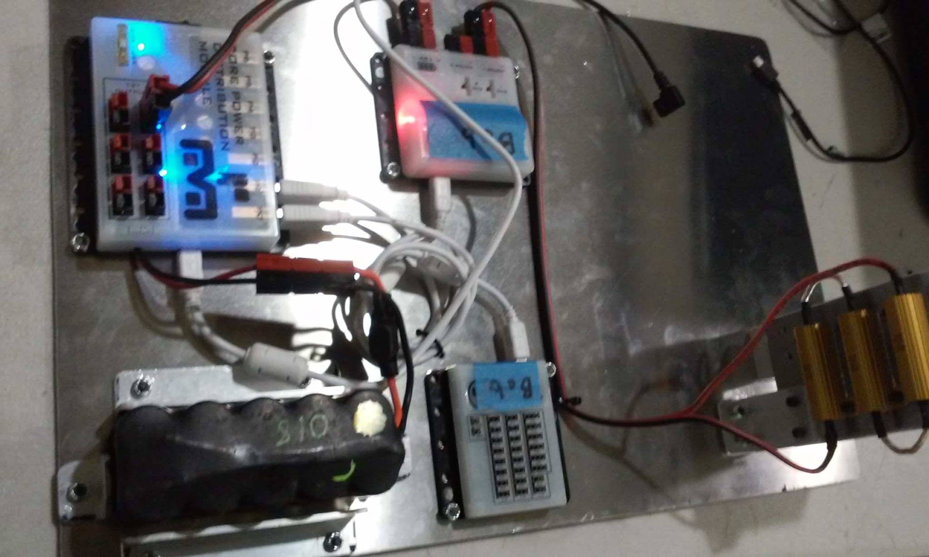
Building the Testbed
-Sketch device. Mentor review. Repeat.
-Created mounting plate
-Mounted components
-Wire management
Notes:
We selected 1/16th aluminum mounting plate because it was strong, light, and relatively cheap as well as being less prone to static electricity.
We started out powering test equipment (motor controller, CDI, CPDM) with the battery being tested. (Point)
However, powering anything except the test load with the test battery is bad practice for testbeds. We first changed to powering only the motor controller with the test battery then changed again to only powering the resistors with the test battery. This eliminated any other power draw on the battery being tested.
Wire management has been an issue since we started. It got even more complex with later versions, but planning where the wires will go at the same time you plan out the rest of the hardware is a necessary step to good wire management. We used Anderson power poles for all our connectors. This allows the testbed to be easily reconfigured because any module with Anderson power poles can be plugged into it.

Slide 12
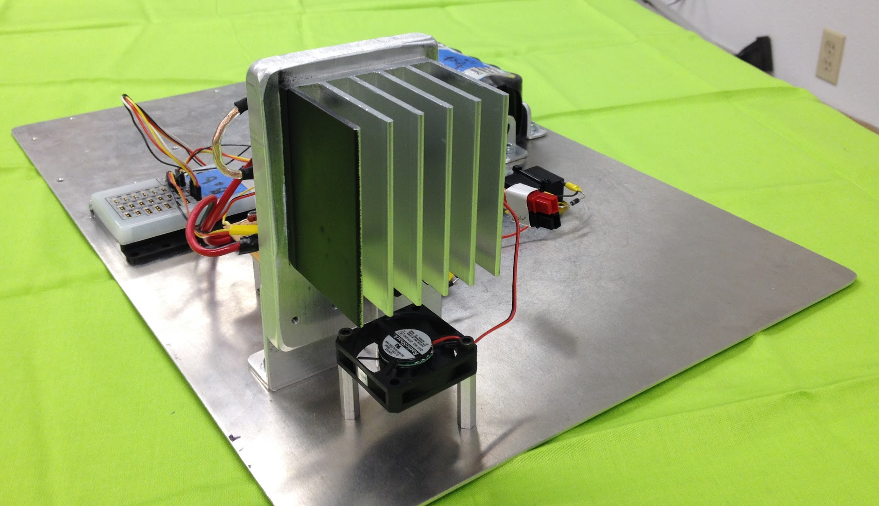
Building the Testbed, cont.
-Heat sink
-Estimated 50℃ with help of Dr. Fraser
-Obtained a heat sink from Dan Terry, a local business owner.
-Added color to enable IR temperature measurement
-Fan added, but not strictly required
Notes:
You can’t see from this picture, but the three one ohm resistors are mounted to the back of the heat-sink, with thermal conductive putty between them to allow more heat to be transferred to the heat sink.
We estimated that the heat sink would heat up to about 50 degrees celsius. If we don’t dissipate the heat correctly, the resistors might change resistance at high temperatures.
4-5 amps over 15 minutes yields a heat-sink that is quite hot to the touch, but probably not going to start a fire.
The infra red thermometer we had didn’t work well against the bright silver aluminum, so we spray painted one side black, which gave us more reliable readings. However, temperature measurement is still not very accurate.
Just to be on the safe side, I added a small fan. With the fan running, the heat-sink is still hot to the touch, but not dangerous.

Slide 13
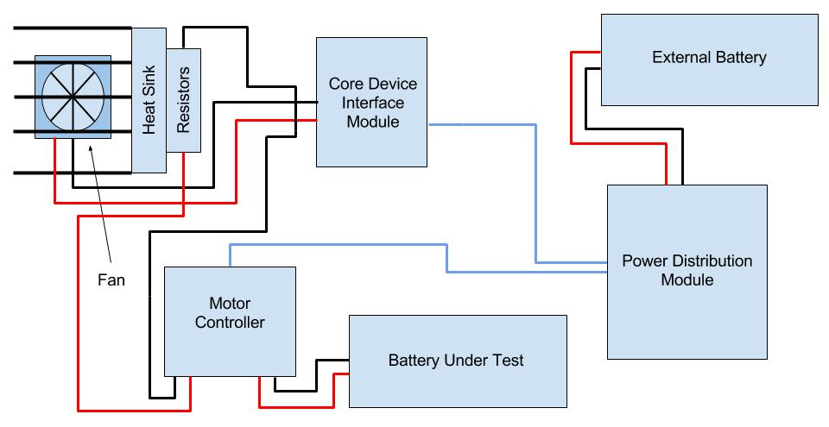
1.0 Wiring Diagram
Notes:
This is a wiring diagram of the initial version of the test bed.
Red wires are positive, black wires are negative, and blue wires are USB cables.
I’ll pause here and give you a second to look over it yourself.
(POINT)
Here you can see that the External battery is powering the test equipment which consists of the power distribution module, the CDIM and the fan. Power from the device under test, the battery, is flowing through the Motor Controller then through the resistors. Unfortunately, while this setup is relatively simple, some voltage is lost powering the motor controller from the test battery which can impact our results.
The phone is connected through the USB port on the power distribution module and has its own battery.

Slide 14
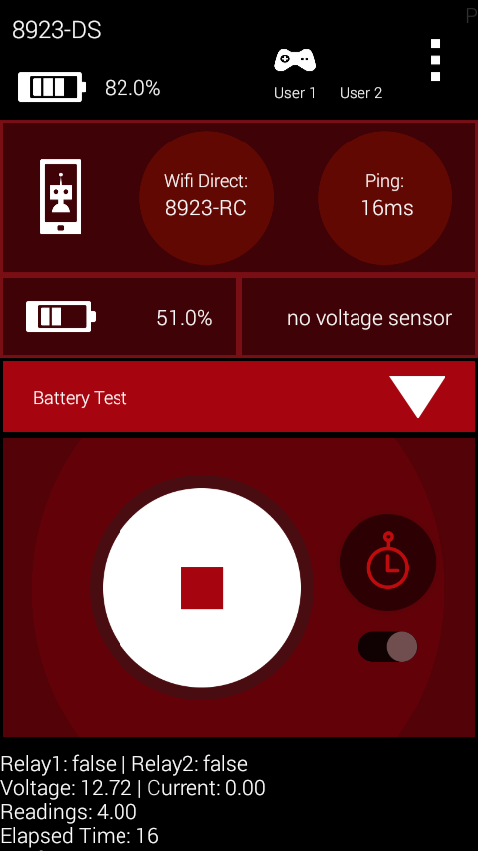
Software
Created different OpModes for testing:
-Batteries -Servos
-Core Device Interface Modules -Motor Controllers
-Servo Controllers -Core Power Distribution Modules
-Motors -Various sensors
Notes:
The hardware on the test bed can be reconfigured to test many different aspects of a robot or an individual component.
To create and log data specific to the element we are testing, we needed a separate OpMode for each item. As we find new uses for the testbed, we will create still more OpModes. Each OpMode writes data to the log differently, so we do not have to write all aspects of performance to the log at once. For example, when testing a sensor, we do not need to log battery voltage.
During a test, the telemetry on the phone screen displays data in the portion in the blue box, including the state of the relays, the voltage, the elapsed time, and the current.

Slide 15
Software, cont.
-Encountered bug in FTC software framework
-FTC framework not expecting a 20 minute match
-Reported bug to Bob Atkinson, bug was fixed during next update
-Can find other hardware components on testbed using standard FIRST apps
Notes:
As we began to test batteries, we ran into a bug where tests would just die after an inconsistent amount of time. Sometimes, the FTC app would freeze after a minute or less and other times it took 10 minutes or more. After doing some debugging, we determined that the issue was with the FTC app, not with our code.
It turns out that a problem in the FTC framework was exposed when the app ran for these long duration tests. The app was only designed to run for the 2 or 3 minutes it would take for a match, so running the app for our static drain test caused a freeze every time because of how long we ran it for. Using the testbed, we could reproduce the bug 100% of the time. After showing the problem to Bob Atkinson, one of the creators of the FTC app, he determined that the issue was in the thread management portion of the app. An update was released a few days later that resolved the issue. The testbed helped confirm the fix because we no longer saw the bug that used to occur consistently. This was valuable for FTC as a whole because the same issue we saw was occasionally causing robots to freeze during matches earlier in the year, and that issue no longer occurs, at least due to this problem. Helping to diagnose a problem like this is exactly the sort of thing testbeds are made to do.
The test bed can find all robot components using the FIRST app without any modification just as it would on a robot. It is also worth noting that the CDI module can be used by itself. We have our phone directly plugged into it without the use of the CPDM.

Slide 16
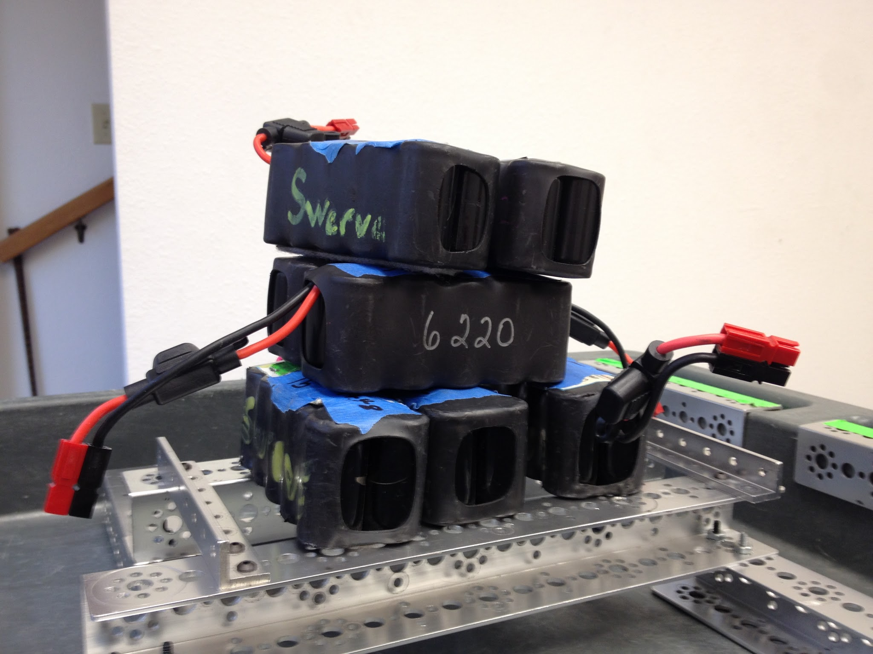
Using the Testbed to Evaluate Battery Health
Notes:
When a team goes into a match, they want to be sure that everything on their robot is going to function like they want. That includes the battery. Determining battery health was the initial motivation for this project and now we are going to go into what we found.

Slide 17
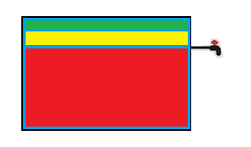
Battery Basics
-3000mah (a.k.a. 3 amp hours)
-In theory, 3 amps for one hour, 6 amps for 30 minutes, etc.
-Working range of 14 to 11.5 volts
-Usable down to 11.5 or 11 volts, depending on need
-Hanging likely the most demanding maneuver
-Actual demand varies per robot
Notes:
So it’s time to talk about batteries! Here are some basics about the batteries used by FTC.
[PAUSE FOR 5 SECONDS]
We think of batteries like a tank of water that we drain. (top picture)
[EXPLAIN]
In reality, the spigot is very high on the tank, making much of the perceived power unusable for our purposes. (middle picture)
[EXPLAIN]
In fact, only the top 10-15% is likely to power your robot to its full potential and do maneuvers like hanging. (bottom picture)
[EXPLAIN]
Most battery vendors recommend batteries be drained no lower than 80% of capacity before being recharged. Draining batteries below 80%, especially draining to 60% or lower, can damage the battery, increase its internal resistance, and dramatically reduce the number of recharge cycles before the battery is no longer serviceable.
From a power perspective, it would be better if we could do the most power intensive maneuver first, then operate only on low amperage in the end-game. Our sister team, 6220 found that they cannot hang once battery voltage drops below about 11.75 volts.

Slide 18
Options for Measuring Battery Health
Drain via static 3Ω resistance measuring voltage over time
Calculate total WaH output during static drain test
Measure a battery’s internal resistance
-Compare results to known-good battery
-Known-good battery can power robot through a match reliably.
Notes:
Our testbed can measure the health of a battery in several ways.
PAUSE FOR 5 SECONDS FOR PEOPLE TO READ THE SLIDE
We measured the time batteries lasted under load before dropping to 11.5 volts, the total power provided, and the internal resistance.
We took measurements on a known good battery to establish a baseline and compared other batteries to it.

Slide 19
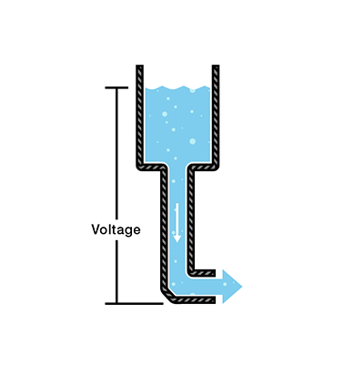
Static Load Test
-Battery connected to 3 one Ohm resistors
-Total resistance is not exactly 3Ω
-Voltage and time logged to document on phone
Notes:
The approach we took was to connect the battery being tested up to a static load of 3 ohms. We recorded the voltage every 5 seconds to a log on the phone, stopping at 11.5 volts so as not to damage the battery by draining it too low.
It turns out, the resistance provided by the wires and connections we used was around .2 ohms, so we had a total of about 3.2 ohms of resistance. We only found that out fairly recently and because of it, we had to redo some of our tests because it had affected the data. When making a testbed, I would recommend checking everything with a multimeter before actually using the testbed.

Slide 20
Capacity Test
-Measures how much the battery outputs in WaH
--The volume of water that came out
-Can be calculated from static load data
- Cumulative WaH=V₂(V₂/I)+V₁(V₁/I)
-Most important because it measures how much it can give to a robot
Notes:
Another way to test battery health is to measure battery capacity. To use our water analogy, the capacity test measures how much water came out of the tank. That represents the total power given by the battery in Watt hours.
[Point]
To perform the capacity test, we took the voltage from our static load data, using ohm’s law, we calculated the current. We then multiplied the current by the voltage to obtain watts. Then we calculated the cumulative watts delivered over the duration of the test for each battery in WaH.
This is the most relevant test because what we really care about is how much power the battery can provide for a match. This test gives an absolute measurement of battery health. A good battery will always have high capacity and a bad battery will always have low capacity.

Slide 21
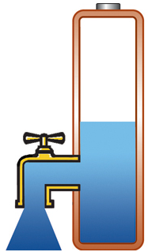
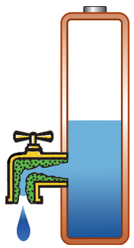
Measuring Internal Resistance
Low IR
High IR
-Internal resistance is resistance inside the battery that causes a voltage drop when the battery is used.
-To measure, change resistance and graph voltage against current before and after change
-Slope is the internal resistance
Notes:
Another way to evaluate battery health is measuring internal resistance.
[Point] Looking at this picture, we see that the internal resistance of a battery builds up over time like gunk inside a pipe.
[Pause]
Internal resistance acts as a resistor inside the battery and drops the voltage immediately before leaving the battery. Our expectation was that internal resistance would be a good predictor of battery health because abuse and age of a battery cause internal resistance to increase.
To test the internal resistance of a battery, I first measured the open circuit voltage, then I measure the loaded voltage and graphed the voltage against the current between those two points. The slope of that line gave me the internal resistance. I will demonstrate how that is done after the presentation.

Slide 22
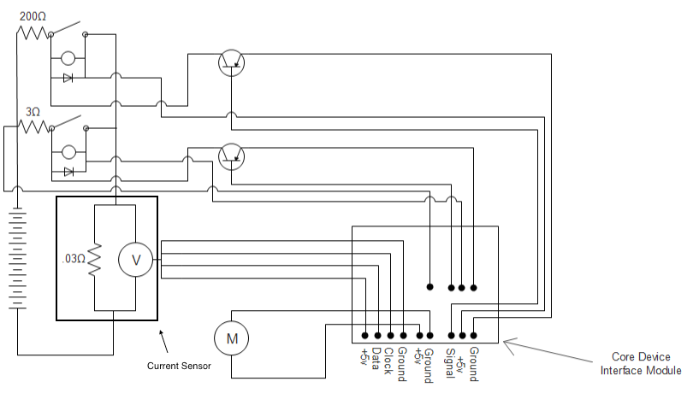
Current Wiring Diagram
Notes:
This wiring diagram, the current iteration of the test bed, includes the ability to perform a static load test, a capacity test, and an internal resistance test.
Since the draw of the motor controller in previous versions was affecting the data by putting additional load on the battery, we took it out. Now, we needed a different way to control whether the power went to the 3 ohm resistor for the static test or just the 200 ohm resistor or both, so we used relays to do what the motor controller had done previously.
The core device interface module did not provide quite enough voltage to flip the relays, so we added transistors connected to a larger voltage source to flip the relays. With this configuration, the battery only powers the resistors, allowing accurate collection of data. The phone powers the transistors and the relays, making it so that no external battery is needed.
By the way, we mistakenly used way too large relays for this. If you do this and use reasonably sized relays, you will be able to use the core device interface module to flip them without the use of transistors.
As you can tell, this testbed is not finished and may never be finished. We can disassemble and reassemble depending on the task at hand. In fact, for our current purposes, we do not use the 200 ohm resistor, but we plan to use it to measure internal resistance more accurately in the future.
I used this iteration of the testbed to run the battery tests I’m about to show results for.

Slide 23
Battery Capacity Requirements
-Able to power a robot through all maneuvers required by a match, including:
-A 20 minute delay before starting the match
-A restarted match following a technical delay
-Able to deliver 5+ amps at 12+ volts (with spikes to 10 amps) for two and a half minutes, including delays
Notes:
This is what we decided we needed a battery to be able to do when on a robot.
PAUSE FOR 5 SECONDS FOR PEOPLE TO READ THE SLIDE
This allows plenty of room for delays in a match and for high power draw maneuvers like hanging.

Slide 24
Profile of a Viable Battery
-13.5+ volts after charging (open circuit)
-Reading 12+ volts after being drained at 3Ω for 15 minutes
-Internal resistance of less than .3Ω
Notes:
After testing our batteries, we decided that a good battery has 13.5 or more volts after charging, still reads 12 or more volts after being drained for 15 minutes, and has the relatively low internal resistance of less than .3 Ohms.

Slide 25
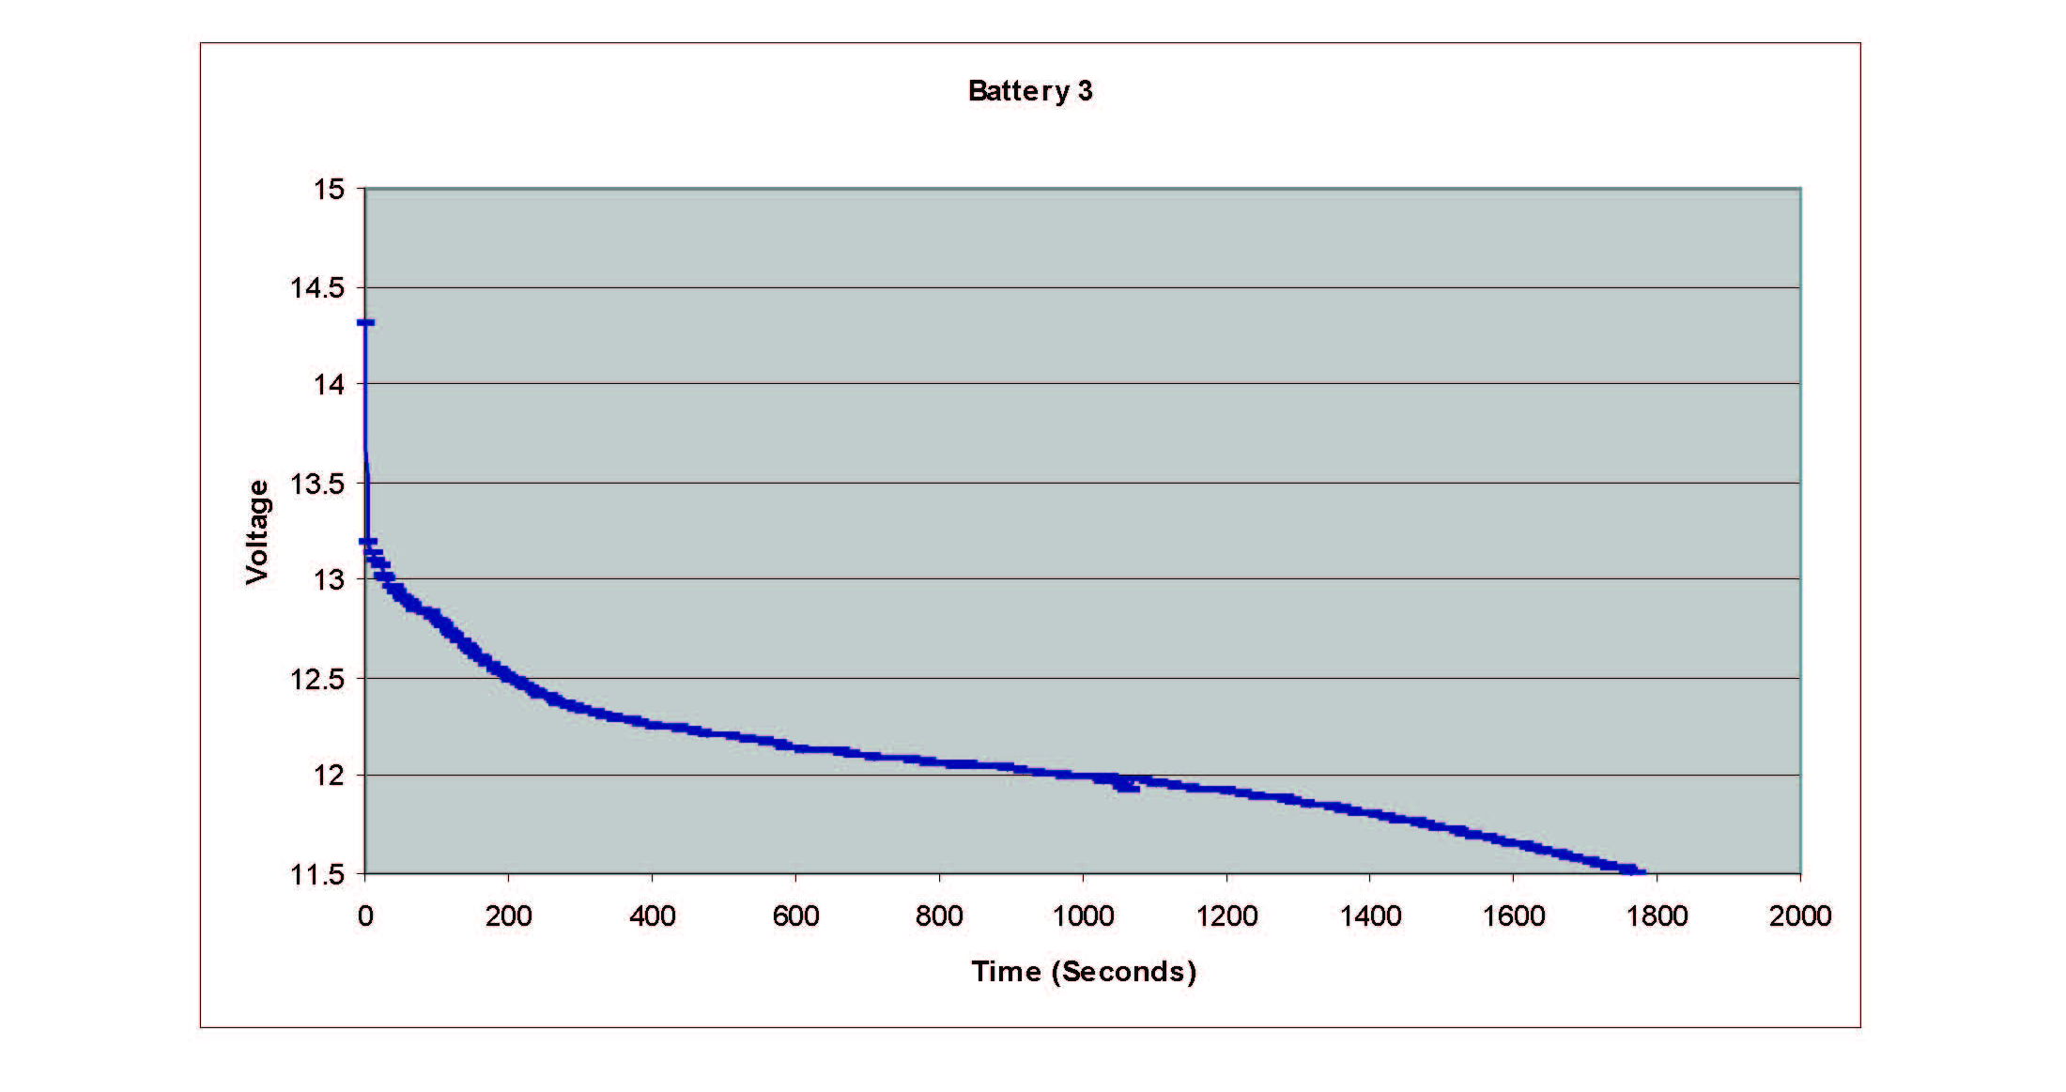
Profile of a Viable Battery
Internal Resistance of .28 Ohms
Notes:
This is the graph of the voltage over time for a good battery, provided by a static load test. The voltage starts at 14.3, drops immediately to 13.2 when a load is applied, but is able to provide 12 volts for a little more than 16 minutes. This battery has an internal resistance of .28 Ohms, under our .3 ohm cutoff. This battery is definitely match-capable.

Slide 26
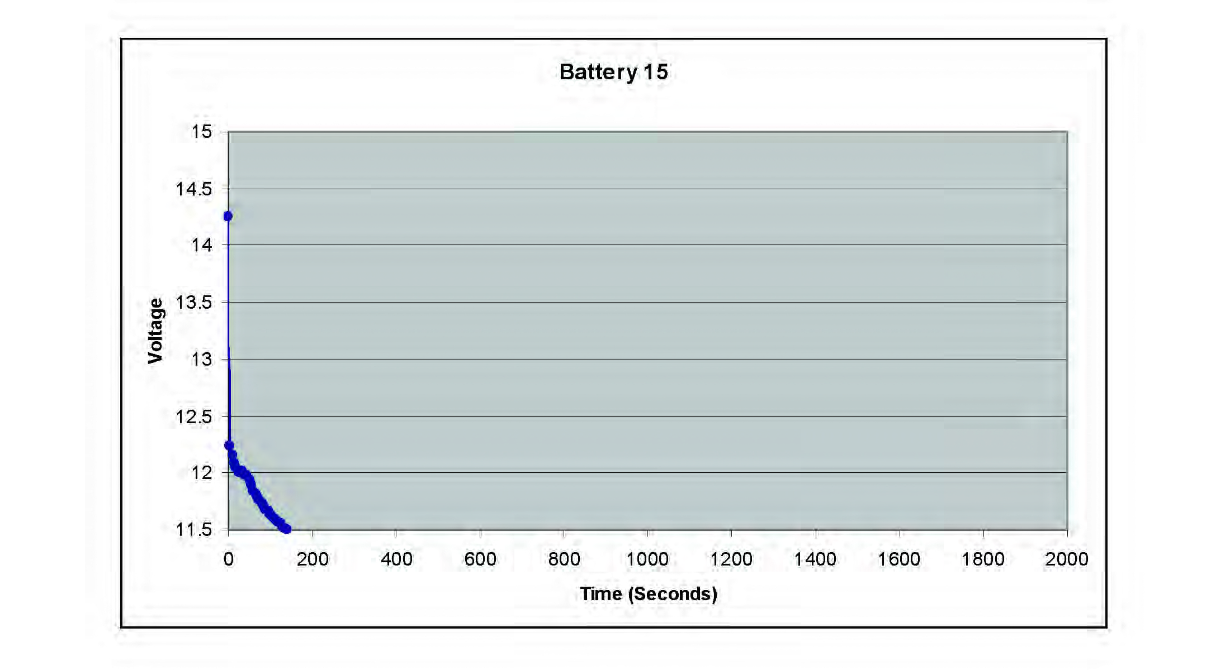
Profile of a Non-Viable Battery
Internal Resistance of
.64 Ohms
Notes:
This is the graph of a bad battery. Notice though, like our good battery, this one had the initial reading of 14.3 volts. However when our 3 ohm load was applied, the voltage dropped immediately, and the battery was only able to sustain 12 volts for about 40 seconds. It also has an internal resistance of .64 Ohms, way higher than all the other batteries tested. This battery is toast, ready for the recycle bin.

Slide 27
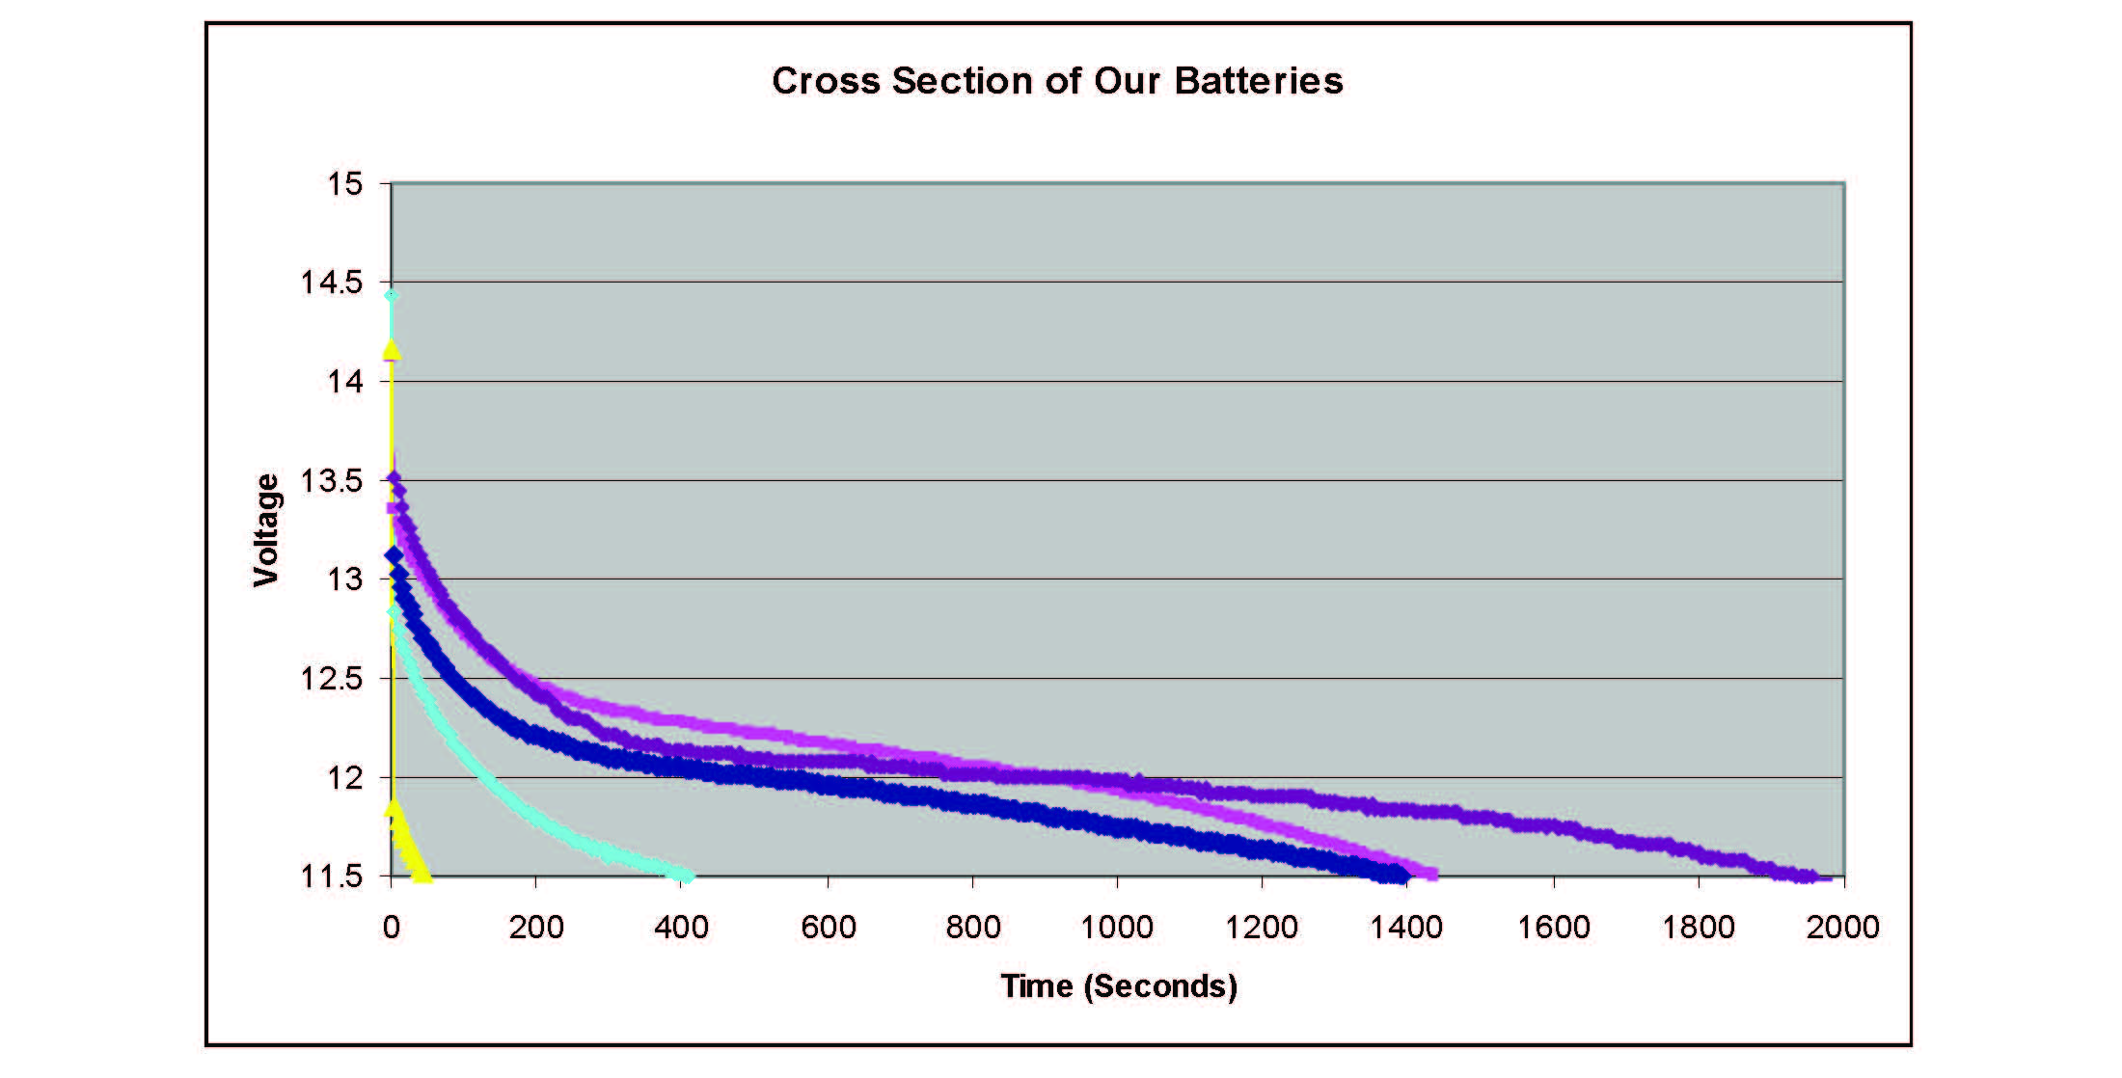
Testing a Number of Swerve Batteries
Notes:
This graph shows five of our batteries. Notice that the highest open circuit voltage reading is from one of our bad batteries. That shows that initial voltage after charging is not a good indicator of battery health. The dark blue battery ends around the same time as the violet one, but drops below 12 volts too soon. The violet battery is okay, the purple one is great. Both purple and violet drop below twelve volts at about the same time, but purple lasts a lot longer afterwards, perhaps being able to provide the extra voltage for a hang at the end.

Slide 28
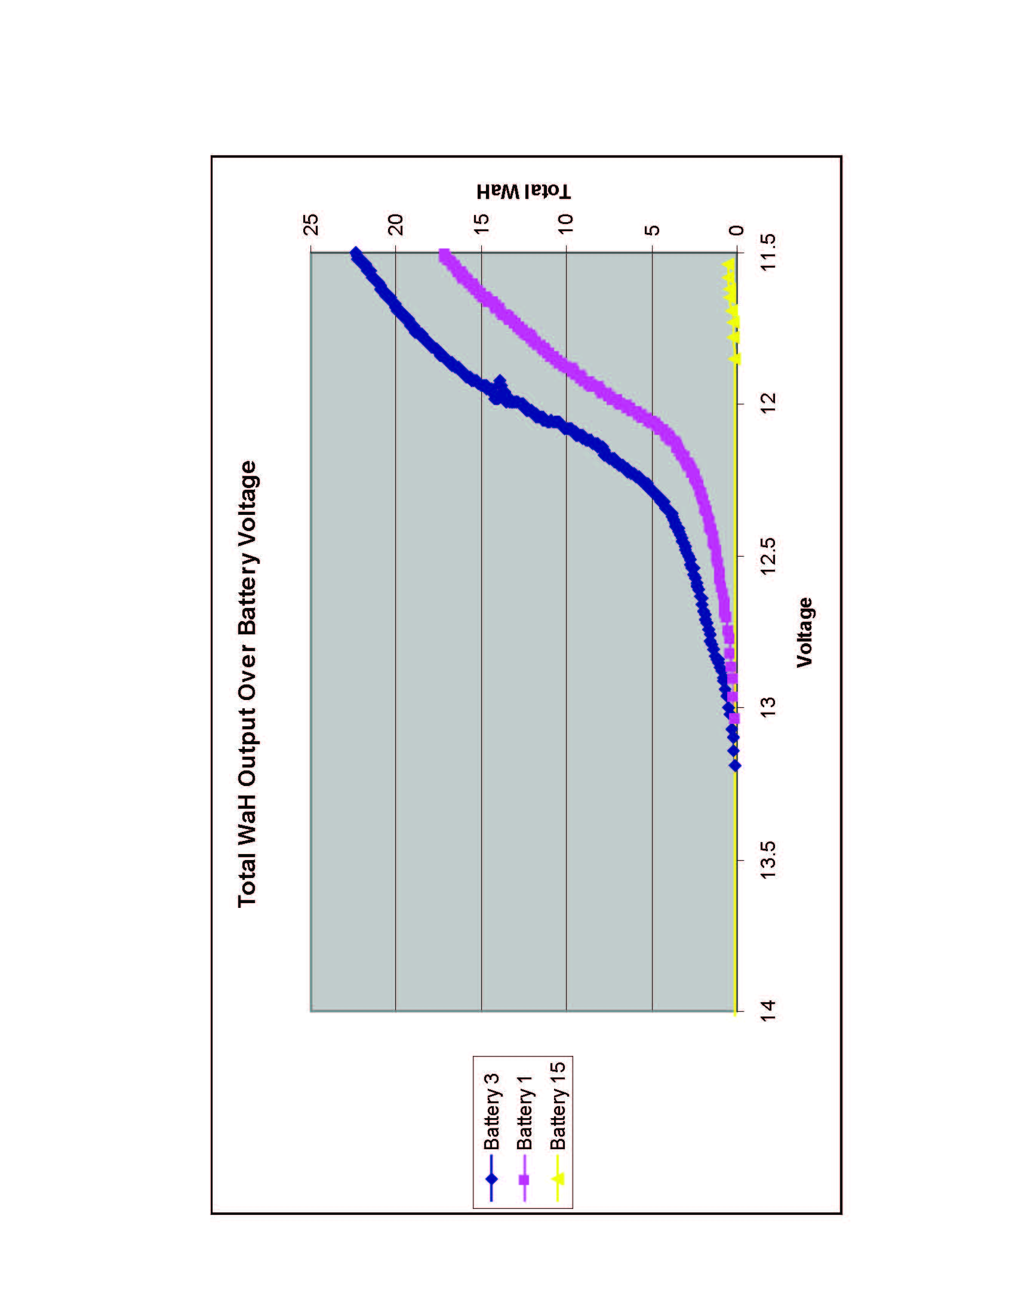
Cumulative WaH Output
Notes:
Watts are calculated by multiplying voltage by amperage. In our water example, watt hours represent the volume of water that drains in an hour.
FTC batteries are rated for 3 amp hours at 12 volts, which is 36 watt hours.
With the data from our static load test we’re able to calculate the total WaH delivered.
This chart shows the cumulative Watt hour output for three of the batteries on the previous slides. Cumulative Watt hour output is how many total Watt hours are output during the test.
The good battery in blue output 22.41 watt hours before dropping below 11.5 volts after 29 minutes.
22.41 watt hours are 62% of the advertised 36 watt hour capacity of the battery, however our battery started well above the advertised voltage and we drained it to 11.5 volts rather than 12.
The purple line is a marginal battery. It provided 48% of the battery’s advertised capacity.
The yellow line is the really bad battery. It provided 1% of the advertised capacity, but remember that this battery still read 14.4 volts on a multimeter after being charged.
Our good battery only delivered 62% of the advertised capacity even though we drained it below the 12 volt rating. That means the ratings on these batteries overstate what the batteries can actually provide.

Slide 29
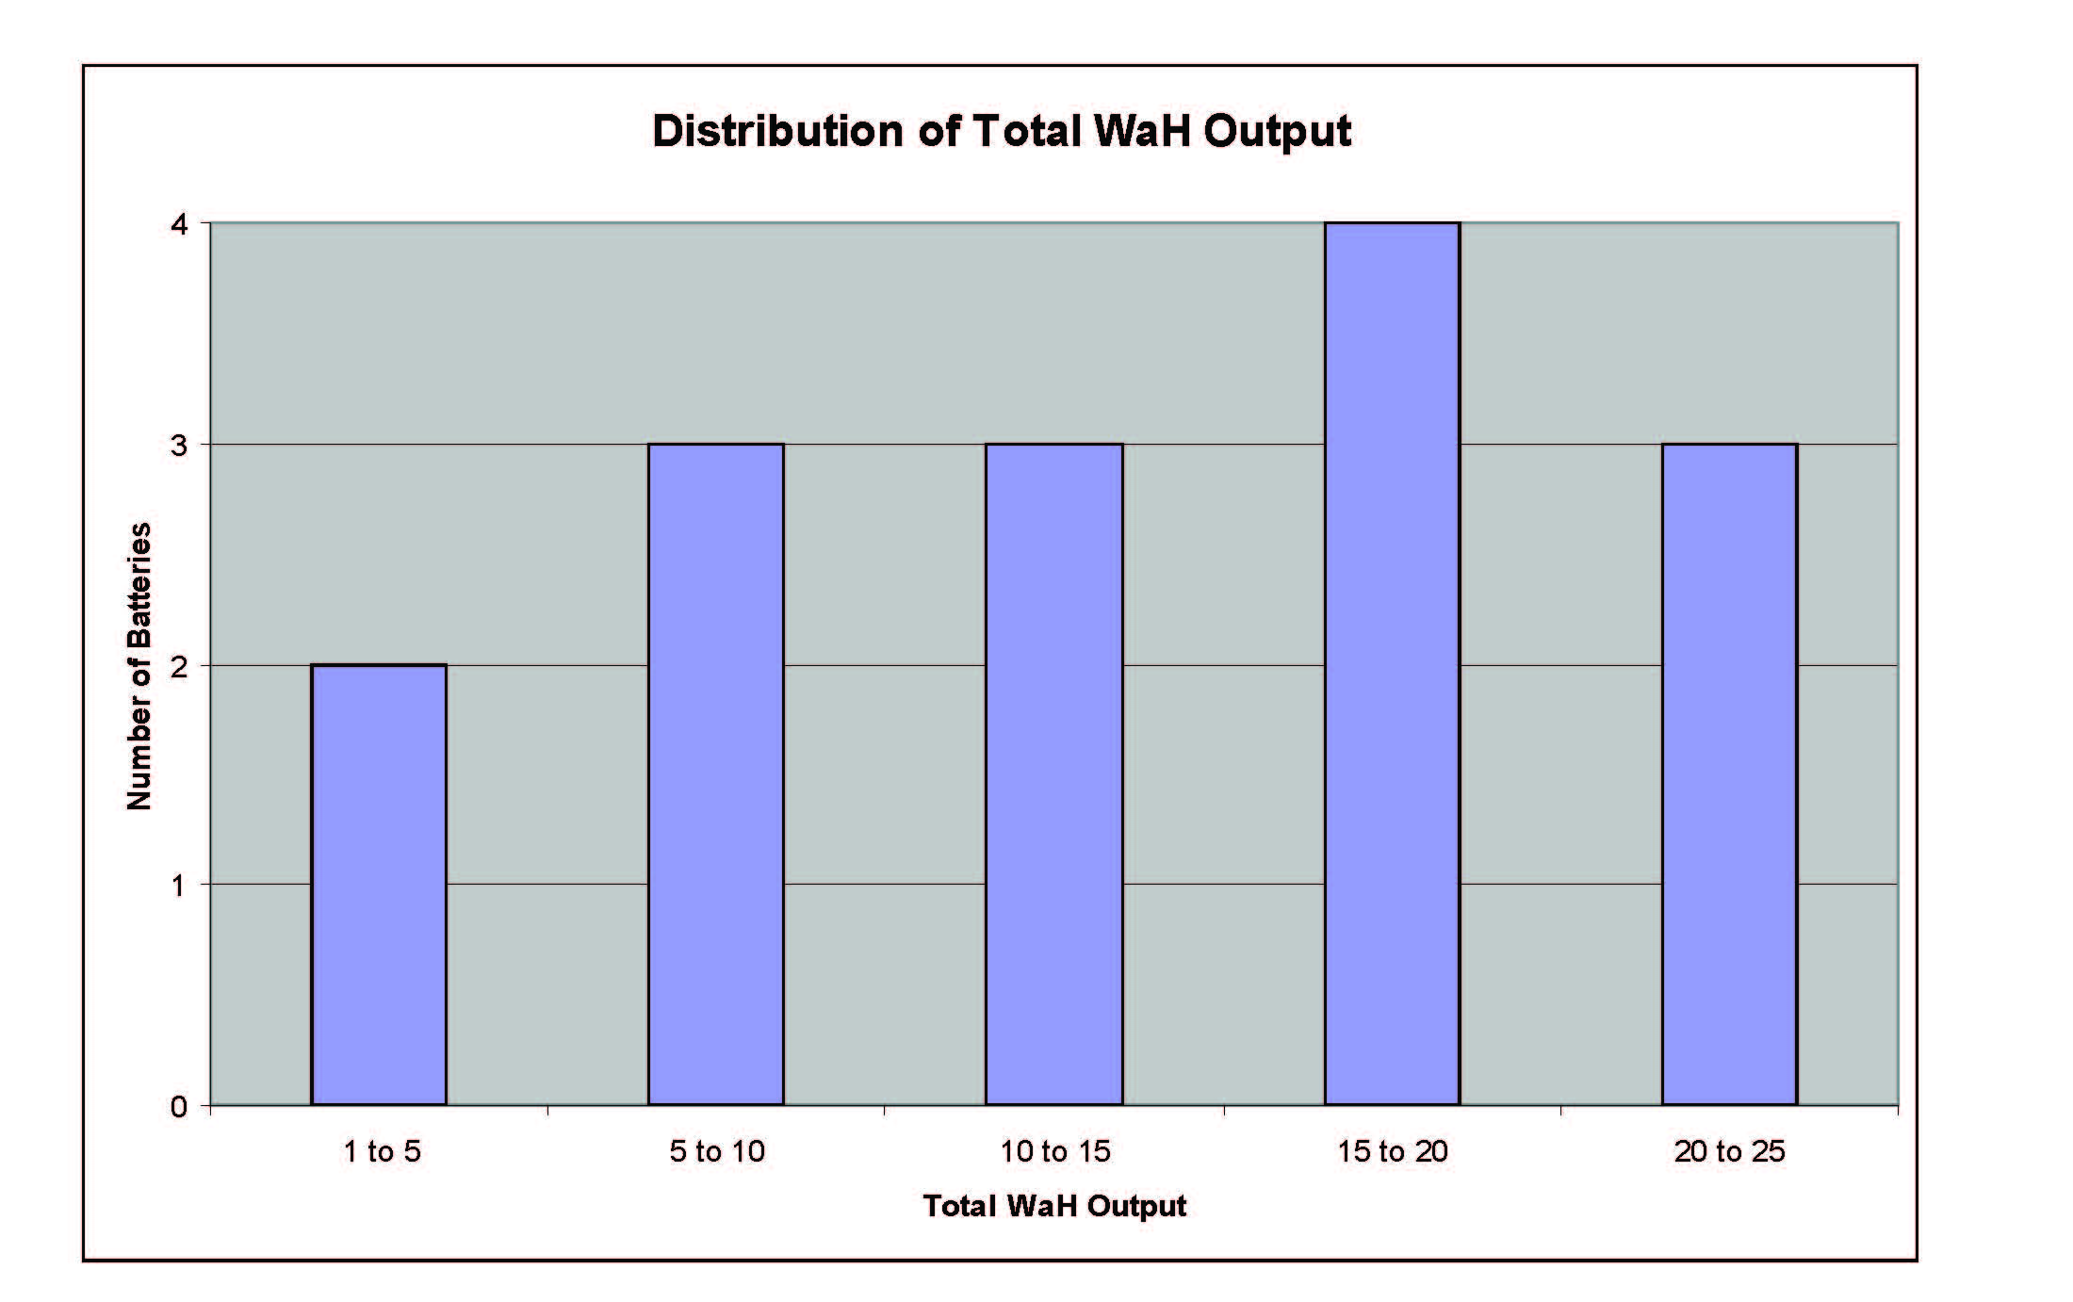
What is a Good Total WaH Output?
Good
Questionable
Okay
Great
Trash
Notes:
So, after you determine the WaH output of your batteries, you want to know how to apply that to what you should do with your batteries.
This is a chart of the batteries we tested one broken down into groups based on their total Watt hour output. Each bar represents how many batteries fell into that range out of our fifteen batteries tested. [POINT] The highest group we called great batteries. We will use those for finals matches at competitions. The next tier below that we call good batteries. We will use those for qualifying matches at competitions. Under that, we have okay batteries. We will reserve those for testing on our practice field. The next tier is questionable batteries. We will have to decide whether to throw those away or use them for testing. The lowest group is garbage. They output well under what we want for a match and don’t even last long enough for testing robots back at the buildspace. We will dispose of those.

Slide 30
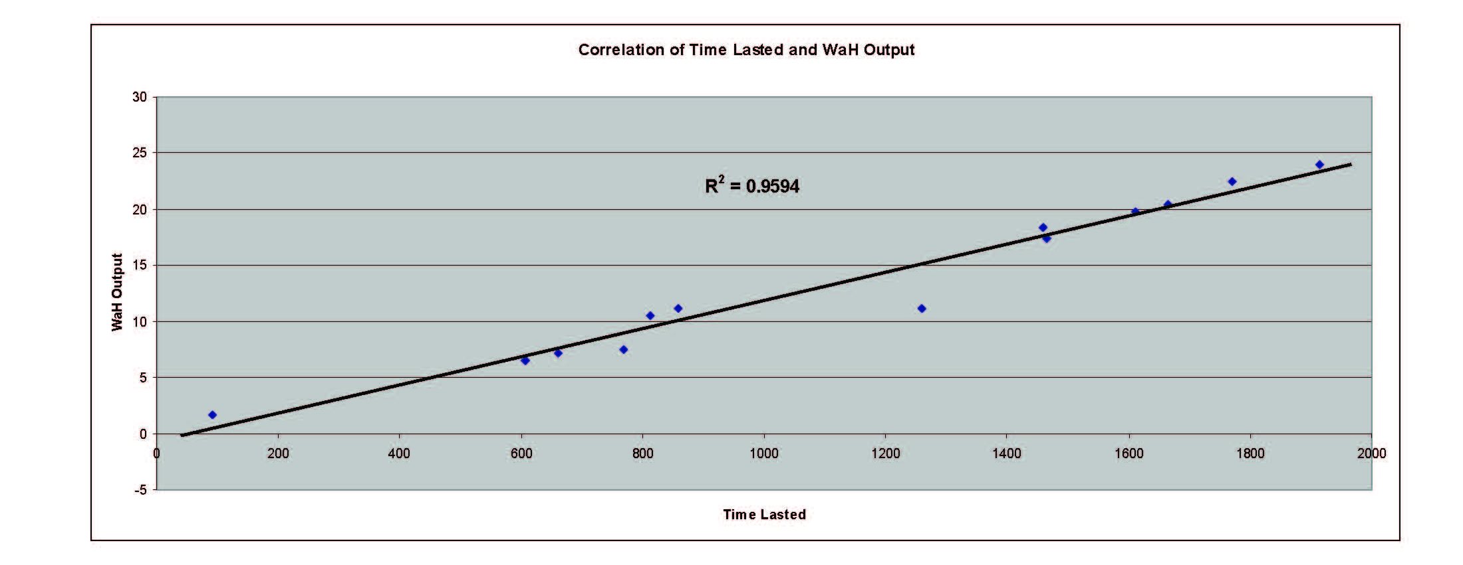
Does Time Lasted Predict Battery Health?
Notes:
Since Watt hour output is our best measure of battery health, we compared Static Load and Internal Resistance test results to it to see whether they were valid ways to determine battery health.
After eliminating one outlier, the correlation between the amount of time the battery lasted during the static load test and the total Watt hours it output had an R squared value of .9594, meaning that it was a strong correlation. That means the static load test provides a good indicator of battery health.

Slide 31
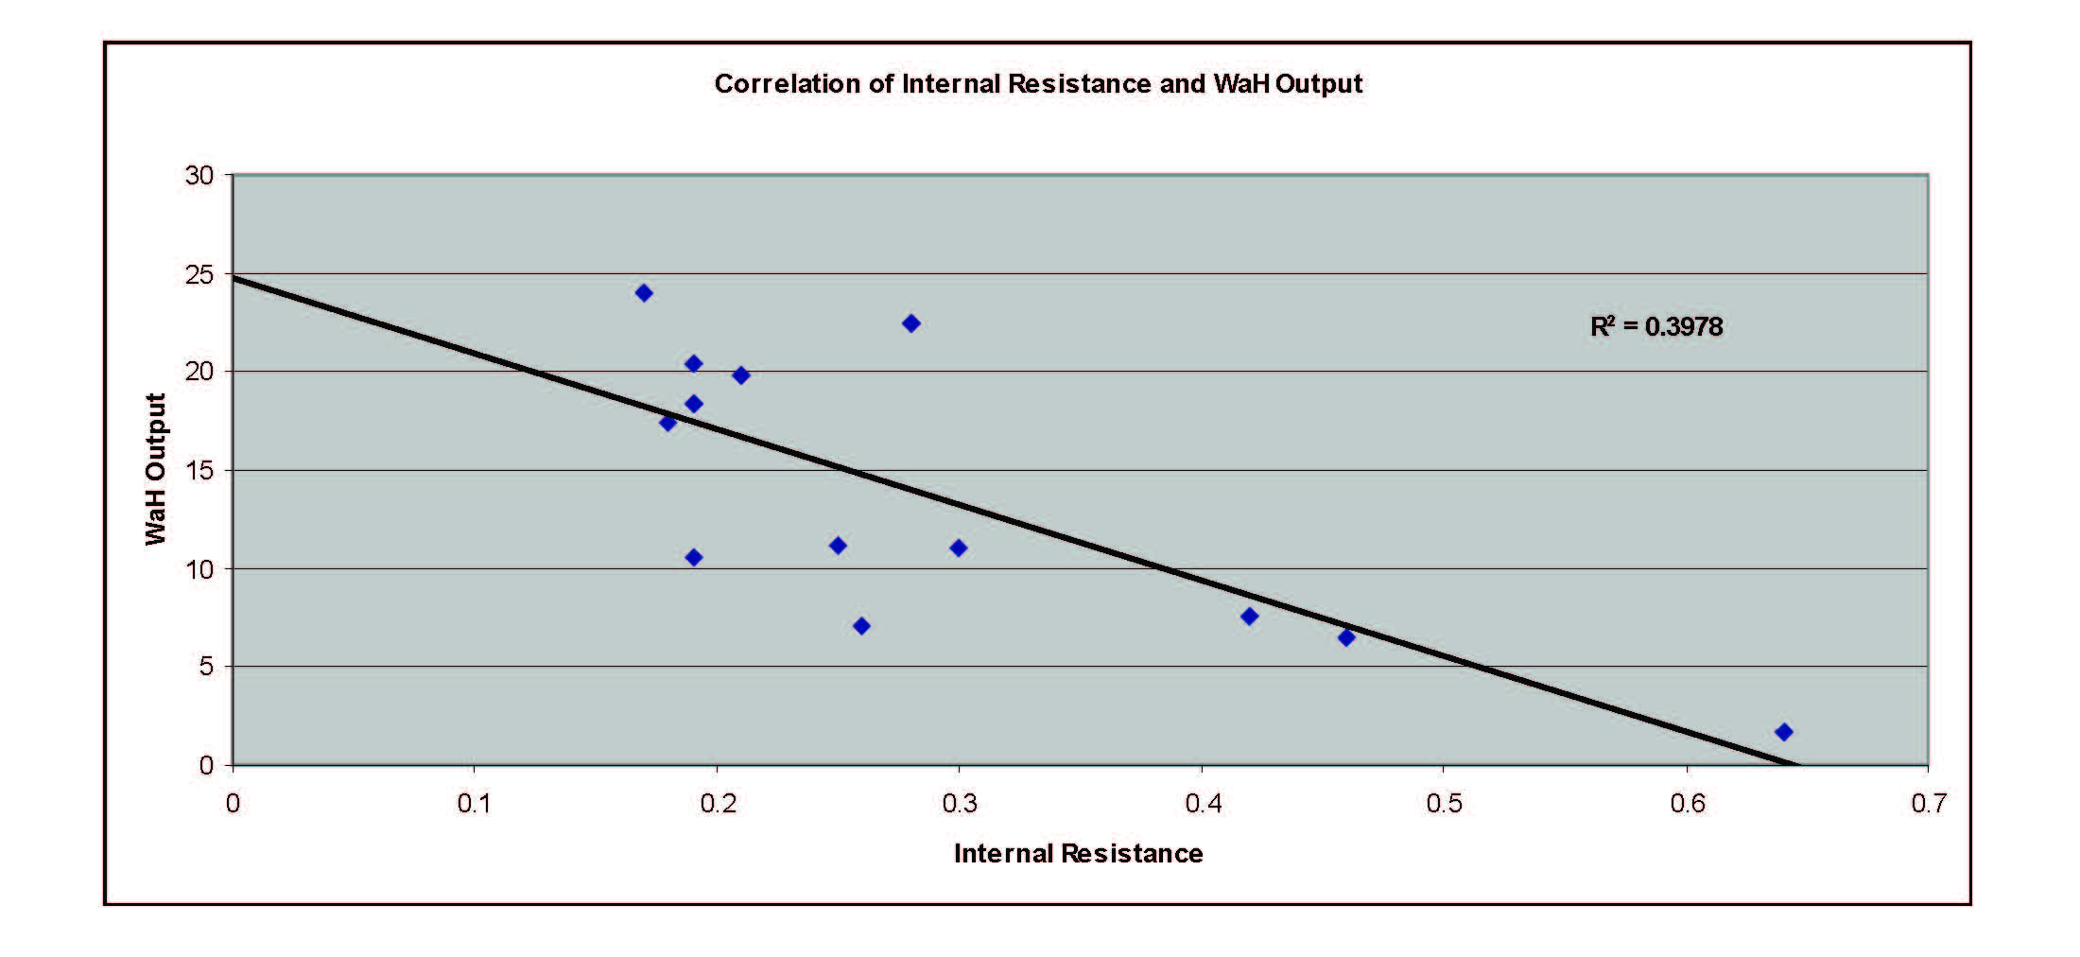
Does Internal Resistance Predict Battery Health?
Notes:
We hoped to use internal resistance as a measure of battery health because it is quick to test and does not drain the battery, but when we correlated internal resistance to Watt hours output, it had an R squared value of .3978, meaning there was an extremely weak correlation. So unfortunately, we have not yet found a way to reliably correlate internal resistance with battery health.
What we did find was that internal resistance on a bad battery will sometimes be less than.3 Ohms, but we have not discovered any good batteries with internal resistance of more than.3 Ohms. That allows us to weed out some bad batteries with an internal resistance test.
However, I found a document online from a company called Albercorp saying that they found internal resistance to be a very reliable indicator of battery health. Since they have successfully done this, we will continue to explore internal resistance as a convenient test of battery health.

Slide 32
Testing with a Multimeter
-Can a multimeter alone be used to evaluate battery health?
-Yes. A reading of less than ~13v right after charging indicates a battery that probably should not be used in a match
-No. Some (bad) batteries show 14+v right after charging (open circuit), but fall to less than 12v within minutes of being loaded, like our earlier example
Notes:
Can a multimeter be used to test battery health? The answer is yes and no.
Yes in that a multimeter can detect bad batteries with low open circuit voltage, and no in that as you saw on the last couple slides, freshly charged “bad” batteries can have an open circuit voltage reading of 14 or more.
So a multimeter can be used to weed out bad batteries when there is an open circuit voltage of less than about 13 volts. If the open circuit voltage is more than 13 volts, that is a candidate for a good battery, but additional testing is required.
With a load applied, you can use a multimeter to monitor and log voltage over time by writing it down, but that is a pain.
By using a voltage sensor and software, this testbed allows us to record voltages over time automatically instead of writing it down.
I’ll be saving these charts and retesting these same batteries next fall to see how they hold up over time.

Slide 33
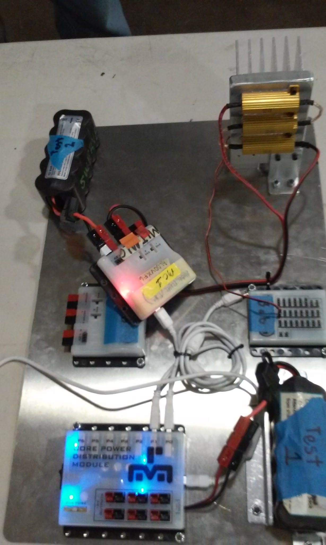
Testing Other Components
-We re-configure the testbed per current needs
-Any component can be swapped in
-Core Device Interface Module allows for the
addition of sensors as needed
-Performed numerous “is this working?” tests
Notes:
This picture was taken with the second configuration of the testbed. The motor controller with the yellow label (point) has been swapped in and is being tested because the team it belonged to thought it was questionable. The testbed has the ability to do this with components other than a motor controller, like the core device interface module, or sensors plugged into it.
Setting this test up was quick and easy because of how we used anderson power poles for all our connections.

Slide 34
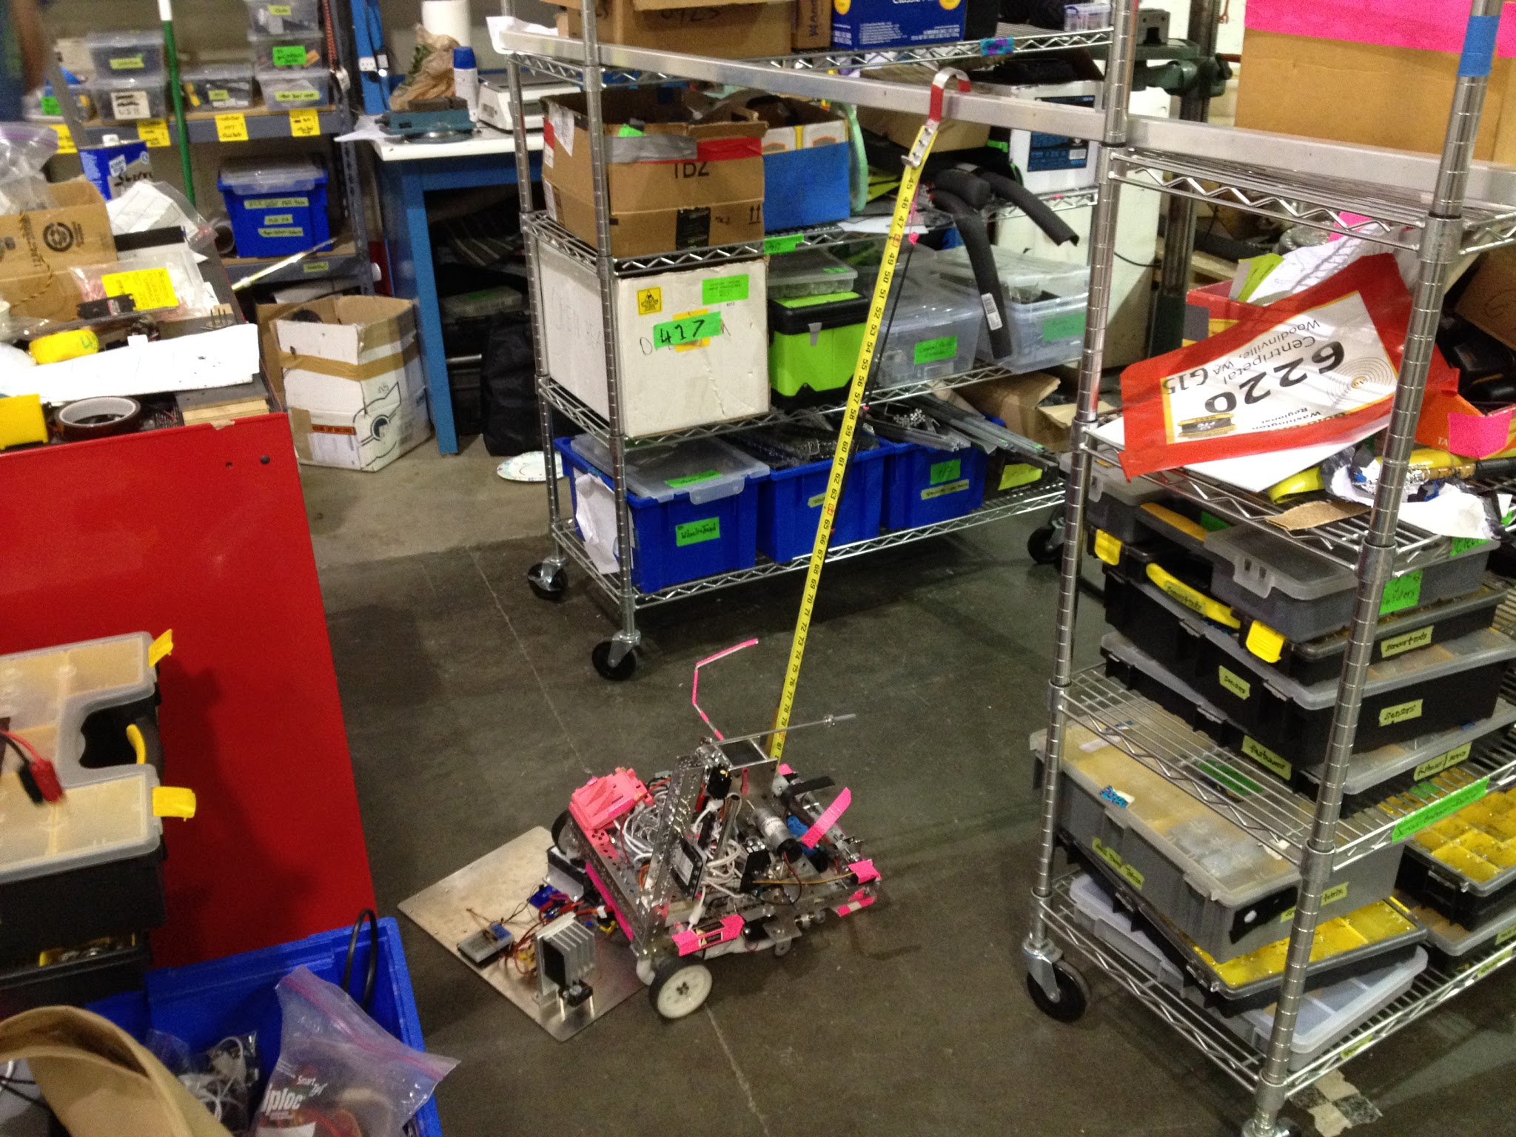
Testing Power Draw
-Tested current required by 6220 during a hang
-Used testbed battery to power the
controller used for hanging
-Measured max draw of 10.3 amps
Notes:
This picture shows an example where we used the testbed to measure the amount of current 6220 needs to hang. 6220 was struggling with not having enough battery power to hang, so after this test, they reduced their amperage draw by giving less power to some motors so as not to exceed what their battery can provide at the end of a match.
To make this reading we used a long power cable between the testbed and the robot (point to where it plugged in), using the test battery to power their hanging motors. An OpMode program displayed the current draw on the phone screen.
We measured a maximum draw of 10.3 amps. The current sensor we used was not capable of measuring that much current, so we replaced the shunt resistor on the sensor with a .03 ohm resistor which increased the sensor’s range from 3.2 amps to 10.67 amps.

Slide 35
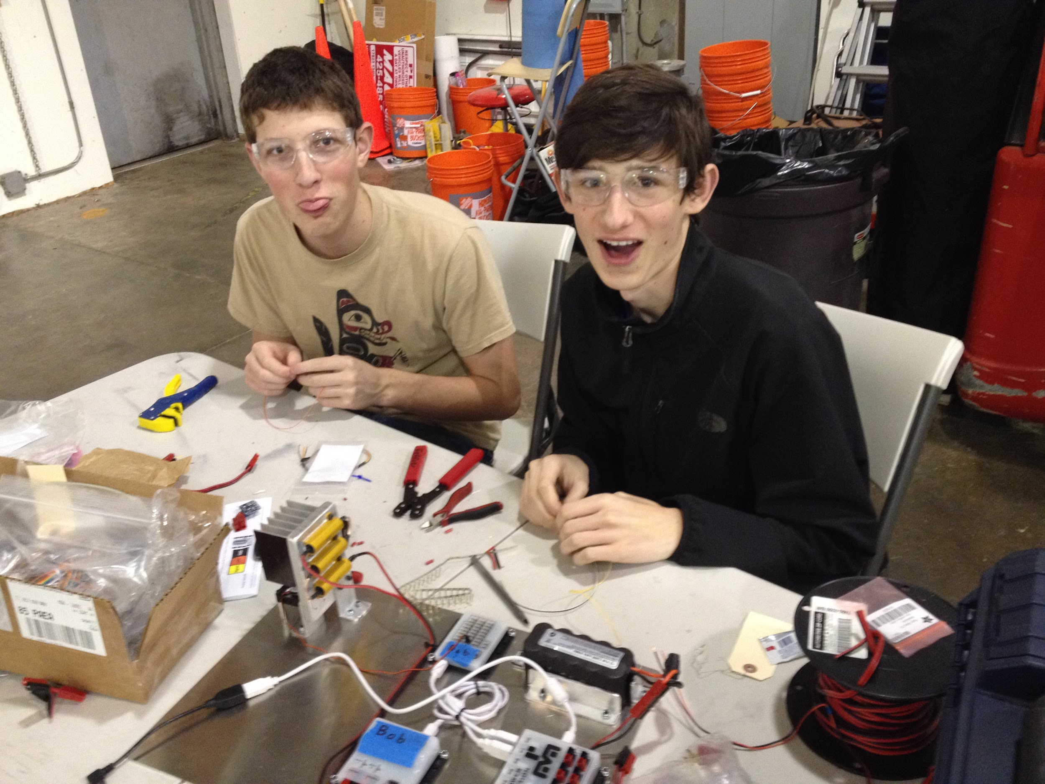
Key Learning and Experience
-Ohm’s law
-Deeper understanding of batteries
-Testbeds can dramatically simplify the
process of isolating problems
-Presenting findings of project
Notes:
This is my friend, Hank, who helped me with attaching some of the connectors on the wires.
During this project, I learned what amperage, voltage, and resistance are, and how they pertain to robots. I learned about using Ohm’s law to calculate what will happen when a circuit is powered.
I also learned about transistors, relays, resistors, how to use them, what makes a good battery, a bad battery, and how to spot them. After collecting the data, I learned more than I wanted to about how to create charts in excel and how it can be useful for analyzing data.
Much of what I discovered is valuable for FTC as a whole because it allows teams to choose batteries that will reliably get them through a match.
Swerve now has a very useful tool to test batteries and other robot components by themselves. We will continue to use this tool for seasons to come.
I also learned about creating and giving an effective presentation.

Slide 36
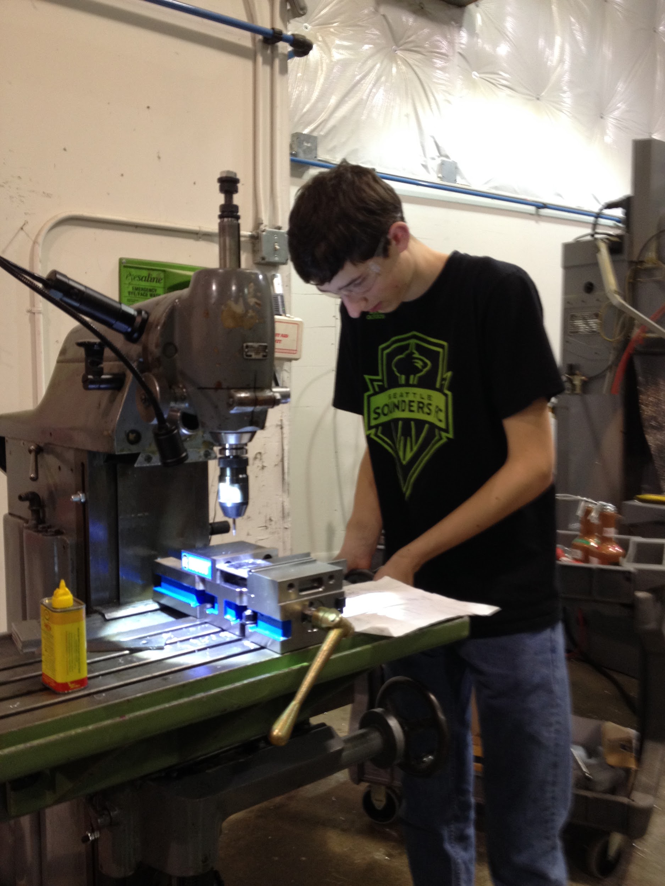
Wrap up
PICTURE OF SIG using shop equipment
-Excellent project for experienced students
-This presentation, the code used, the wiring diagram, and some battery test results files as well as more details of this project are posted on our website: http://swerverobotics.org
-Thank you for attending this presentation!
-Q&A
Notes:
I would encourage every club to build a testbed. Both for the experience of building one, as well as for the value it brings as a testing device for batteries and robot components.
I encountered an amazing number of nuances with FTC technologies that could potentially negatively impact robot performance if not accounted for. I will post more information about these to our website.
As we use this testbed over the next few years, we will surely find more uses for it, ways to expand it, and along the way, we’ll uncover and learn more of these cool nuances, which can be shared with and benefit the FTC community.
This presentation, the wiring diagram, the URL to the albercorp document, and some battery test results as well as other findings that I did not have time to cover in this presentation will shortly be on the Swerve Robotics web page.
After this conference is over, this testbed will be in 6220’s pit at fire 47 and you can drop by if you would like to test any modules or batteries.
After questions if anyone wants to stick around, I’ll go over how internal resistance is calculated then I’ll demonstrate an internal resistance test on one of the batteries I brought with me.
Thank you all for attending.
Questions you may be asked:
Q: What are you going to add next to the testbed?
A: I will make it so that internal resistance is done at the same time as the static load test as well as try to find a less time consuming way of measuring battery health.
Q: What size of relays did you use and what would be a more reasonable size?
A: I do not know the size I used, but we have at most 5 amps and 14 volts, so I’d say 70 watt relays should be sufficient.

Slide 37
Calculating Internal Resistance
14.27,0.00 12.46, 3.20 internal resistance: 0.47 Ohms
I = V/R
That data gives us two points:
(14.27,0.00) and (12.46, 3.89)
I₁ = 0
I₂ = V₂ / R₂
I₂ = 12.46/3.2
I₂ = 3.89
We find the slope between those points using the slope formula:
m = ΔV/ΔI = (V₂-V₁)/(I₂-I₁)
m = (12.46-14.27)/(3.89-0)
m = -.47 Ohms
m = .47 Ohms
Notes:
Okay, if anybody wants to stick around, I’ll demonstrate how to calculate internal resistance and an internal resistance test.
So, let’s look at what actually happens when calculating the internal resistance.
[Click slide]
This is the data that gets recorded in the file on the phone. The program automatically calculates the internal resistance, but I will go over how it is done. The first number recorded is voltage and the second is resistance.
[Click slide]
We had an issue with our current sensing, so we have to calculate it manually using Ohm’s law. In the first measurement of open circuit voltage, there is no current so the current is 0.
[Click slide]
In the second measurement, there are 12.46 volts with 3.2 ohms of resistance, giving us 3.89 amps of current.
[Click slide]
Now, we have two coordinate points. We graph them with current on the x axis and voltage on the y axis.
[Click slide]
We plug the coordinates into the slope formula and it comes out as -.47 ohms, but it only comes out as negative because our line is sloped down.
[Click slide]
After multiplying our resistance by negative one, we see that this battery has .47 ohms of internal resistance. That is above our .3 Ohm cutoff. This is a bad battery.
If anyone wants to stick around and see an internal resistance test, they can come up to the front to see the phone screen. Anybody is welcome to stop by 6220’s pit, fire 47, to test batteries or other components.
Thank you all for coming and good luck at competition.

