Slide 1
Go Ahead, Be Disruptive
Everything is changing…
Including the pace of change

Slide 2
Credit Where It is Due…

Slide 3
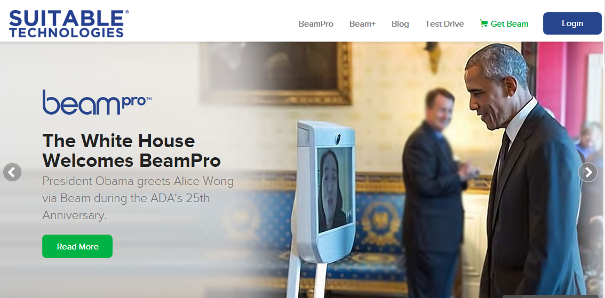
Thank You Suitable Technologies and FIRST! Kevin Rogers, Taylor Sewitt, Jamie Sachs

Slide 4
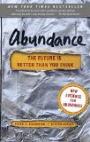
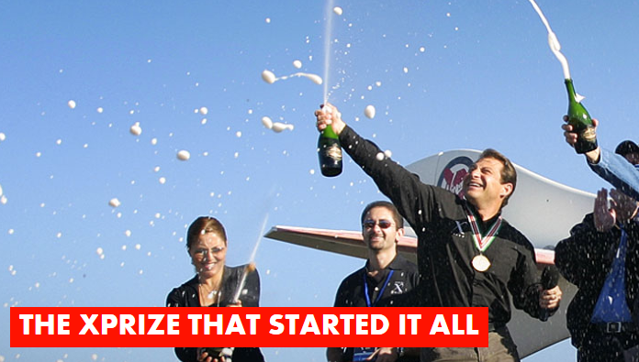
Thank You Peter Diamandis!

Slide 5
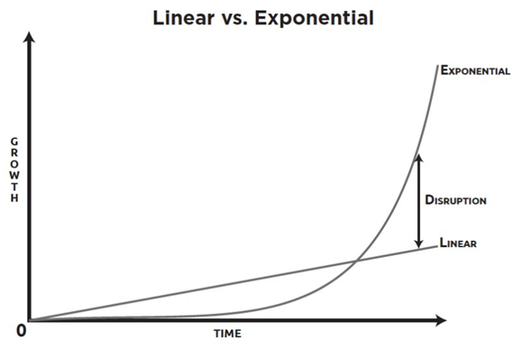
Agenda: Exponentials, Disruption, FIRST, and Your Career(s)
Deceptive

Slide 6
My hopes for this discussion
Entertain, Educate, and Inspire
Exponential / Disruptive Technologies
Innovation
Exponentials and FIRST
Exponentials and new STEM careers
Continuous improvement opportunity for FIRST
The mission of FIRST is to inspire young people to be science and technology leaders, by engaging them in exciting Mentor-based programs that build science, engineering, and technology skills, that inspire innovation, and that foster well-rounded life capabilities including self-confidence, communication, and leadership.

Slide 7
Introduction to Exponentials and Disruptive Technologies

Slide 8
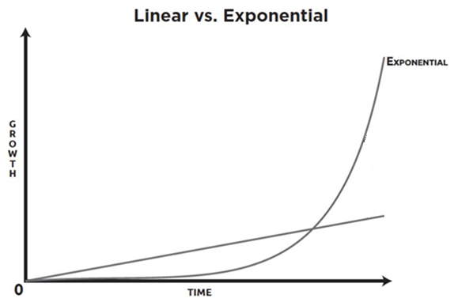
The “6 Ds” of Exponential Technologies
Dematerialized
Smartphones dematerialized many products
Demonetized
Skype: long distance calls. Beam: travel
Democratized
Smart phones >> Bill Clinton
Digitized
Required for Moore’s law to apply.
Deceptive
7 doublings
Disruptive
Disrupt or be disrupted. Uber, Kodak.

Slide 9
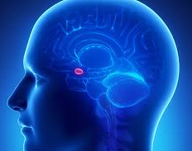
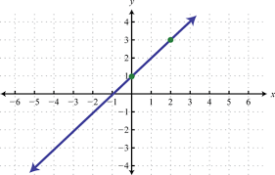
Our hard-wired challenge

Slide 10
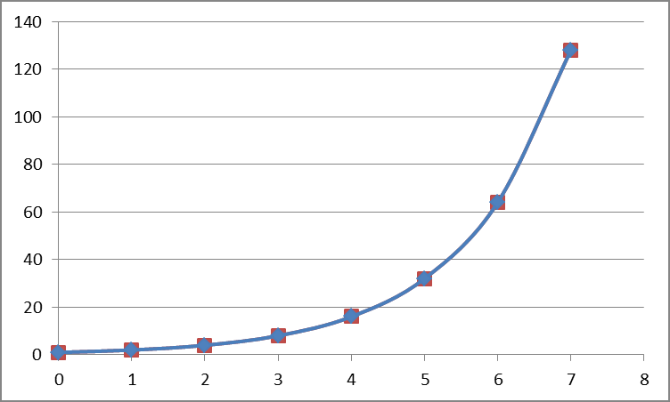
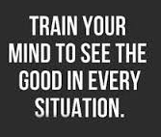
Innovation requires different thinking

Slide 11
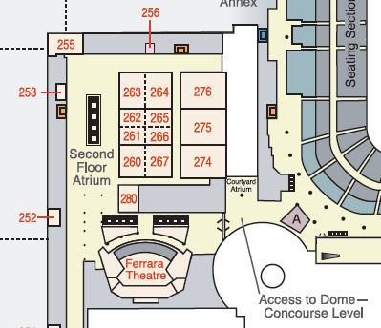
Experience Exponentials: Walking
You are Here
You are Here…
26 times
13 orbits come on the last step

Slide 12
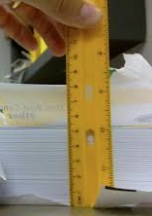
Experience Exponentials: Folding Paper
Stack 50 Sheets of Paper
Fold One Sheet of Paper 50 Times

Slide 13
Experience Exponentials: Lily Pads
A pond has 1 Lily pad.
The Lily pads double every day.
On day 20 the pond is full.
When is it half full?

Slide 14
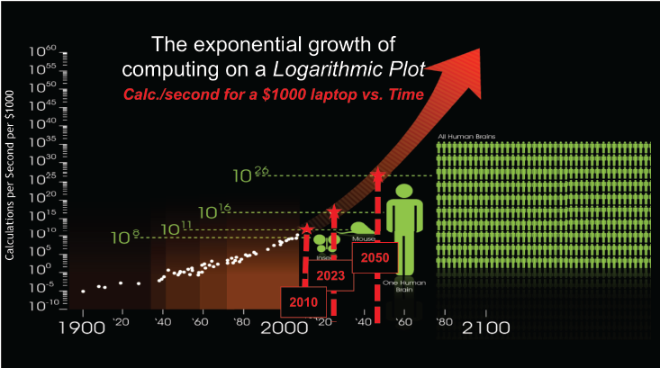
Experience Exponentials: Kurzweil Curve
more than

Slide 15
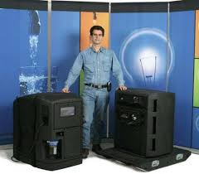
The truth and myth of “overnight success”
Change happens in a hurry
15 years for overnight success

Slide 16
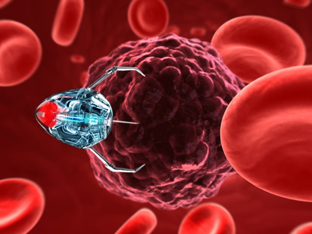
Kurzweil Take 2: Some Exponential Predictions
Most Americans trust AI to read/reply to their email
2027
Computers pass the Turing Test
2029
3D Print Food, housing, cars, clothes, jet engines
Today – technically yesterday. Trick question
Viral disease, bacterial disease, and cancer defeated
2033

Slide 17
Great, but how does this all relate to FIRST?

Slide 18
Some of today’s important exponential technologies
Robotics / ROS
IOT
3D printing
AR / VR
Sensors
AI
Infinite Computing
Drones
Deep Learning
Neural Networks
Mobile Technology
Material Sciences
Nanotechnology
Autonomous Control
Hyper-connectivity
Natural Language
Crowd Sourcing
Machine Learning

Slide 19
Strong correlation to FIRST
Robotics / ROS
IOT
3D printing
AR / VR
Sensors
AI
Infinite Computing
Drones
Deep Learning
Neural Networks
Mobile Technology
Material Sciences
Nanotechnology
Autonomous Control
Hyper-connectivity
Natural Language
Crowd Sourcing
Machine Learning

Slide 20
Question: Does FIRST’s mission demand more?
Note to GDC:
Drone submarine water game confirmed!
Robotics / ROS
IOT
3D printing
AR / VR
Sensors
AI
Infinite Computing
Drones?
Deep Learning
Neural Networks
Mobile Technology
Material Sciences
Nanotechnology
Autonomous Control
Hyper-connectivity
Natural Language
Crowd Sourcing
Machine Learning

Slide 21
OK, now how does it relate to my career(s)?

Slide 22
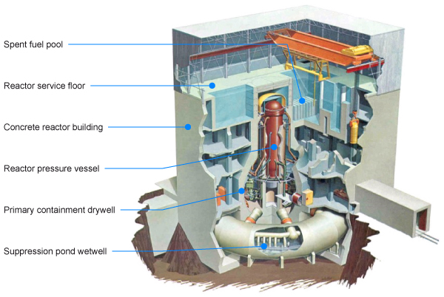
Anyone recognize this?

Slide 23
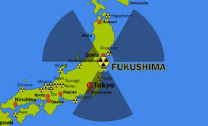
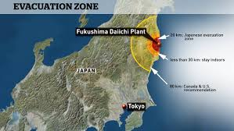
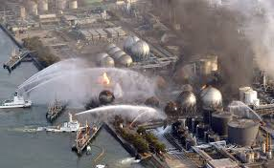
How about now?

Slide 24
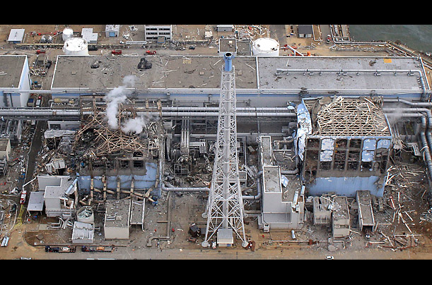
How do Fukushima and exponentials relate to my careers?
“… not even robots [can enter] the main fuel-debris areas [yet].”
“... a textbook doesn’t exist for something like this.”
“… [optimistically] the work will take about half a century…”
“… New science will have to be invented…”
Fukushima decommission chief, Naohiro Masuda, Dec 15, 2015

Slide 25
Challenges
What careers can you create using exponentials?
What will you do to stay in touch with progress?
What new science will you unveil?
What can you suggest to FIRST to ensure our game challenges don’t fall behind the exponentials?
What can FIRST do to incorporate more exponential technologies into game design at all levels?

