Slide 1
Inspiring Women in STEM
Presented by Aaron Willcock

Slide 2
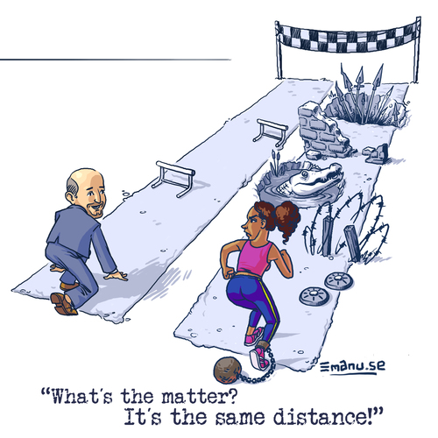
Overview
Background & Motivation
Anecdotes
Session Goals
Problems
Challenges
Countermeasures
Tools
Conclusion: Takeaways
Discussion

Slide 3
Background and Motivation

Slide 4
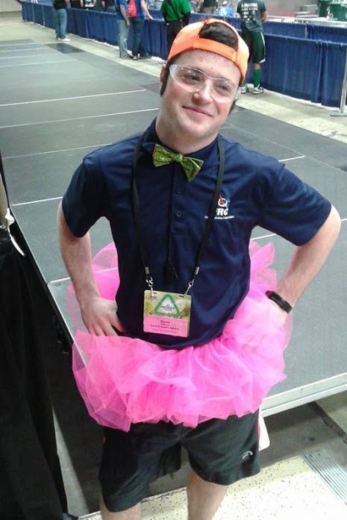
Background
ThunderChickens 217 (2011-2012)
Mentor (2014-present)
Volunteer (2013-present)
FIRST Technical Advisor (FTA)
Control System Advisor (CSA)
Cross the Road Electronics (2013-2015)
CS PhD Student Wayne State (2016 - a long time)

Slide 5
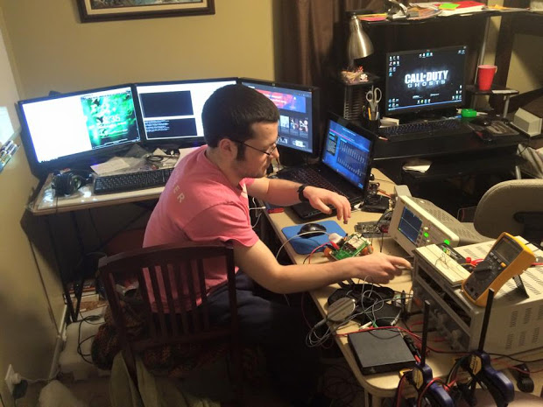
Motivation
No understanding of gender gap
No experiences with intolerance
Industry and FIRST provided perspective
Mentor behavior
Student blame
Inclusion / Exclusion
Realization and research

Slide 6
Anecdotal Evidence

Slide 7
Anecdotal Evidence - Look Pretty
“Just stand there and look pretty. You’re doing a great job!”
Context: Lifting heavy objects

Slide 8
Anecdotal Evidence - It’s because a girl did it
“That’s what happens when the girls plug in the battery”
Context: Lost match and did not function because battery connection became undone

Slide 9
Anecdotal Evidence - Because it’s a woman
“It’s because a woman programmed it”
Context: Bug in code preventing robot operation

Slide 10
Anecdotal Evidence - Who’s the other FTA?
“There are two FTA’s here? Where’s the other one?”
Context: Working with the only female FTA in Michigan, often goes unrecognized

Slide 11
Challenges

Slide 12
The first step in solving a problem...
“The first step in solving any problem is recognizing there is one” - Will McAvoy, The Newsroom
Women face challenges in STEM pathways that are not always incurred elsewhere

Slide 13
Stereotypes
“Female engineering students held weaker implicit gender-math and gender-reasoning stereotypes” [1]
STEM is not correlated with Women

Slide 14
Stereotype Threat
“Women’s impaired performance, occurring on the math items only (i.e., specific to the domain in which women are negatively stereotyped) suggests an influence of psychological and interpersonal processes on seemingly objective test outcomes” [2]

Slide 15
Organizational Practices
“Formal and covert organisational practices, which upheld gender discrimination and bias, were the main challenges that women face” [3]
“Lack of confidence in women’s competence” [3]

Slide 16
Countermeasures: Resistance to Challenges

Slide 17
Resistance to Challenges
“Elements of women’s resilience included the use of femininity, adopting male characteristics, mentorship, and intrinsic motivational factors” [3]
Focus on factors we can influence

Slide 18
Why So Few
Women have coping mechanisms, have clearly been successful, are progressing in the field… why still so few?
Networking practices overlook women [4]
Ex. Position held by a male, replaced by a male

Slide 19
Best Practices by Organizations
Fill leadership positions with competent women
The path must be repeatable
Provide mentorship
Support from the very top of the organization [4]

Slide 20
Advisability?
Why encourage women to enter a field with so many challenges?
“It is essential for companies to have the most talented people, whatever their gender or race” [4]

Slide 21
Tools: Mentoring

Slide 22
Mentoring: Project Kaleidoscope
Program for building leadership skills, agency, teamwork, communication, and performance [5]
Kolb Experiential Learning Cycle
“Cycle begins with a concrete experience - an event or exercise in which the learner actively participates”
Reflect on what happened
Expand on it, “So what?”
Apply it to the “real world” [5]

Slide 23
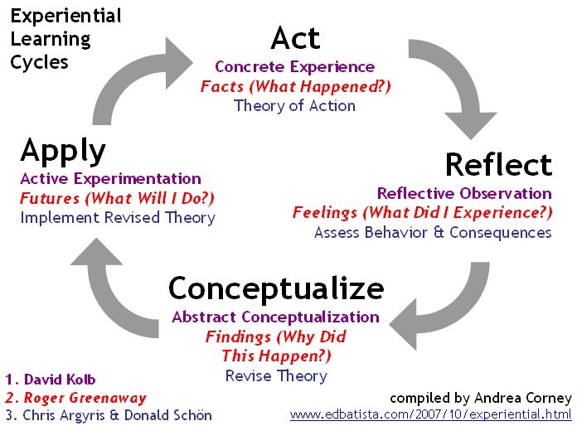
Kolb Experiential Learning Cycle
CAD Sheet Metal
Program a robot to drive forward
Crimp / wire a motor

Slide 24
Tools: Leadership

Slide 25
Participative Leadership
“Participative leadership has a positive relationship with job performance” [6]
Participatory leadership improves performance, mediated via trust between employer and intern
Ask for input on decisions, incorporate ideas

Slide 26
Empowered Leadership
“Empowering leadership positively affected psychological empowerment, which in turn influenced both intrinsic motivation and creative process engagement” [7]
Recall: Intrinsic motivation - one of women’s resistance to challenges
Creative process = Ancillary benefit

Slide 27
Implementing P.L. and E.L.
Create / fill positions with women
Female role models are strong motivators [4]
Be supportive through care and consideration
Likely easier for female mentors
Pause to show importance to overall goal
Excellent vision code! It’ll make for a smooth auton
Express confidence, reinforce after setbacks
You have to believe
Provide autonomy, avoid “helicoptering”

Slide 28
Tools: Shame Resilience Theory

Slide 29
Shame Resilience Theory: Overview
Brené Brown - BSW, MSW, PhD
Framework for understanding impact of shame on women, triggers, and countermeasures [8]
Identifies socio-cultural expectations that form a web of shame triggers

Slide 30
Shame Resilience Theory: Definitions
Shame = I am a bad programmer
Flaw is within the individual [8]
Guilt = I made a poor code choice
Flaw is in a decision, NOT self [8]
Growth = I can find a better way
Flaw is in a decision, NOT self AND room to grow

Slide 31
Tools: SRT Countermeasures

Slide 32
SRT - Empathy, Vulnerability
When sharing doubts about a task, understand, take, and feel another’s perspective [8]
Be vulnerable, share from your own experiences
Ford plant window + My First Auton

Slide 33
SRT - Reach Out, Don’t Shame
Provide an environment where reaching out for help is safe
Do not reinforce stereotypes
Ex. Problem was because of arithmetic error, not gender
Don’t shame failures, understand the difference between shame and guilt
Combat self-degrading attitudes

Slide 34
Progress & Regression - Personal Experience
Provided the right environment, growth occurs, often quickly and superficially
Continue P.L., E.L., and SRT regardless of forward progress
Counter regression after mistakes with SRT and an understanding of Imposter Syndrome

Slide 35
Tools: Imposter Syndrome

Slide 36
Imposter Syndrome
“Psychological phenomenon in which people are unable to internalize accomplishments” [9]
“Proof of success is dismissed as luck, timing, ... deceiving” [10]
“Notably, imposter syndrome is particularly common among high-achieving women” [10]
Take the syndrome as a sign you’re doing your job

Slide 37
Conclusion: Takeaways

Slide 38
Takeaways (1/2)
Women in STEM face a number of challenges
Resistance:
Mentors, female role models, intrinsic motives, support networks
Empowering & Participatory Leadership
Place women in lead positions, highlight contribution, confidence, autonomy
Kolb Cycle + Lead positions
Opportunity to learn, gain confidence, and demonstrate capability to self

Slide 39
Takeaways (2/2)
SRT
Empathy, Vulnerability, Reaching out
Safe workspace: SRT + E.L.
Creativity through Mistakes
Respond to mistakes WITHOUT shaming
Use SRT + Imposter Syndrome to counter regression
Facilitate creativity through supportive, trusting leads

Slide 40
Closing Notes - Head Fakes
Inspired by Randy Pausch’s Last Lecture
FIRST is more than robots
Gold medals are nice
Life lessons are nicer
We cannot actualize another’s potential
They have the keys
We can convince students to use them
We can create a space that enables them to pursue their dreams

Slide 41
Acknowledgements (My Motivation)
Carina
Caitlin
Ellen
Kristen
Mom
My Students
For your courage, persistence, support, and inspiration

Slide 42
Citations
[1] Smeding A. Women in Science, Technology, Engineering, and Mathematics (STEM): An Investigation of Their Implicit Gender Stereotypes and Stereotypes’ Connectedness to Math Performance. Sex Roles. 2012;67:617-629.
[2] Koch SC, Konigorski S, Sieverding M. Sexist Behavior Undermines Women's Performance in a Job Application Situation. Sex Roles: A Journal of Research. 2014;70:79.
[3] Martin P, Barnard A. The experience of women in male-dominated occupations: a constructivist grounded theory inquiry. South African Journal of Industrial Psychology. 2013;39:1.
[4] National Academy of Sciences. Women Engineers: Why So Few? J Manage Eng. 1994;10:20-23.
[5] Elrod S, Kezar A. Developing Leadership in STEM Fields: The PKAL Summer Leadership Institute. Journal of Leadership Studies. 2014;8:33-39.
*[6] 2012 ANZAM Conference held at Perth Convention Centre, Perth, 2012-12-05to 2012-12-07
[7] Zhang X, Bartol KM. LINKING EMPOWERING LEADERSHIP AND EMPLOYEE CREATIVITY: THE INFLUENCE OF PSYCHOLOGICAL EMPOWERMENT, INTRINSIC MOTIVATION, AND CREATIVE PROCESS ENGAGEMENT. Academy of Management Journal. 2010;53:107.
[8] Brown B. Shame Resilience Theory: A Grounded Theory Study on Women and Shame. Fam Soc. 2006;87:43-52.
[9] Clance, P. R., & Imes, S. A. (1978). The imposter phenomenon in high achieving women: Dynamics and therapeutic intervention. Psychotherapy: Theory, Research & Practice, 15(3), 241-247. doi:10.1037/h0086006
[10] Clance, P. R., & Imes, S. A. (1978). The imposter phenomenon in high achieving women: Dynamics and therapeutic intervention. Psychotherapy: Theory, Research & Practice, 15(3), 241-247. doi:10.1037/h0086006
Kolb Cycle: http://www.edbatista.com/2007/10/experiential.html
Wall-E and M-O: http://www.lovepixar.com/character/m-o-the-cleaning-robot-from-wall-e/
Pink Elephant: Lemmling - https://openclipart.org/detail/17482/2d-cartoon-elephant
It’s the same Distance: Emanu - http://www.emanu.se/

