Slide 1
Effective Leadership
Strategies in FRC
Presented by Team 1885
ILITE Robotics

Slide 2
Effective Leadership Strategies in FRC
Welcome!
From ILITE Robotics
Team 1885
Notes:
Welcome everyone to the championship. Tell them how it is a huge accomplishment to be here. Thank them for coming: Reeya, Amr, Justine

Slide 3
Brief Team History
Effective Leadership Strategies in FRC
Notes:
Amr

Slide 4
ILITE History
Haymarket, Virginia
2005: Started as RoboCats
2008: Rebranded into ILITE
ILITE stands for Inspiring Leaders in Technology and Engineering
Notes:
Quick ILITE History to establish credibility as a team. Major awards- show them that we are effective and serious. Amr

Slide 5
ILITE History
FIRST Championship: Rookie All Star Award in 2005
FIRST Championship: Innovation in Control in 2014
6 Chairman’s Award for 5 consecutive years
5 Engineering Inspiration Award
3 FIRST Dean’s List Finalist Award
2 Woodie Flowers Finalist Award
Notes:
Quick ILITE History to establish credibility as a team. Major awards- show them that we are effective and serious. Amr

Slide 6
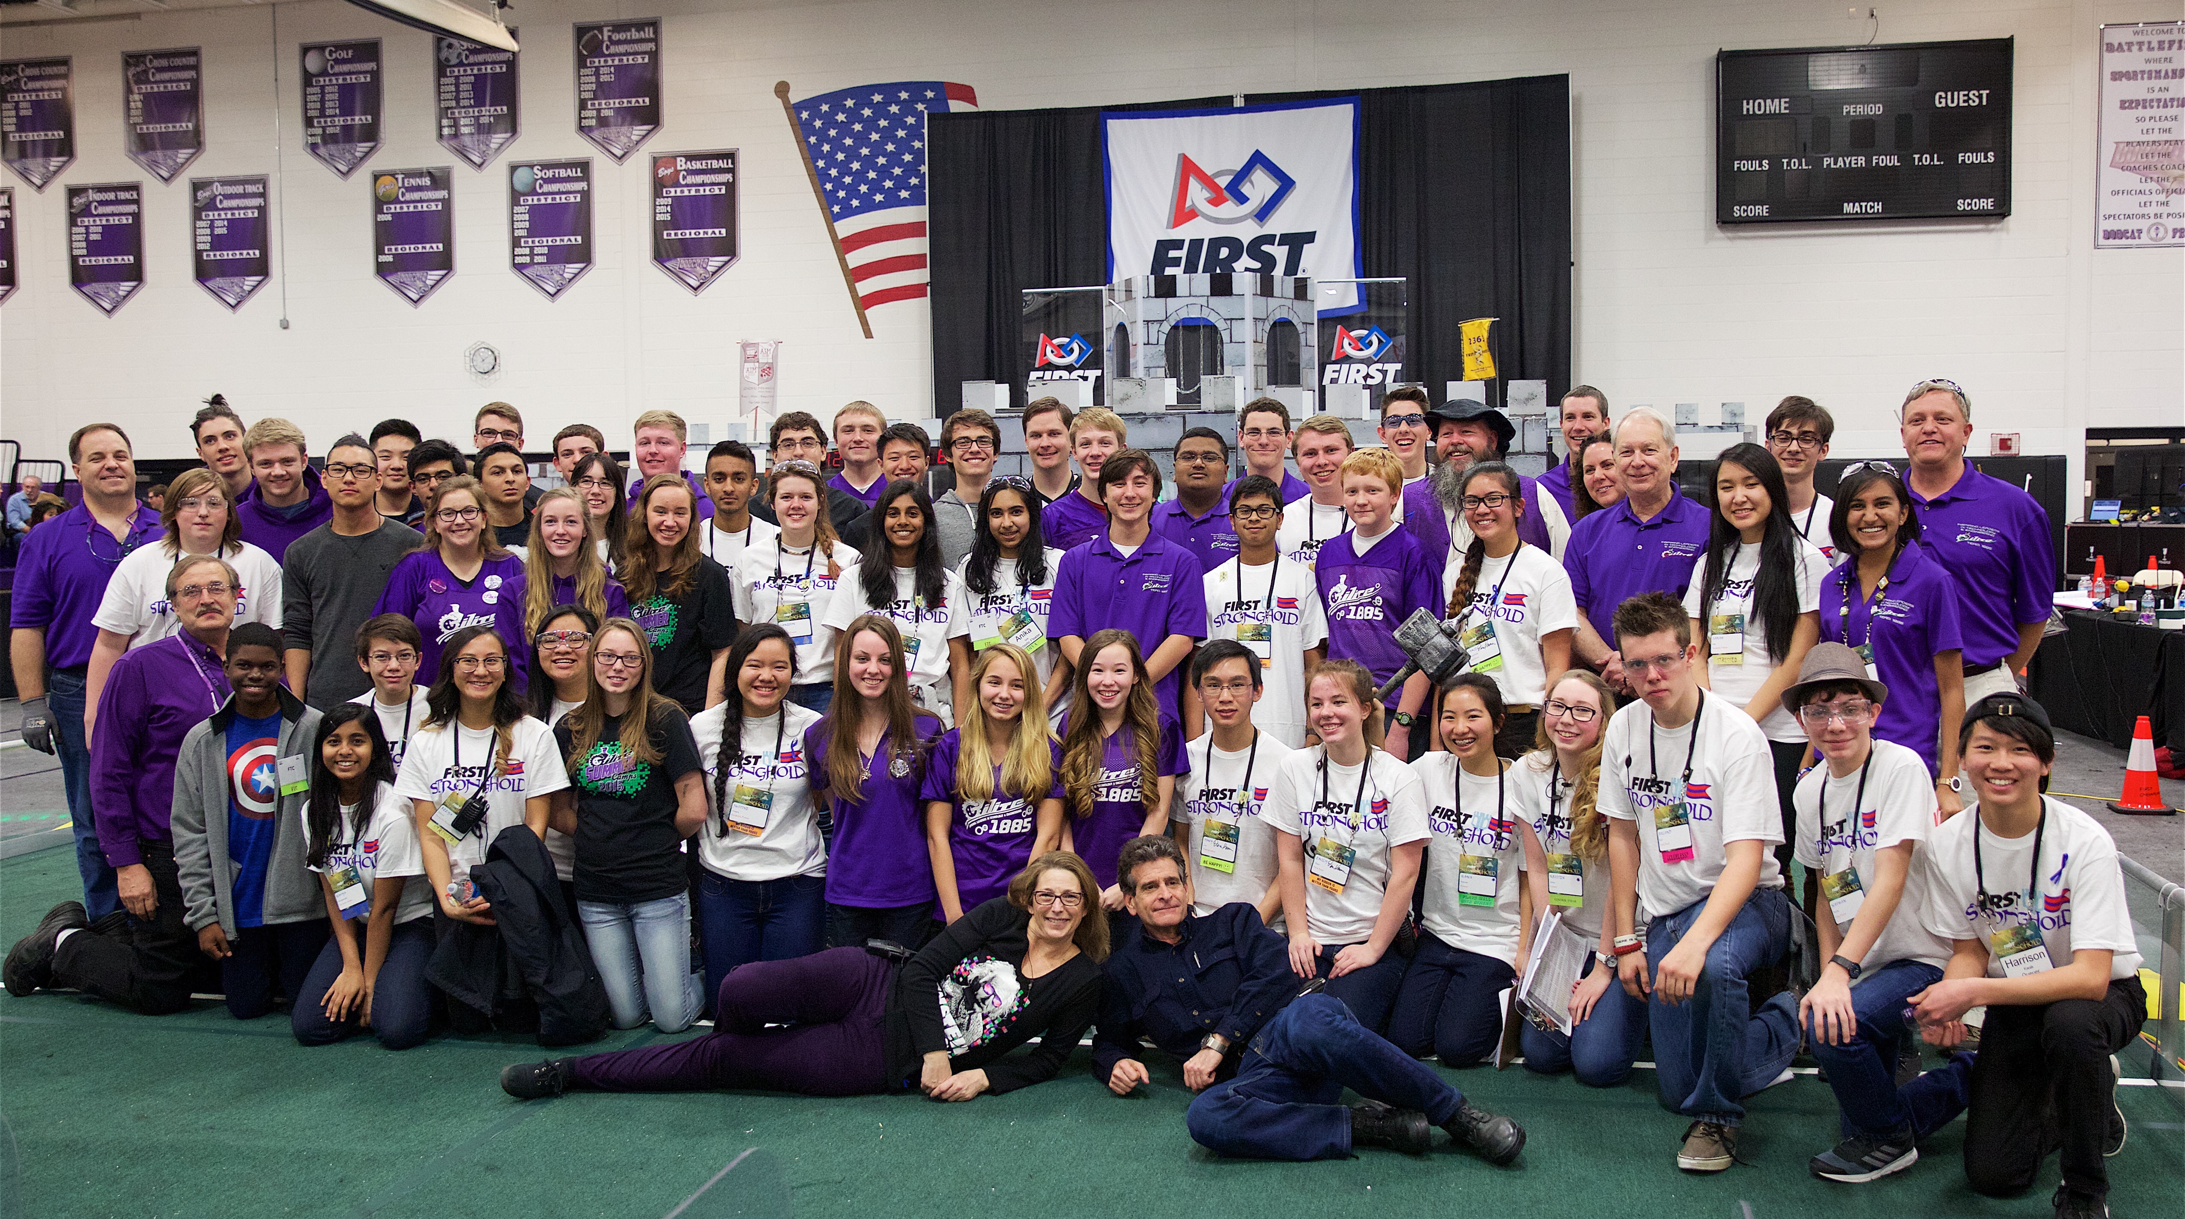
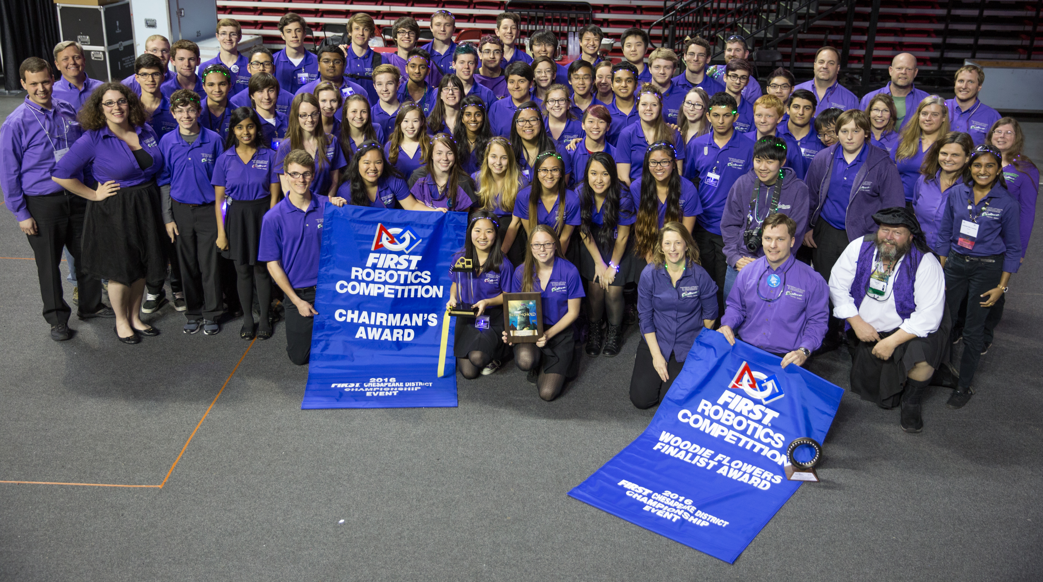
Our Team
72 team members
20 student leaders
Notes:
Amr

Slide 7
Inspirational Leadership Quotes
"A true leader has the confidence to stand alone, the courage to make tough decisions, and the compassion to listen to the needs of others. He does not set out to be a leader, but becomes one by the equality of his actions and the integrity of his intent."
- Douglas MacArthur
Notes:
Justine

Slide 8
Inspirational Leadership Quotes
"Leaders aren't born, they are made. And they are made just like anything else, through hard work. And that's the price we'll have to pay to achieve that goal, or any goal.”
- Vince Lombardi
Notes:
Noah R

Slide 9
Inspirational Leadership Quotes
"A leader takes people where they want to go. A great leader takes people where they don't necessarily want to go, but ought to be."
- Rosalynn Carter, former First Lady
Notes:
Sam S

Slide 10
Paper Tower Activity
You will work as a team with the people at your table
Teams will be given 20 pieces of paper and have 4 minutes to build the tallest tower
No other materials can be used - just paper
Good luck!
Notes:
Start off general. Engage the audience. What is a leader? What makes an effective leader ? What is the difference between a leader and a boss? Have a 3 min discussion. Roland

Slide 11
The Importance of Leadership
Effective Leadership Strategies in FRC
Notes:
Reeya

Slide 12
Questions about Leadership
What is a leader?
What makes an effective leader?
What is the difference between a leader and a boss?
Notes:
Start off general. Engage the audience. What is a leader? What makes an effective leader ? What is the difference between a leader and a boss? Have a 3 min discussion. Reeya

Slide 13
Our Definition
A leader should be able to do the following
Have a vision
Motivate and inspire others to carry out the vision
Manage the execution of the vision
Being able to effectively coach and grow the team
Notes:
Reeya

Slide 14
Our Definition
Effective leaders can do all of those while
Communicating efficiently
Maintaining integrity and high ethical standards
Showing enthusiasm
Being aware of the team environment
Notes:
Reeya

Slide 15
Leaders vs. Bosses
Leader | Boss
develops people | uses people
compassionate | impersonal
effective delegation | micromanagement
They must earn respect and inspire those around them
They must see the “Big Picture”
A good leader treats everyone with respect
Notes:
Very quickly say these key points. Maybe put info in a T-Chart shape ? Reeya

Slide 16
The Responsibilities and Authority of Leaders
Effective Leadership Strategies in FRC
Notes:
Hana

Slide 17
Responsibilities of Leaders : Communication
Communication is what drives the team’s efficiency, unity and productivity.
Must be done in a timely manner
Use respectful language that is clear and concise
Utilize different platforms of communication appropriately
Notes:
Hana

Slide 18
Responsibilities of Leaders : Delegation
Delegation gives opportunities to others and gives the leader an opportunity to work on “Big Picture” tasks .
Identify members’ strengths and weaknesses
Delegate tasks accordingly
Collaborate with others
Trust team members to carry out tasks by themselves
Notes:
Hana

Slide 19
Responsibilities of Leaders : Unity & Inclusion
Leaders must be the unifying force on a team
Unity among student leaders and within sub-teams
Inclusion of all members
Being focused on working towards a common goal
Notes:
Ethan

Slide 20
Responsibilities of Leaders : Sustainability
A team’s sustainability relies heavily on the sustainability of its leaders and leadership structure
Encourage growth and development through proper training
Understand the interconnection of all sub-teams
Shadowing or leading by example through actions
Think and work towards the future
Notes:
Ethan

Slide 21
Dedication & Attendance
Must be emphasized when recruiting and accepting new members
Dedicated Member vs. Visiting Member
Affects team efficiency and productivity
Gives students a sense of responsibility
Must have an organized system of attendance
Notes:
Hana

Slide 22
The Importance of Attendance (Sample)
The concept of “lives”
Excused vs. Unexcused absences
Notes:
Hana

Slide 23
Membership Handbook
The best way to prevent disparities and problems is to have everything written in stone.
Outlines required events, expectations, the chain of command, and other relevant information
A signed document to emphasize importance
Example: Kickoff
Notes:
Sam

Slide 24
Being the Voice of Authority
Public speaking and authoritative skills
Clarity and comprehensibility
Know your topic
Come in with a plan of attack
Be prepared to answer questions
Respectable presence
Commanding tone (but not dictatorial) at an appropriate volume
Notes:
Justine

Slide 25
The ILITE Leadership Structure
Effective Leadership Strategies in FRC
Notes:
Justine

Slide 26
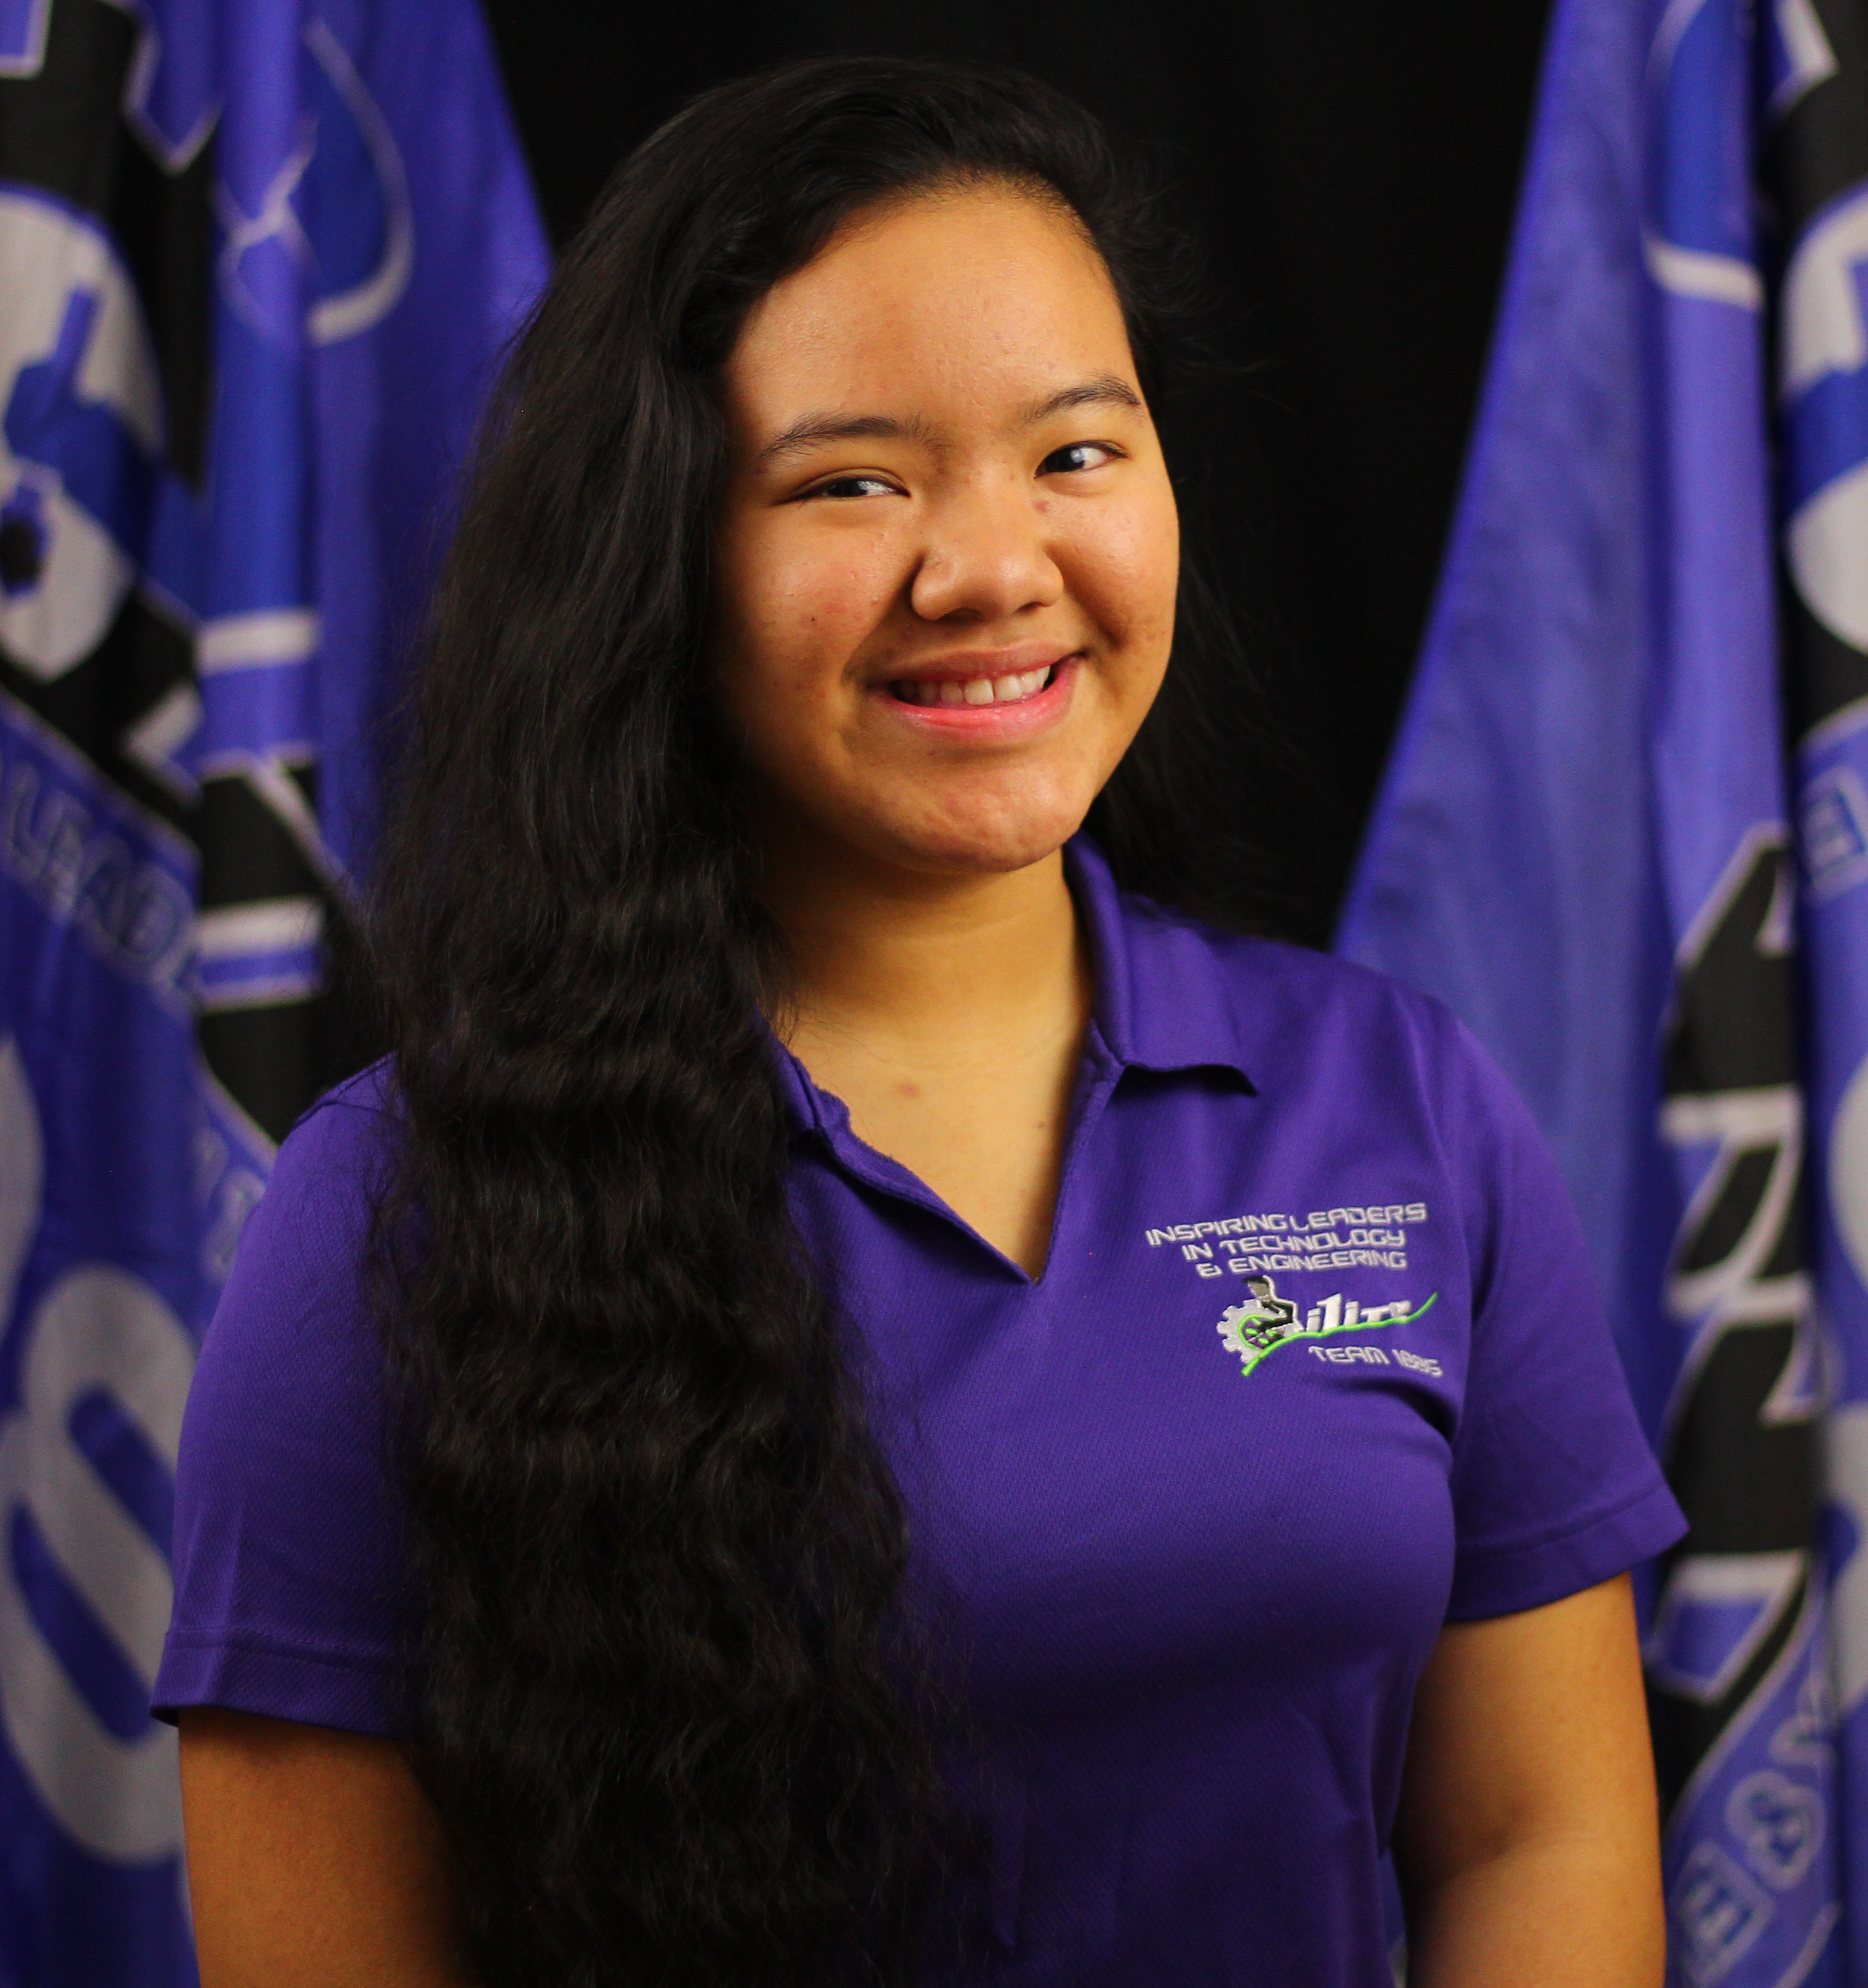
ILITE Leadership Structure: Co-Presidents
Justine Suegay
Business/Non-technical
Teddy Todorov
Technical
Non-Technical President deals with awards, graphics, documents, outreach, and everything else not robot related
Technical President deals with the build , programming , electronics aspects and anything robot related
Notes:
Justine and Teddy

Slide 27
ILITE Leadership Structure: Co-Presidents
Leads full team and student leadership meetings
Reports directly to head coach
Tackles presidential tasks AND sub-team work if needed
Ensure that mentors are kept up to date
Notes:
Teddy - Emphasize first AND

Slide 28
ILITE Leadership Structure: Sub-team Leaders
Sub-team | Leader
Build | Nicholas Lechner, Noah Lechner, Samuel Spelsberg
Programming | Ethan Villagran, Noah Reilly
Electronics | Roland Bell, Richard Kil
Graphic Design | Tony Lin
Web Development | Navya Annapareddy
Engineering Inspiration | Hana Komine, Reeya Rabena
Sponsorship | Amr Metwally
Notes:
Reeya - Make sure to talk about how there are other leaders too

Slide 29
ILITE Leadership Structure: Sub-team Leaders
Each sub-team leader has their own leadership style, however all must communicate/report to Co-Presidents and Coach
Sub-team leaders manage “Work In Progress” document
Sub-team leaders have meetings with their team to bring them up to date
As a leader, you are responsible for your students
Notes:
Reeya - Explain how we communicate to each other and the purpose of the WIP

Slide 30
The Effectiveness of our Structure
Many factors make our structure effective
It leads to a sustainable team
It makes the team very student driven
More people have a say on what goes on
More efficient work being done
Everyone gets included
It makes robotics more engaging
Notes:
Amr - Very important to explain how effective in a small amount of time

Slide 31
Team Meetings
Effective Leadership Strategies in FRC
Notes:
Amr

Slide 32
Student Leadership Meetings
Student leadership meetings are where all of the leaders come together and talk about the projects and major issues or events coming up.
Talk about any other relevant aspects of the team
Updates from all sub-teams are presented
Head coach is the only adult present
Co-Presidents lead this meeting
Documentation done by secretary
Notes:
Amr - We may want to elaborate more on how we run the meetings so they can try it themselves

Slide 33
Mentor Meetings
Mentor meetings are for decisions, such as logistics of events, that students cannot make themselves.
Head coach is present to convey what the students want and is the intermediary between the meetings
Makes sure our awesome mentors are on the same page
Notes:
amr - EMPHASIZE AWESOME AMR

Slide 34
Full Team Meetings
Full team meetings should occur at a designated time every week where all important information is conveyed.
All sub-team leaders briefly talk about their individual sub-team
Important announcements are made about upcoming events
Keeps the whole team updated
Notes:
Amr

Slide 35
Sub-Team Meetings
Each sub-team leader has a meeting with their team after the full team meeting to present an overview of tasks.
Tasks are delegated at this meeting
Any sub-team announcements are made
Leaders are free to handle it the way they want
Notes:
Amr

Slide 36
Selection of Leaders & Team Members
Effective Leadership Strategies in FRC
Notes:
Sam

Slide 37
Leadership Selection
At the end of each school year, a leadership selection committee consisting of mentors, teachers, and alumni will choose the next year’s leadership team.
The selection process is based on each person’s previous leadership experience, dedication to the team, particular expertise, and written application to ensure the student can handle the responsibilities.
Notes:
Sam

Slide 38
Selection of General Members
Application posted and announcements made
Leaders go through applications
Students may apply to more than one sub-team
Interviews are set up and conducted
The leadership team meets to pick new members
New members are then incorporated into the team
Students not selected are then given opportunities to participate in team-hosted events
Notes:
Noah - Emphasize how everyone gets incorporated somehow and that we take students of all ages. It is based on leadership decisions

Slide 39
Evolution of Leadership
Effective Leadership Strategies in FRC
Notes:
Amr

Slide 40
Evolution of our Team Structure
The team started off with one president and fewer leaders, causing decisions to be made by less people.
We added more leaders and shifted to a co-presidency as time went on. Now, we have found a balance of approximately one leader for every 5 students.
Ex: The build team is comprised of 10 people, therefore there are 2 leads.
Notes:
Amr - Explain how it also depends on the size of the team and other factors

Slide 41
How Leaders Grow Through Leadership
Working in a professional environment
Growth from experiences and situations
Applying the knowledge learned and teaching it to others
Organizational and documentation skills
Learning how to be a voice of authority
Being inspired then inspiring others
Notes:
Noah and Sam

Slide 42
Growing from a Member into a Leader
New leaders start as members of the team and learn from current leaders, so they will be able to incorporate what they have learned.
This shadowing process allows for consistency within the student leadership team, while allowing them to develop their own methods of leading.
Notes:
Justine - talk about how we use certain methods of leadership...we realize it has been used on us

Slide 43
Things to Remember
The ultimate goal of being a leader is to inspire those around you
Do not be a boss and be a leader that is loved and commands respect
You are ultimately all peers
Treat everyone with respect and you will receive the respect you deserve
Notes:
Justine - Talk about how everyone from the CEO of a company to a janitor should be respected. INSPIRATION is a buzzword. Use it as much as possible.

Slide 44
Inspiring as a Leader
Here at ILITE, inspiration, leadership and the culmination of both in the field of STEM are what the team works towards.
“Inspiring Leaders”
Both leaders and members carry out the inspiration
Ultimately, the goal is to inspire the community
Notes:
Justine

Slide 45
Questions?
Notes:
Reeya

Slide 46
Thank you!
How did we do? Please fill out a survey before you leave.
Notes:
Amr

