Slide 1
Inspire Your Community with Walt’s STEM Toolbox
Walton Robotics Team 2974
Notes:
Welcome! We are so glad that you could join us today to learn about how Walt’s STEM Toolbox products can help you easily connect with and promote STEM in your community.
(Introduce ourselves: names, positions, year in school and year on team/FIRST, team accomplishments)
Khyati: I am a sophomore in high school, I am the project lead of Camp in a Can and storybook, I write essays and talk to judges at competition, and I’m on the Girls FIRST planning committee,
Ria: Freshman in highschool, and while it is my first year on team and I actively work in multiple departments, contributed on essays and represented the team in the pits with our Awards Team, Girls FIRST planning committee, produced videos, 2 presentations (in Oswego Novelis aluminum plant and Georgia Science Teacher Association State conference)
We are pleased to be presenting Kaitin Kress, Corporate Social Responsibility Specialist and Ashley Gravlee, Manager for Corporate Social Responsibility at Novelis.
Novelis is a phenomenal sponsor of FIRST World-wide as well as being personally involved with teams. We are fortunate to have worked with Novelis on the development of this project.

Slide 2
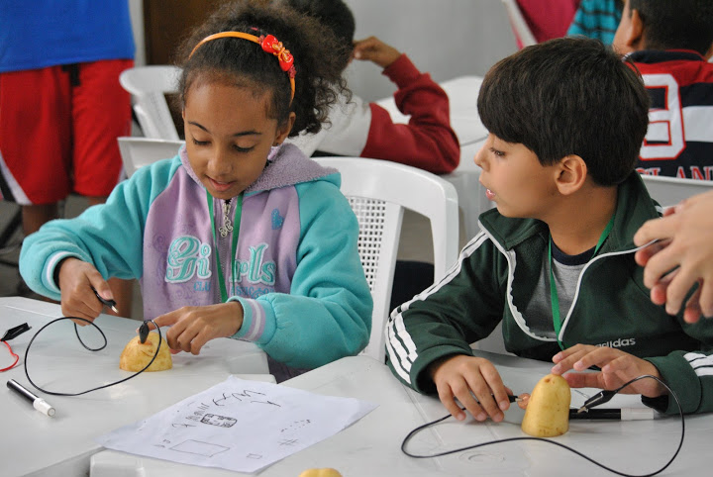
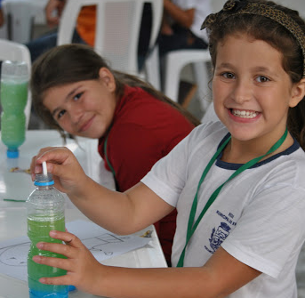
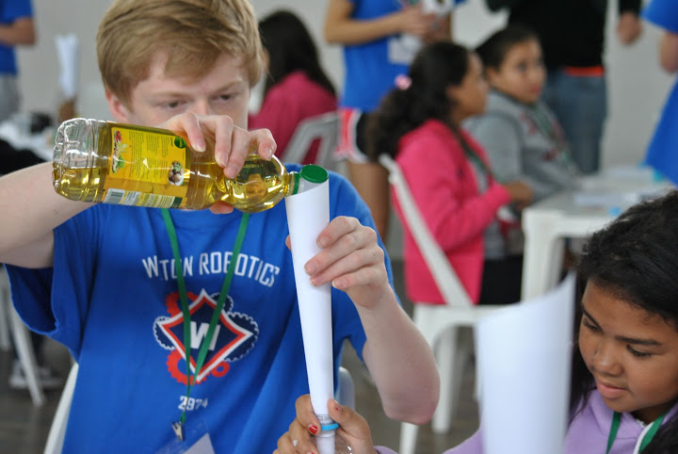
We Believe...
STEM is for EVERYONE!
STEM is FUN!
STEM is IMPORTANT!
And Failure is an Opportunity to Learn!
Notes:
We want students to learn that STEM is a great way to have fun! We want every student to know that they can find fulfilling careers in STEM. We want students to know that STEM is for everyone!
An essential part of learning and success is FAILURE! A huge part of engineering is to learn to try again. If something does not go as planned, then make some adjustments and try again.

Slide 3
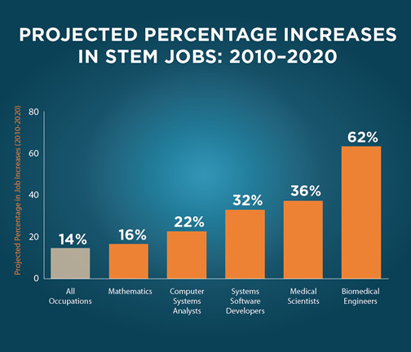
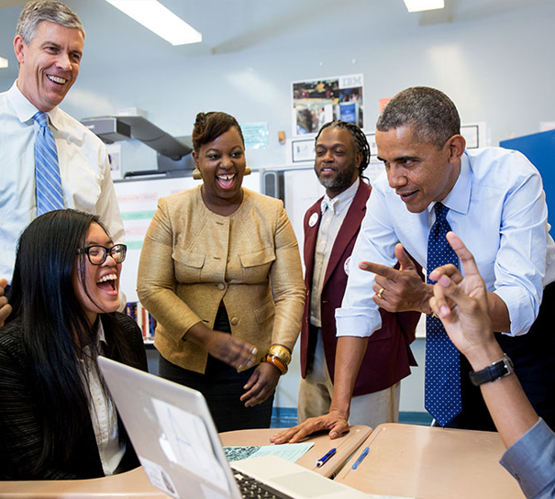
STEM is important
16-62% increase in STEM Jobs
by 2020
Educate to Innovate Campaign
Notes:
As you already know the demand for STEM jobs is increasing dramatically. Industry also knows this! And we know how cool and fun STEM is!
STEM is so important that our president has created the “Educate to Innovate” Campaign for Excellence in STEM Education
Khyati - Personal STEM story (something cool you’ve got to do, see, or learn because of STEM. Maybe you could talk about the really cool plant tour we took in Brazil!)

Slide 4
Engaging Girls
We can change this!
Notes:
You also know, a big issue in STEM fields is the lack of females. We need to show young girls that they can not only pursue careers in STEM but they can be incredibly successful.
We need to change these statistics. This desire drove our team to create a program called Girls FIRST

Slide 5
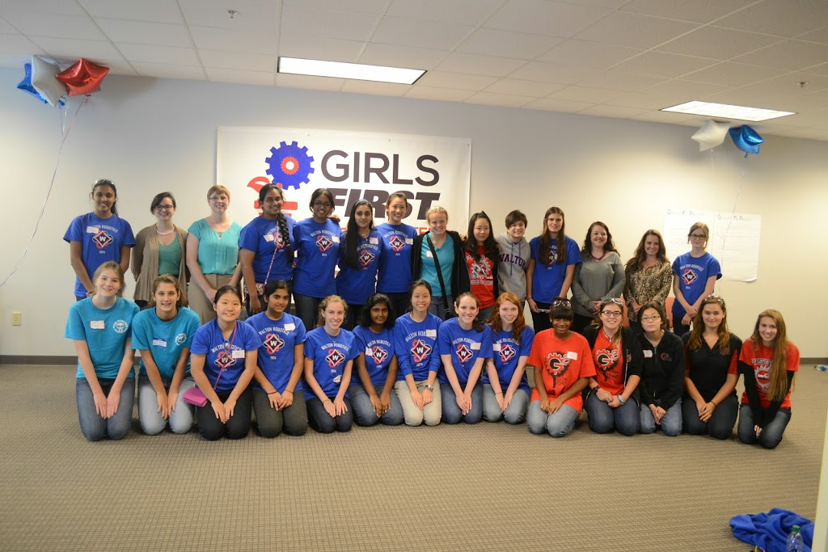
Walt’s Toolbox - Answering Needs
Camp in a Can
Inspired by Requests
Outreach in a Box
Inspired by Girls FIRST
Notes:
Girls FIRST brings girls together from all over the state to network with successful professionals and discuss topics specific to girls in STEM.
OIAB was originally created from these events as a way to provide outreach kits to inspire girls.
Camp In a Can
With the support of Novelis, we hosted our first international STEM camp last summer in Pinda, Brazil. While learning Portuguese dances and songs with our new friends, the idea of CIAC came to us! We wanted to create a product where people could easily run a STEM camp themselves anywhere in the world.

Slide 6
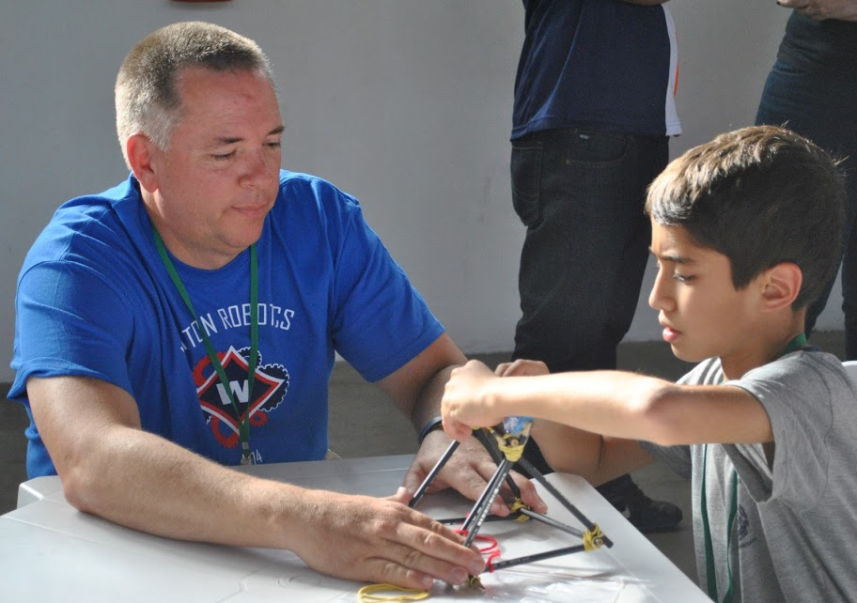
Empowering Teams
Community Connections & Career Choice
Easy & FUN!
Notes:
The goal of Walt’s STEM Toolbox is to equip other Teams and the Community with engaging activities showing that STEM is fun for everybody!
These easy activities teach students about a variety of engineering fields, and that STEM can be a great career choice.

Slide 7
What you will hear today
Kickstart your STEM Outreach with Walt’s Toolbox
“The Adventures of Walt”
Outreach in a Box: Earhart
Outreach in a Box: Curie
Camp in a Can
Leveraging Sponsor and Team Partnerships
How to Get a Box!
Notes:
You know why STEM outreach is important to you, your community, industry, education, and students.
We will show you how Walt’s STEM Toolbox can kickstart your outreach! Using:
Our Storybook - “The Adventure’s of Walt”
Outreach In A Box Earhart
Outreach In A Box Curie
And our newest product - Camp In A Can
you will learn how developing relationships with sponsors and leveraging combined resources will help you achieve greater success.
Finally, we will give you information on how you can get these products to kickstart STEM outreach objectives in your area

Slide 8
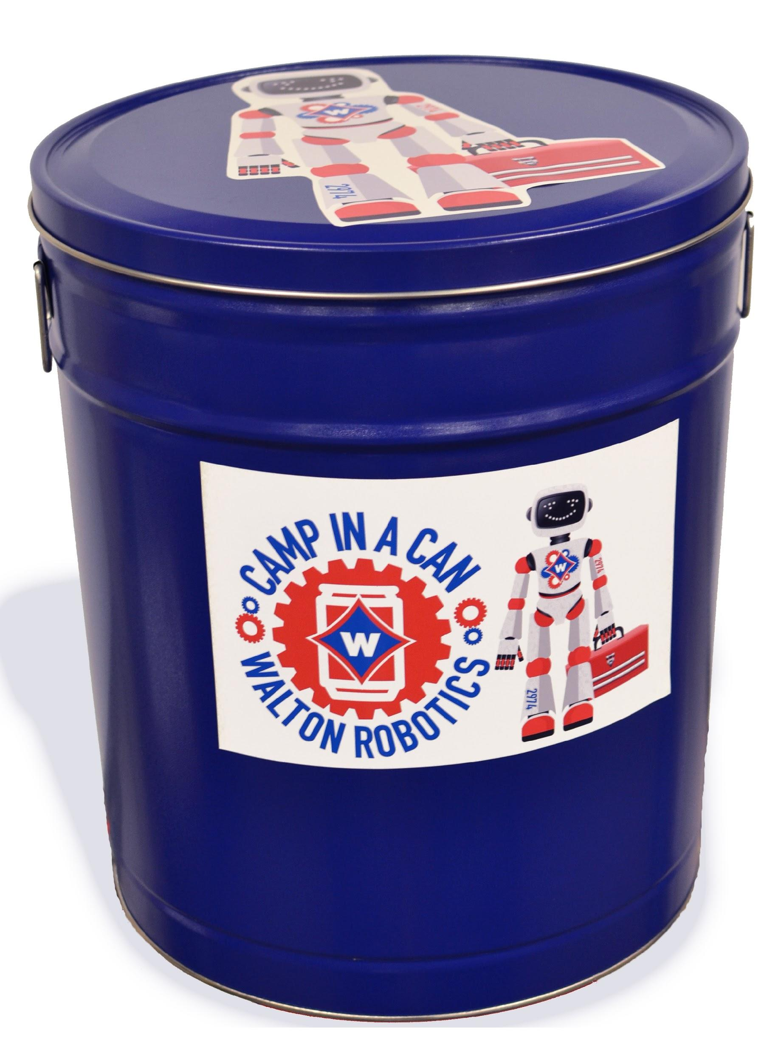
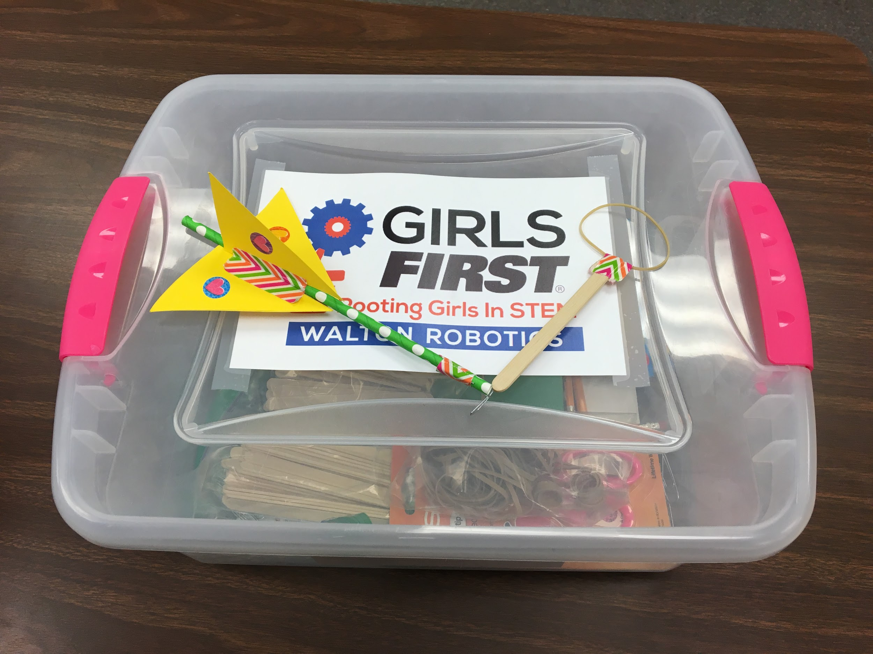
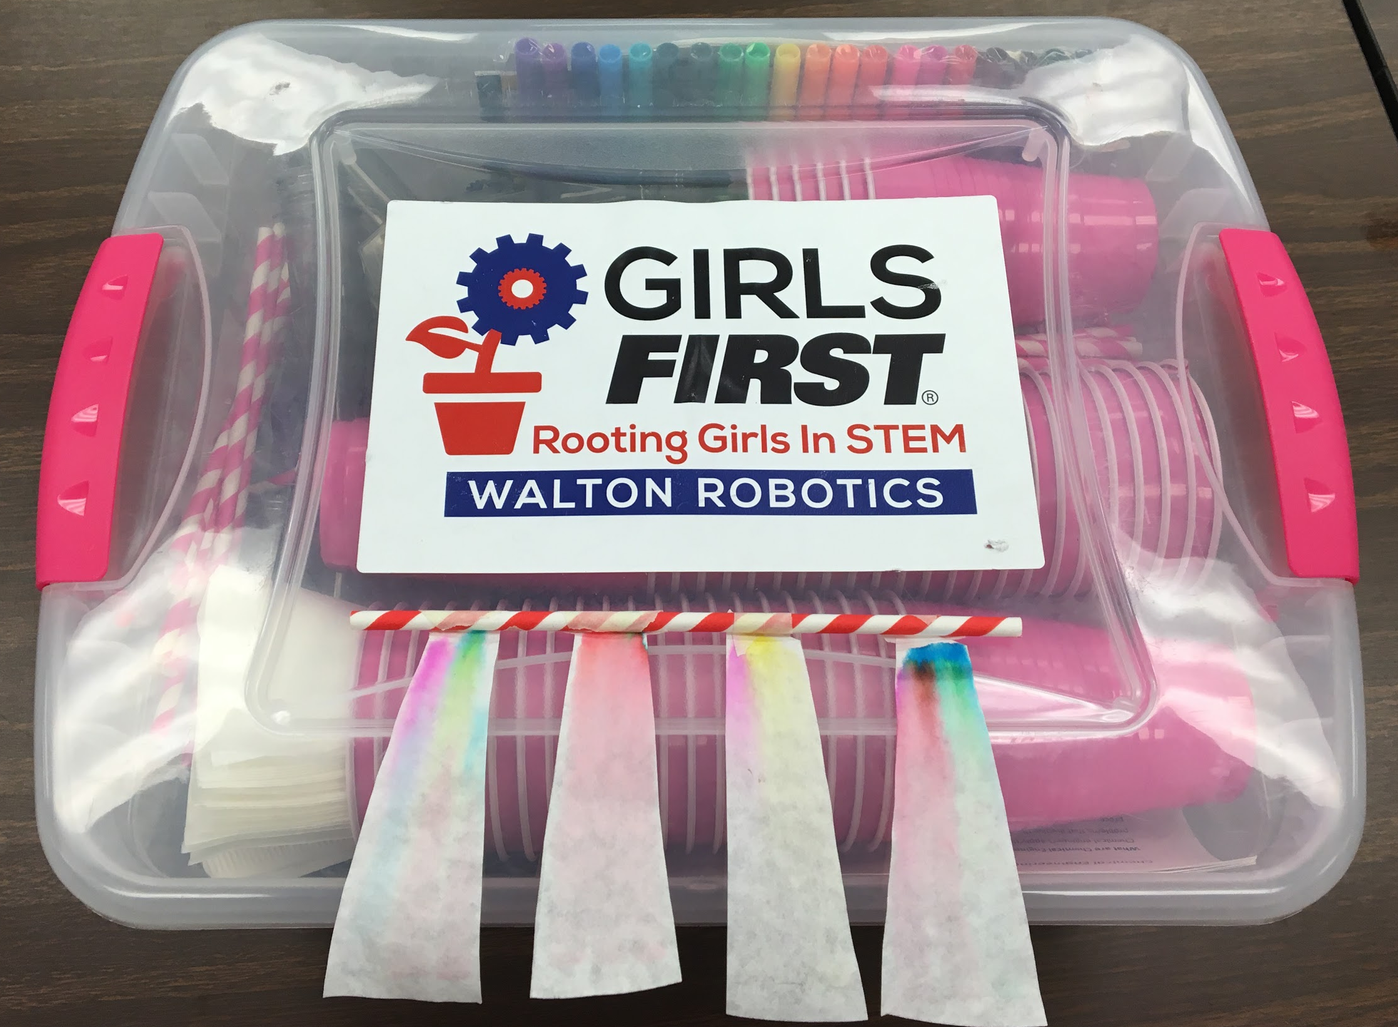
What’s In the Box
OIAB Earhart
OIAB Curie
Walt’s Storybook
CIAC
Notes:
So here's what is in Walt’s STEM Toolbox.
OIAB Earhart: Outreach events for 50+ kids at any age
OIAB Curie: Outreach events for 50+ kids at any age
Storybook: elementary kids or schools
CIAC: 4th to 8th grade camps
Tested by the team
Free of charge to other FIRST teams and organizations

Slide 9
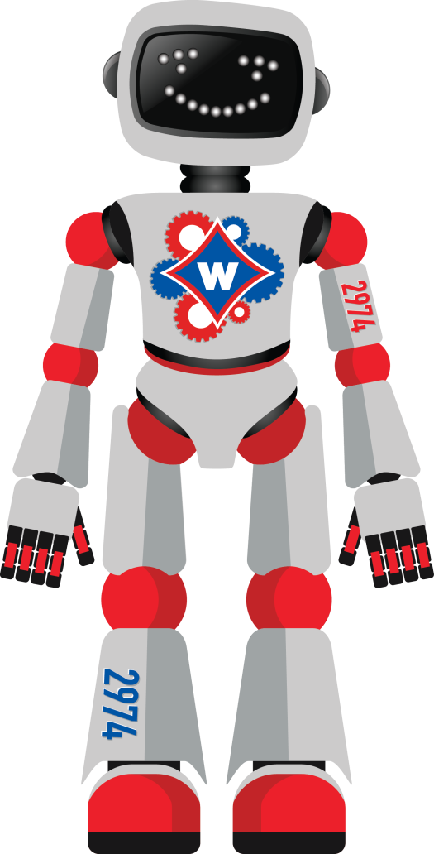
“The Adventures of Walt”
Our STEM Storybook
Notes:
(Hold up preview copy)
-”Walt” team mascot - He was developed as a Fun Character that we could use to market our team. To that end, we have created a Flat Walt version that we hand out at events. So far he has been to all 7 continents and has been to space 3 times!
- Our storybook centers around Walt’s adventures in the STEM world.

Slide 10
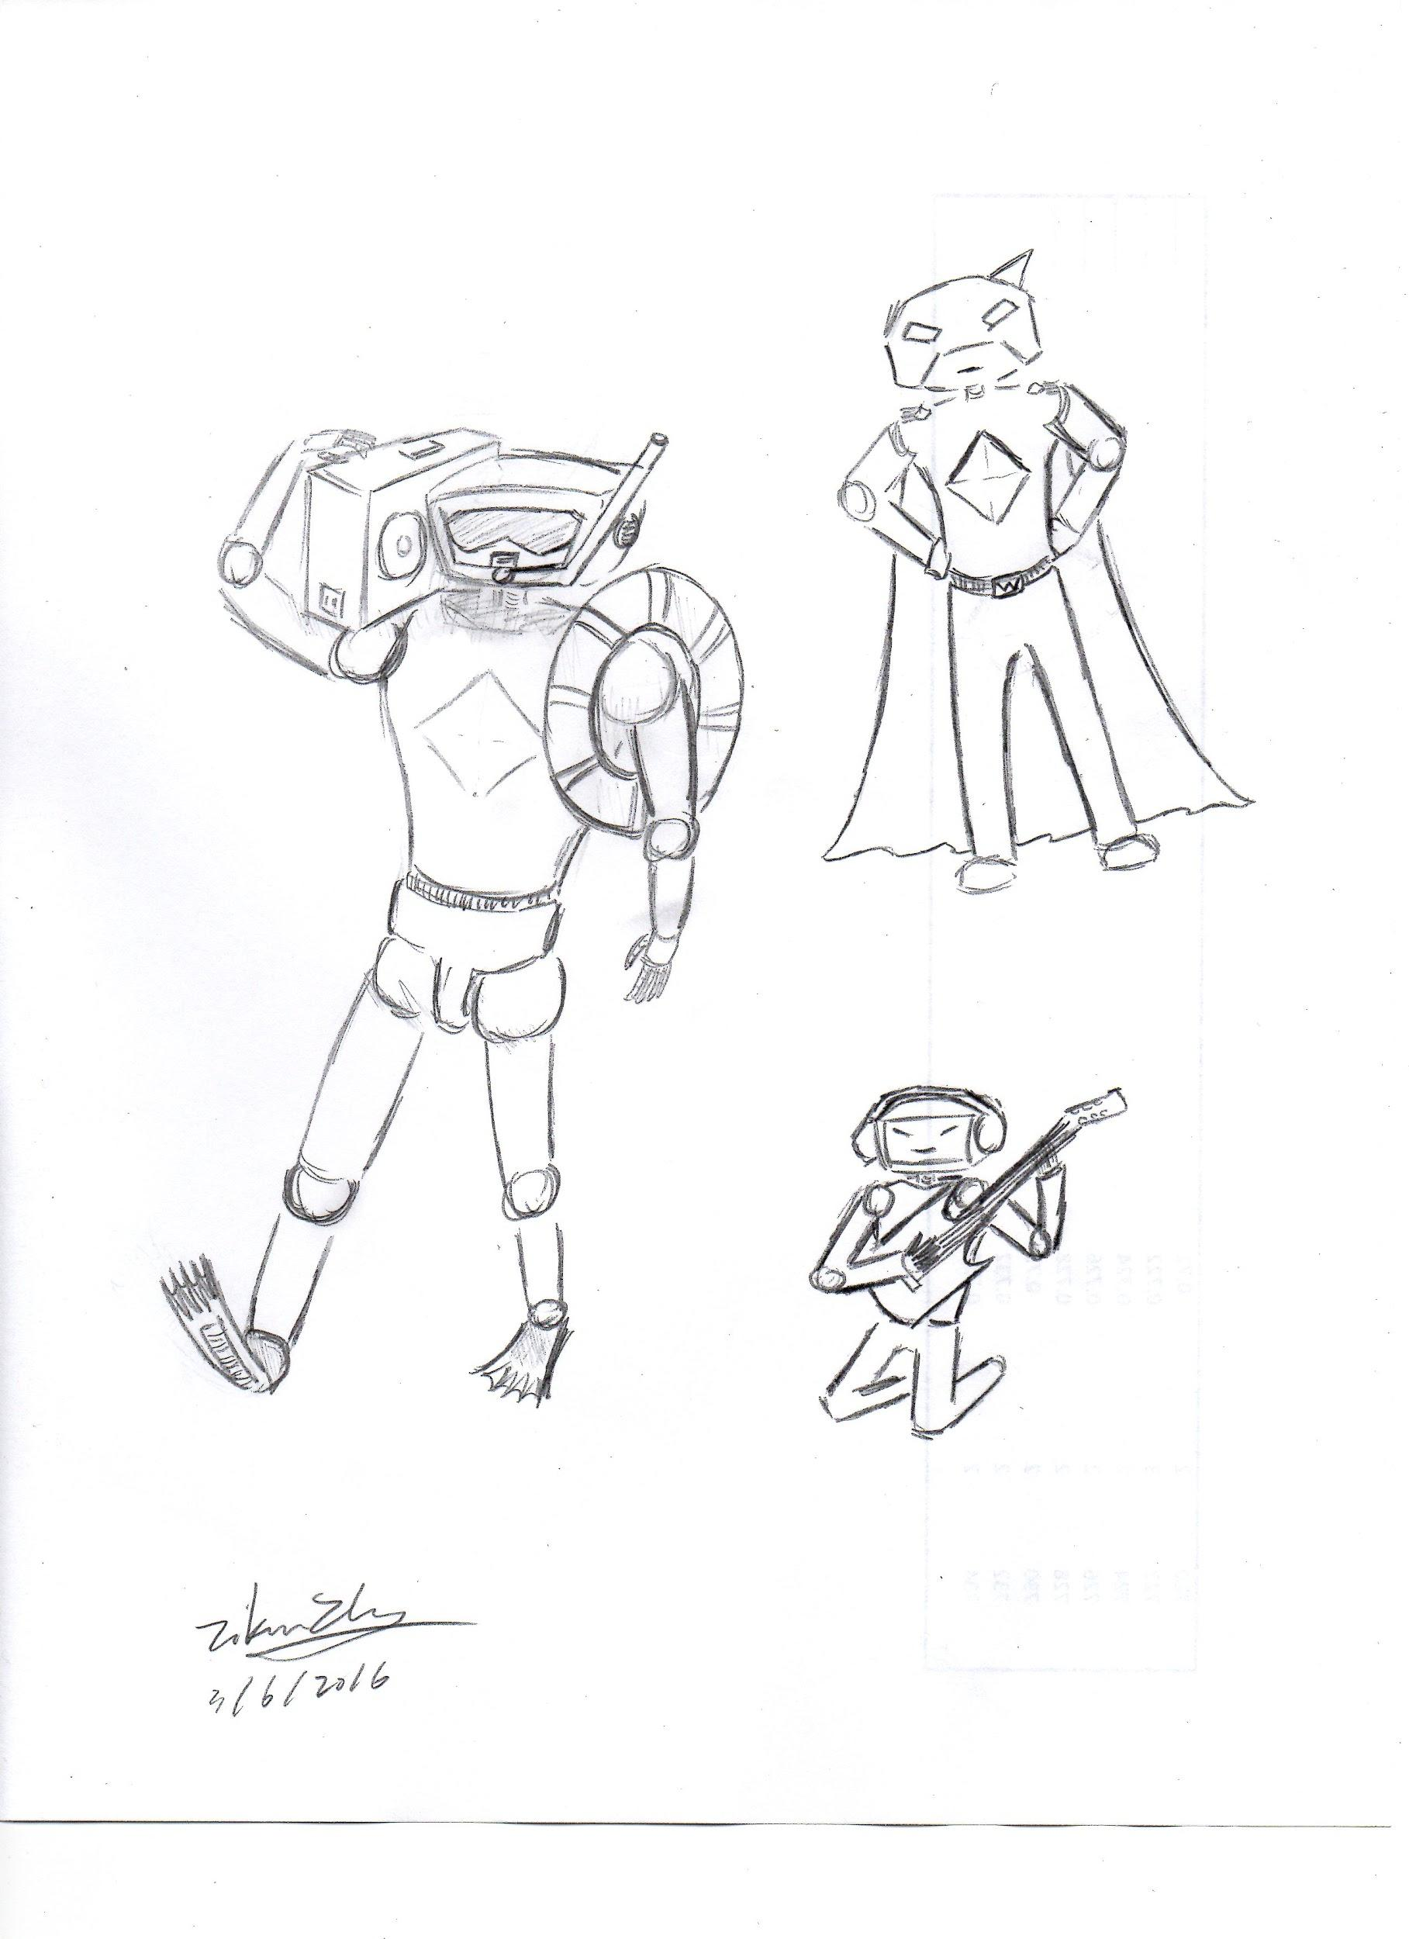
Inside the Book
Fun Stories
Engineering Fields
Activities and Labs
Civil Engineering
Mechanical Engineering
Biomedical Engineering
Notes:
many elementary teachers are not comfortable or confident teaching STEM; this book is a great resource for them as well as their students!
Each engineering field is brought to life with a short story,activity, and lab.
This allows students and teachers to connect the benefit of literature to STEM and STEM to literature.
You each have a sample page in your folder with one of the stories on the front and one of the activities on the back. We are finalizing the book and plan on releasing it this summer.

Slide 11
Outreach in a Box: Earhart
Notes:
Outreach In A Box Earhart is our first kit.
It contains materials to make 50 customizable slingshot rockets to teach kids about aerodynamics.

Slide 12
World wide distribution
Attractive & Functional!
Walton & Novelis
300+ boxes to 14 countries
Notes:
You also receive supporting materials explaining the engineering design process, aerodynamics, marketing information for our team, FIRST, and sponsor companies, a Flat Walt, and a notebook to record data and capture fun information from the event.
There is also a video to explain the process and make it easier.
The Big Hook is the decorative materials; the stickers, fancy tape, and markers that allow girls to customize their rocket.
An essential part that makes this kit so successful is the idea that functionality and attractiveness are not mutually exclusive:Things can function well and look attractive at the same time!
While the kit was originally developed for girls, the idea has grown well beyond its beginning. With the help of our sponsor Novelis we’ve shared over 300 kits in 14 countries to boys AND girls of ALL ages.

Slide 13
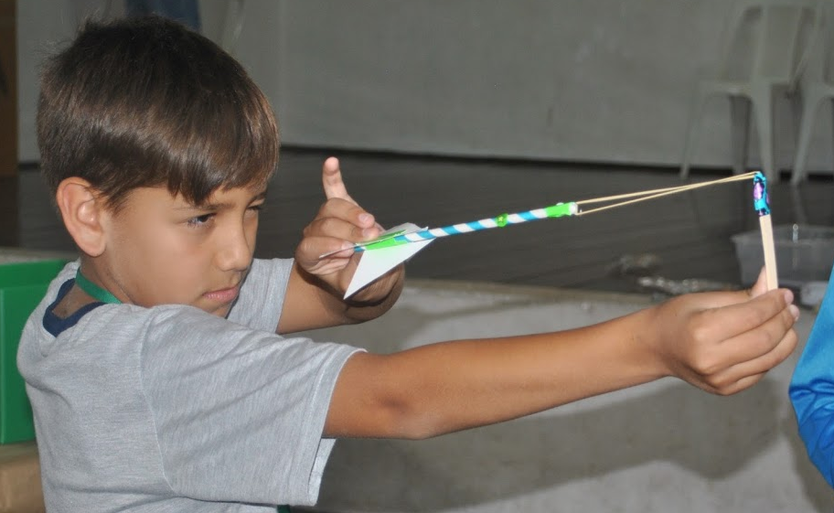
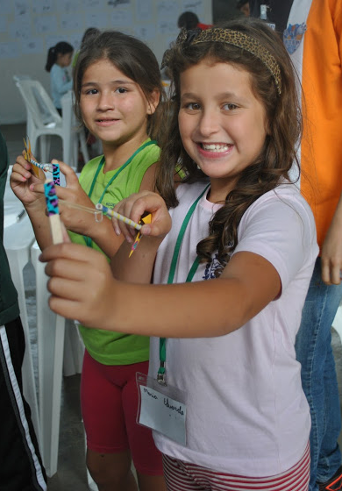
Inspiring Kids
Jack
Alyssa
Katie
Notes:
Personal OIAB story
Jack = whose rocket flew way further than expected into bushes. Brought his whole family and his brothers made more

Slide 14
Outreach in a Box: Curie
Notes:
Our first kit was a big hit, and we wanted to continue its success. We created our second kit Outreach in a Box: Curie to incorporate a different STEM concept, in this case - chemical engineering using chromatography. We also connected Materials Engineering and 2L soda bottles as an extension that they can continue at home.

Slide 15
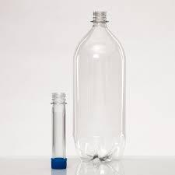
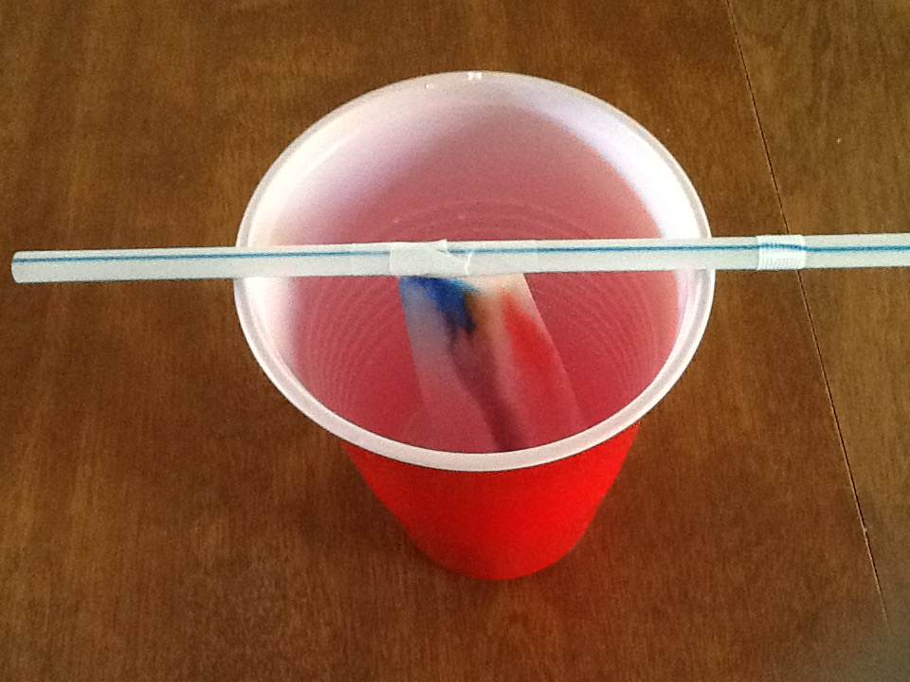
Cool Industry Materials
PET Preform
Marker Chromatography
Notes:
Chromatography is the technique used to separate materials in a mixture. Here we utilize the different colors of dyes that go into single color markers.
The extension activity lets kids continue the fun at home using the different food dyes in Skittles and M&Ms.
We included PET preforms (hold one up) used to package soda. They start in this compact form, and when the soda is ready to be bottled, they blow these up into 2L bottles at the bottling site. These were specifically designed to solve the problem of transportation costs for industries.
In this box, the PET preform operates in 2 ways: it can be used as a container to perform chromatography, and connect engineering in an exciting way to recognizable materials.

Slide 16
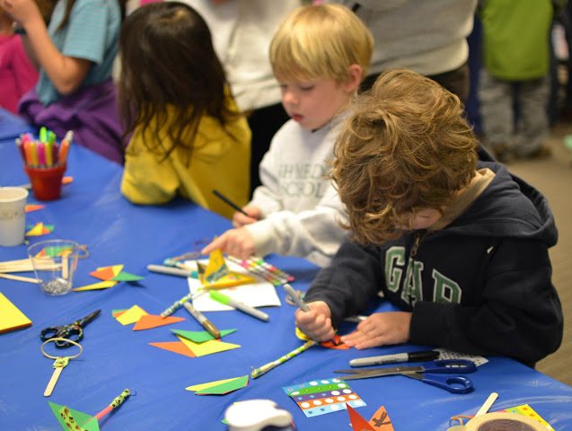
Places for Use
Sponsor events
Local events
Notes:
Let’s say if you and your team were invited to an after school event to teach kid why STEM is important. You can use this kit to teach them the idea of STEM and the engineering design process in an easy and exciting way.
For example, we have taken OIAB Earhart to sponsor and corporate events and even to local elementary schools.
We plan to launch a new Outreach in a Box each year with a different STEM concept each year.

Slide 17
Camp in a Can
Do-it-Yourself Camp Kit
Notes:
And now we are very excited to introduce you to our newest addition in our Toolbox! Camp In A Can!
Camp In A Can is breakthrough Do-it-Yourself Camp Kit!
We developed CIAC as an easy and fun way to host your own STEM camp. We have experience hosting 17 camps and have acquired a reputation for hosting fun camps. As a result, there is not enough time to accept all of the requests that we receive.
This product allows us to still support organizations with materials that have been developed and tested by students, and sent free of charge.
Before we go into details about what’s in the box, let me tell you why Walton has spent thousands of hours developing CIAC.

Slide 18
Importance of STEM Camps
STEM Students:What Can Parents and Schools Do to Help
Kids and Teens Become Interested in STEM?
“Expose them at an early age, show them it is fun and interesting.” —Biomedical Sciences Student
“Fun games — see how science, technology, engineering, and mathematics are actually applicable to real life.” —Engineering Student
“Parents can be more hands on and supportive in teaching their children outside of school to help reinforce what is learned in school. Schools should also have a lot more hands on and visual learning rather than always reading from the textbook. —Pre-Med Student
Notes:
According to the Harris Interactive Study - STEM Perceptions: Student & Parent Study
“More than half of STEM college students say that, before going to college, a teacher or class got them interested in STEM. – This is especially true of female students, who give “a teacher or class” as the top factor that sparked their interest.
In addition here are some direct quotes from students in the study: Notice their comments on what parents and teachers can do to help kids become interested in STEM:
Exposure at an early age
Make it fun and interesting
Outside of school
Hands on and visual
Actually applicable to real life
We believe our Walt’s STEM Toolbox hits all these points!

Slide 19
Facing Challenges
Are you overwhelmed?
Where to start
Cost
Find and Test activities
What do I Need
Structure the day
Getting Along
Planning
Forms
Notes:
So you want to make a difference but maybe you feel it’s too hard? You might be thinking:
I don’t know where to start
How do I know what to it will cost?
It takes a lot of time to find and test activities
What materials do I need?
How do I structure the day
How do I get kids to talk and get along?
How and when do I start to plan?
What forms do I need

Slide 20
We’ve Got You Covered
Solutions to Challenges
Budget Plan
Curriculum
Marketing Materials
Administrative Materials
Template Forms & Signs
Sample Certificates
Icebreaker and Team Building Activities
Glossary
Notes:
We thought of all the details!
In each can we have included helpful administrative items such as a budget plan and curriculum. The budget plan included in the manual plans out how to allocate money based on 20 campers and 6 mentors. The curriculum offers a suggested schedule for a 5 day camp. You will also find information on how to market your camp.
Upon arrival, all the campers may or may not know each other so it is suggested to start off with an icebreaker activity. We have included some icebreakers and team building activities which you can choose from.
There is also a glossary filled with STEM- related words found throughout the manual. The definitions are written in easy to understand relatable language based on appropriate content levels of children. Each word used in the glossary has been bolded in the corresponding activity. This will cue the teachers in to a difficult word or concept.

Slide 21
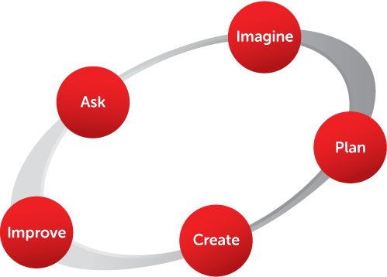
Easy Model for Everybody
Engineering Design Process
Notes:
An important tool included in all components of Walt’s STEM Toolbox is the Engineering Design Process.
Students and professionals can find it hard to explain this process. We have found this simple model a great place to start!
We have provided supporting material to explain how to use this model so that students will begin to think like real engineers!

Slide 22
Useful Support Material
Suggestions on How to use the Manual
Lessons Learned
Flash Drive with Manual and Videos
Notes:
Additionally you will find information on how to use this manual. In this section you will learn how to handle challenging behaviors, time management, and the importance of a predictable routine.
We have included some lessons learned, or Do’s and Don’ts, from our experience running camps. Here we discuss the importance of organization, breaks, and teaching strategies.
There is also a flash drive with the manual and videos recorded by the team of all the STEM activities written up in the manual.

Slide 23
Estimated Time
Suggested Age Group
Picture of Completed Activity
Concepts Learned
Considerations
Materials Needed
Safety Equipment Suggestions
Procedure
Background Science Information
Extension Activities
18 Tested STEM Activities
Notes:
We have also included 18 researched and tested STEM activities. Each activity comes complete with
Estimated time for completion, a suggested age group, a picture of the activity, and full sections on - concepts students will learn, considerations before and as you begin, materials needed, safety considerations, procedures in easy to understand steps, many with additional pictures to guide you, background science or engineering information to help you prepare for all the questions you’ll get, and suggestions for how to extend or modify the activity for quick learners, or to continue the learning at home.
Some activities will also have prototypes included in the can so that you can see in 3 dimensions, a model of the final product.
We also spent time learning about product development and met with a lawyer to learn the process of copyrighting. While our projects are supplied happily free of charge, they are also copyrighted.

Slide 24
Novelis & Walton Robotics
FIRST Robotics
Meaningful Partnership

Slide 25
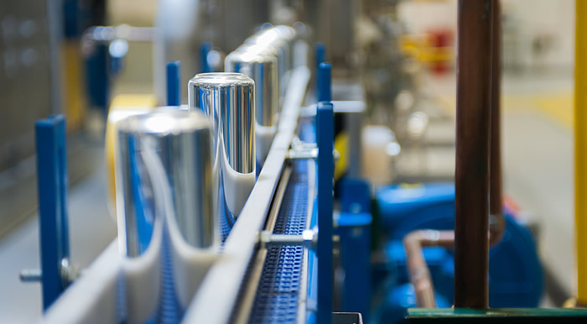
Novelis: Who We Are
Global Leader in Rolled Aluminum Products
Supplier of premium aluminum sheet for cans, cars, electronics, architectural applications, etc.
25 operations in 11 countries
11,500 employees worldwide
Worlds Largest Recycler of Aluminum
Recycles more than 50 Billion used beverage cans annually

Slide 26
Importance of Community Engagement
Community Benefits
Strengthens the community
Deposits in the “bank of trust”
Fosters a win-win partnership
Novelis Benefits
Supports the Novelis “license to operate”
Enhances the company’s reputation & brand visibility as a socially responsible company
Attracts new employees
Employee Benefits
Creates a sense of pride
Increases workplace satisfaction
Encourages teamwork
Supports workplace skill development

Slide 27
Novelis Talent
Developing Future Scientists, Technologists & Engineers
Novelis Issue:
Weak global technical talent bench strength
Global Need:
Skilled, driven technical talent with strong communication skills
FIRST develops exceptional leaders while building technical skills

Slide 28
More Reasons for FIRST Partnership
Perfect Trifecta of Corporate Giving
Monetary
Novelis has invested mores than $400,000 in four years
Material
Aluminum supplier for the FRC kits
$200,000 in two years
Mentors
Skills-based volunteering

Slide 29
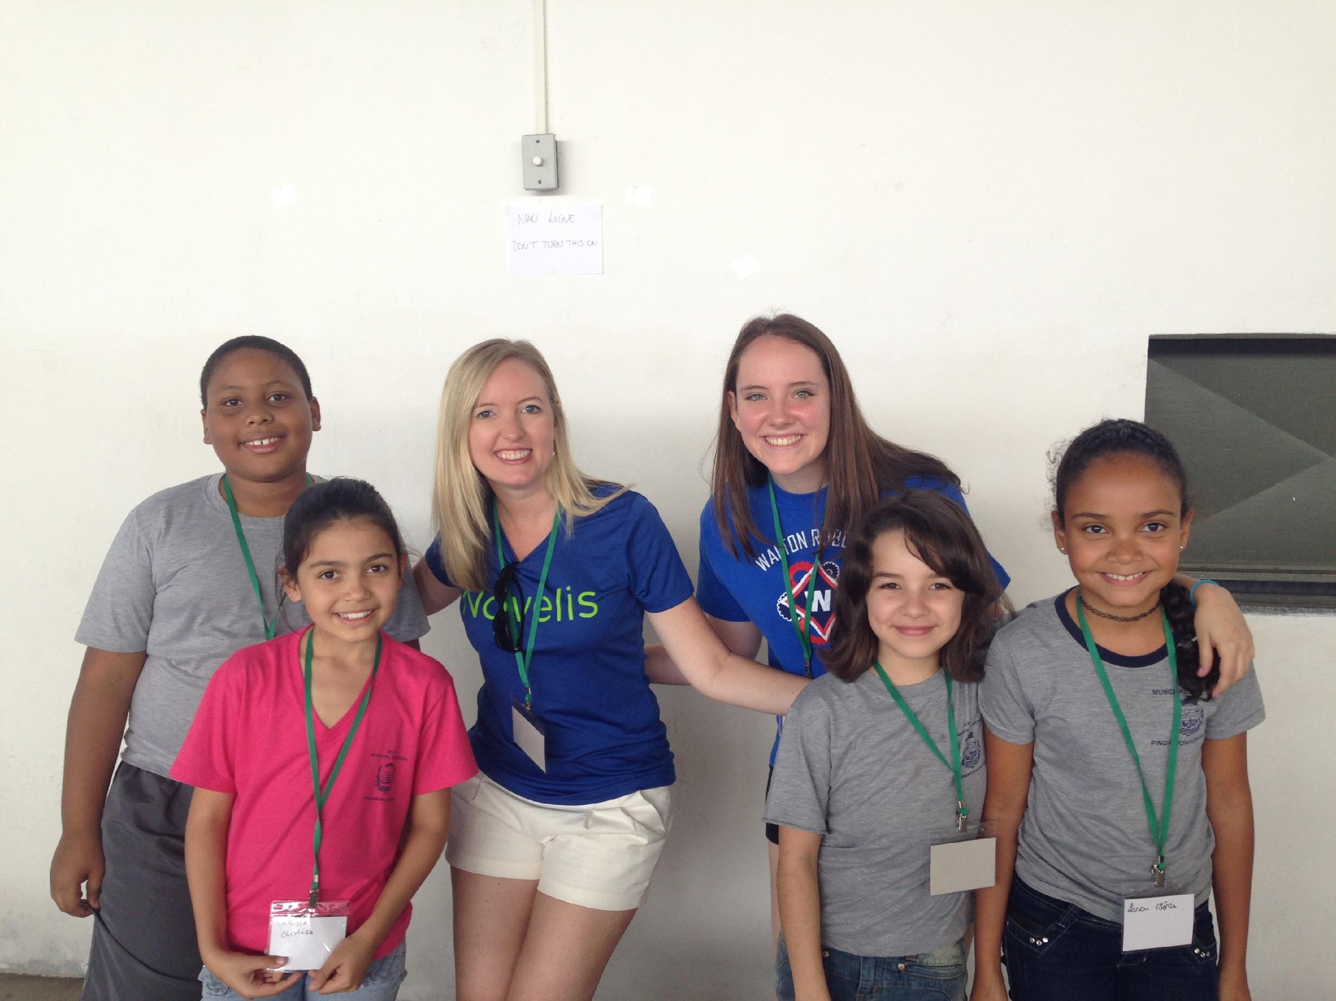
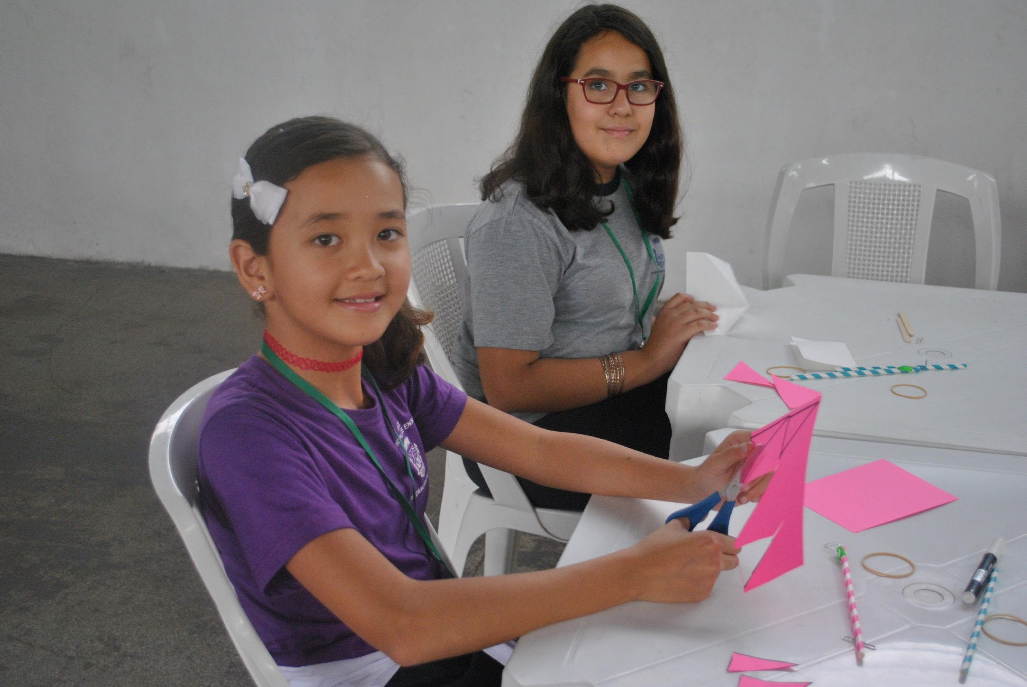
A Valuable Partnership
STEM Camp in Brazil
Walton-led STEM Camp
Free to the community
Costs underwritten by Novelis
Outcomes
Increased engagement around STEM education in local community
Allowed Novelis to introduce FIRST to colleagues in Brazil
Building on relationships to grow FIRST in areas where we operate in Brazil

Slide 30
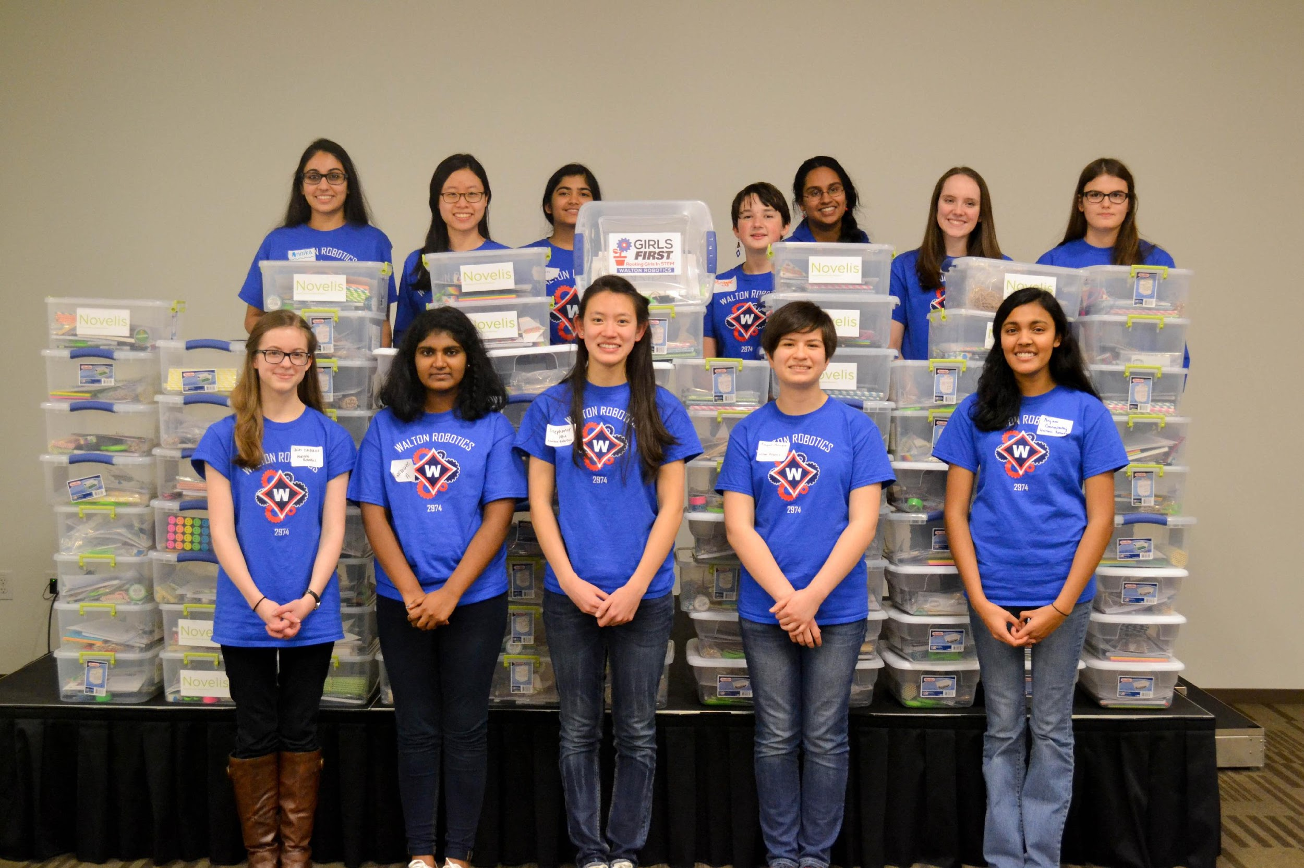
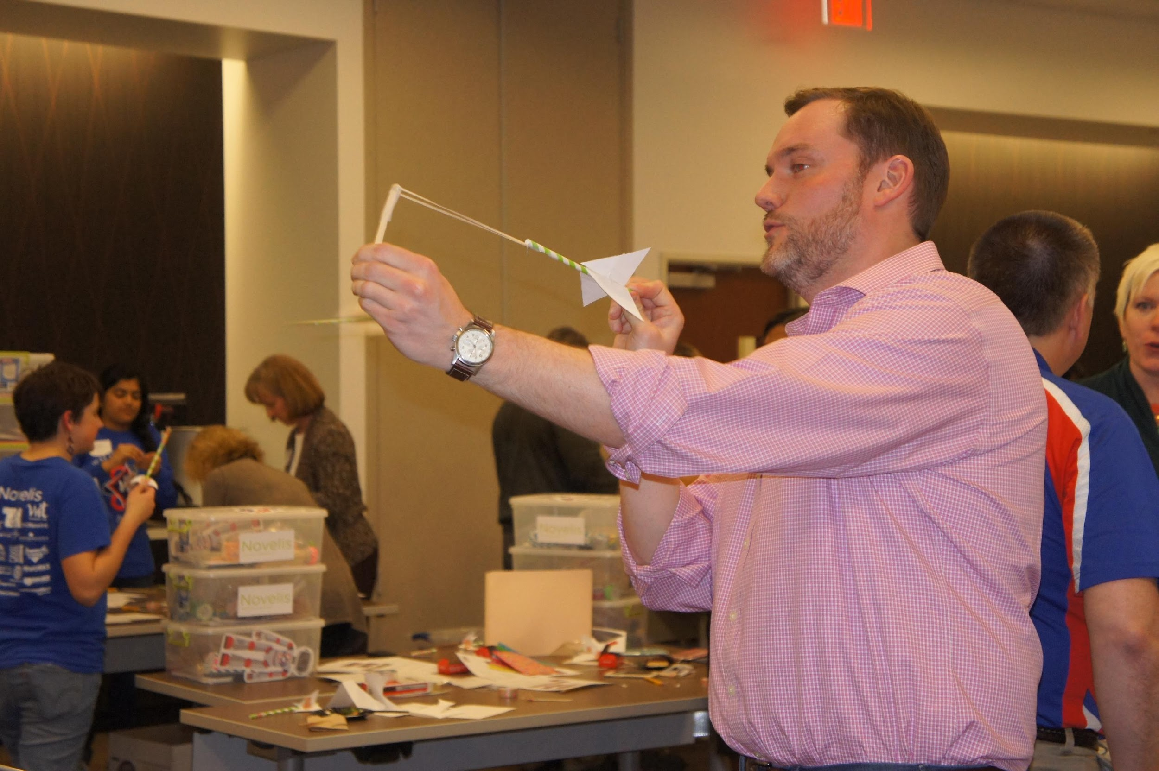
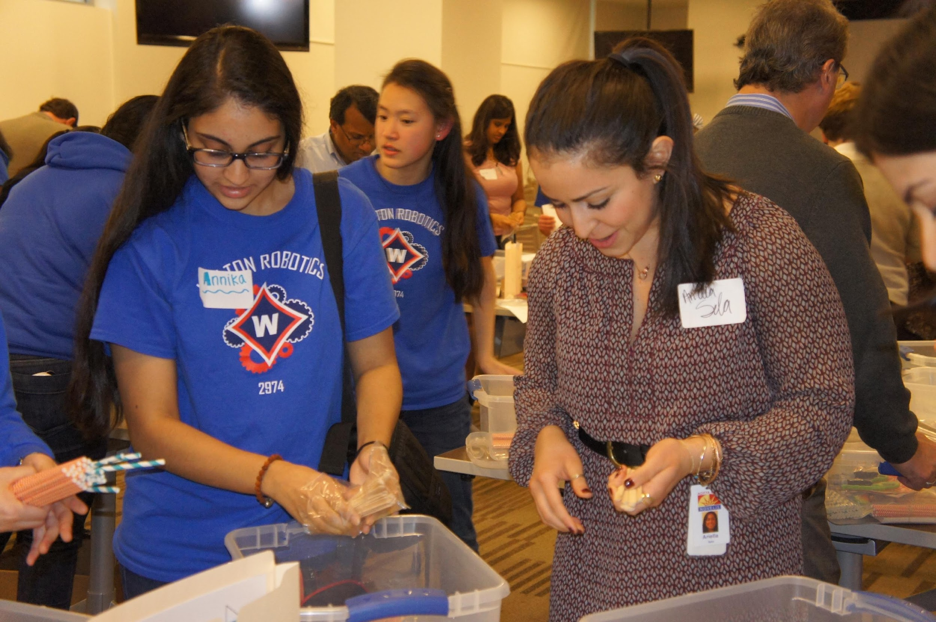
A Valuable Partnership
STEM Kit Outreach
Easy Employee Volunteer Activity
Build kits in the office
Implement kits with different youth groups led by employees
Global Reach
Sent kits to over 35 different locations/ groups globally
Fun & Interactive Activity
Adults & students both enjoy

Slide 31
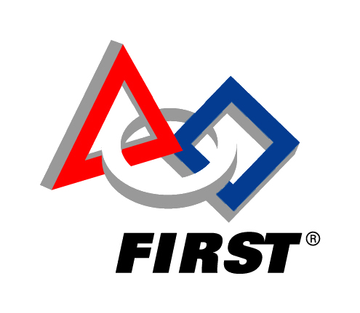
How to Engage Your Sponsors
Sponsors
Spreading STEM
Corporate Social Responsibilities
Fun
Effective
Engaging
STEM Events
Connection
Experience
Perspective
Man-Power
Professionals
Materials
Funding
Facilities
WIN!

Slide 32
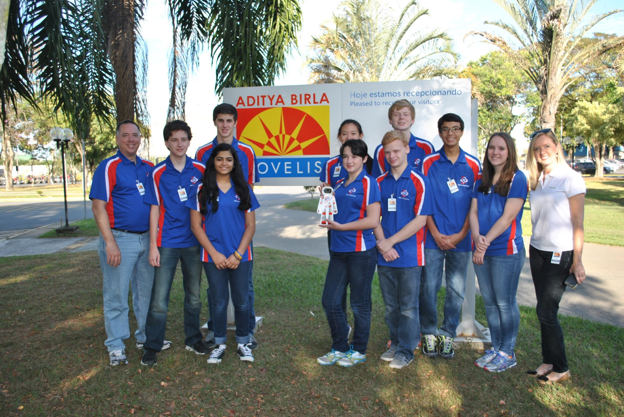
Key Takeaways
FIRST & Sponsors
Know Your Sponsor
Understand their business and community outreach focus areas
Get Creative
Think big – your sponsor will let you know what’s plausible
Engage Their Employees
Corporations want to engage employees in meaningful ways

Slide 33
How do I get a Kit?
For Additional information or to order your free Walt’s STEM Toolbox kit, contact Walton Robotics FIRST Team 2974 at
waltsstemtoolbox@waltonrobotics.org
Notes:
You each have a Walt’s STEM Toolbox flyer in your folder. The flyer includes a short description of all the components of the toolbox and on the bottom there is contact information on how to obtain your own Walt’s STEM Toolbox.
While Novelis has made it possible for us to produce these products, there is also a shipping costs. We will graciously accept any shipping donations to offset the cost.

Slide 34
Got Questions?
Leveraging Resources
Connects Sponsors to FIRST Teams
STEM can lead to exciting Careers!
STEM is for EVERYONE!
Solutions to Challenges
STEM is FUN!
Walt’s STEM Toolbox can kickstart your STEM Outreach
Notes:
At this point, we would like you to come up and look at our products and ask questions

Slide 35
Thanks!
Contact Us!
www.waltonrobotics.org
Together we can connect the message of FIRST in a fun and powerful way
Share your pictures!!!
Notes:
I would like to thank everyone for coming here today to learn about the Walt’s STEM Toolbox and learning how it can help promote STEM in your community.
Today we can inspire tomorrow's leaders with the message of FIRST

