Slide 1
A Problem Solving Approach to Drivetrain Design
Clinton Bolinger - FRC2337 (EngiNERDs) Nick Lawrence - FRC3940 (CyberTooth)
Evan Morrison - FRC5803 (Apex Robotics)
Ty Tremblay - FRC319 (BOB)

Slide 2
Three Platforms of Drivetrain Design
Expert
Advantage
Optimization
Advanced
Consistency
Fundamental

Slide 3
Fundamental: Consistency
What does an FRC drivetrain do?
Get the robot to where you want...
when you want
consistently
Robustness, ground clearance, proper speed selection
“A drivetrain cannot win you a match, but it can lose you one”
Notes:
mmm: Every year we mapped out the different ways to play the game our team seemed to settle on 5 different things a robot can do in a game. Drive Fast, Be Agile, Bulldoze robots, Hold your ground, and be slippery. Each ability has a cost(weight, volume, resources, complexity, and robustness) so choosing wisely on which are important to play the game your team wants to play is clutch. We would pick 2 or 3 from that list of abilities. Nobody gets everything. Its game dependent.
Some examples:
Game has no protected scoring zones = Hold your ground --> traction wheels
Game requires full court traverse to get game object and score = Be Fast → gear for >10fps
Game has open field and for defensive t-bones = Be slippery → 2omnis+2 traction wheels
Game has single score spot or single game piece = Bully other robots → traction+gear for <8fps
Game has small goal to game object size ratio = be agile → omni/low traction wheels+turning torque
I personally don’t think you ever need an advanced drivetrain of crab or mecanums to get the job done.
mmm: Don’t use the drivetrain as a place to invent. Great solutions already exist. Spend the resources to get your drivetrain robust. This is where you want the weight on a robot… down low. Set it and forget it. Go with what works. Shouldn’t need to prototype.

Slide 4
Get Where You Need To Go
If your drivetrain fails, the robot doesn’t get to where it needs to
A failure can be a mechanical failure (e.g chain breaking) or a design deficiency (e.g. not enough ground clearance, gets stuck)
Use game analysis to figure out where you want to go on the field
Determine if you need to be a certain size (2010 tunnel, 2012 bridges)
Determine if you need to go over/under any obstacles (2016 defenses)
Notes:
mmm: maybe an example calc? Experts agree 10fps is pretty all around awesome for quick dashes, and agile turning. 4” wheels are nice for low CG but still some ground clearance. 4” have a circumference of 4”*pi =~ 1ft. So 1ft per rev. So I need to spin the wheel 10 times per second to go 10ft/s. A CIM spins at 5000 rotations no load speed, take 80% of that so 4000rpm = 67 rotations per second. 67/10 means I need a 6.7:1 gear ratio… for a more advanced take use the JVN calculator with pretty plots. I train my students on that and we always do an exercise of mapping the different sprints we will make on the field. In 2015&2016 the sprint distance was very short, in 2013&2014 is was very long. Acceleration matters.

Slide 5
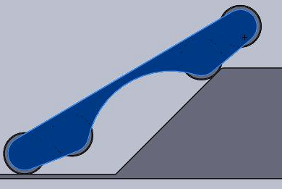
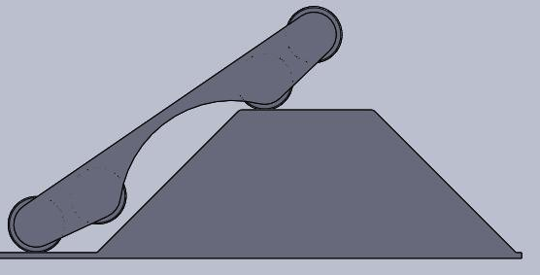
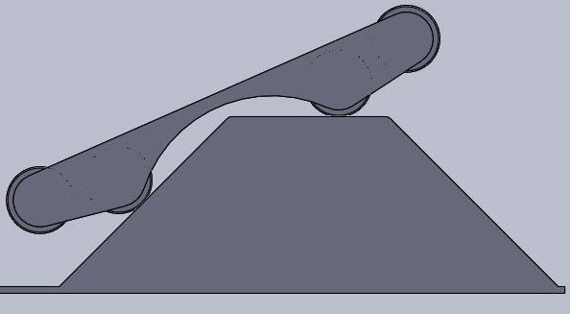
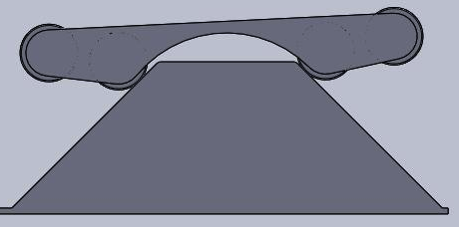
Get Where You Need To Go
Ground Clearance - Recommend at LEAST ½”
This will ensure you don’t get caught on field lips or ripples in the carpet
Some games may requires additional clearance for obstacles (Example of 2010 bump)
Do the geometry! (CAD, scale sketches, mock-ups)

Slide 6
Get Where You Need To Go
Picking speeds
Fast enough to do the tasks you want to do
Controllable, won’t eat battery or brown out
9-11 fps is a good speed if you’re not sure
Many COTS gearboxes offer multiple ratios
Resources - JVN calculator, Gearbox datasheets
Example calculation - Quick dash @10ft/s
4” wheels is about 1 linear foot per revolution (4*pi)
10 revolutions gets me 10 feet
Using CIMs in the drivetrain, free speed is ~5000rpm
Under load, assume 80% free speed for drivetrains, 4000rpm = 67 rps
I need to spin the wheel 10 rev/s to go 10 ft/s
(67 rev/s)/(10 rev/s) = 6.7:1 reduction
Notes:
mmm: maybe an example calc? Experts agree 10fps is pretty all around awesome for quick dashes, and agile turning. 4” wheels are nice for low CG but still some ground clearance. 4” have a circumference of 4”*pi =~ 1ft. So 1ft per rev. So I need to spin the wheel 10 times per second to go 10ft/s. A CIM spins at 5000 rotations no load speed, take 80% of that so 4000rpm = 67 rotations per second. 67/10 means I need a 6.7:1 gear ratio… for a more advanced take use the JVN calculator with pretty plots. I train my students on that and we always do an exercise of mapping the different sprints we will make on the field. In 2015&2016 the sprint distance was very short, in 2013&2014 is was very long. Acceleration matters.

Slide 7
Do it Consistently
Maintainability, simplicity are paramount
The Kitbot is a usually a very good option
4 CIMS recommended
6-8wd dropped-center skid steer is the “Gold Standard” in FRC
Kitbot, VexPro drive-in-a-day, VersaChassis, 221 SimpleTube are COTS options
Most top teams use some version of it
Before you do ANYTHING else, ask the question:
Does adding or changing the functionality of my drivetrain make my robot more competitive than addition functionality elsewhere?
It doesn’t have to be “the best” to be good enough to compete
Notes:
mmm: Tyler said it best and apply this not just to wheels but the whole drivetrain: https://www.chiefdelphi.com/forums/showpost.php?p=1289946&postcount=19
Please just hype how many great options already exist and are off the shelf. VEX, AM, and 221 all have fantastic complete packages. And if you have to build your own, at least download thier cad and copy all the great ideas. I can buy a vex gearbox (http://www.vexrobotics.com/vexpro/motion/gearboxes/single-speed-double-reduction.html), slap some 4” colsons on, and swap gears until i’m happy with the speed and cover the full range from too fast to too strong. [sorry Nick, I’m sure AM has a similar option, I just dont know it off the top of my head]
Nick: The Toughbox and Toughbox Mini support changing the output gears too in this manner.
mmm: Can we talk a lot about how good COTs have gottten in the last few years. Options like this didn’t exist before so old school FRC was about inventing good drivetrain and wheel solutions. We don’t have to do that anymore. So don’t! Omni wheels these days are great, you can get a good amount of tractive effort. A 4wd drive robot with 2traction + 2omni can be very very elusive on the field and easy to control. I personally am a huge fan of this and think it will replace the drop center drive as what the cool kids are doing. Be wary of too much traction… roughtop is amazing but can dig into the carpet so much that turning torque goes through the rough and holding your ground is easier to lock up in a tbone.

Slide 8
Advanced: Optimization
What does an advanced FRC drivetrain do?
Get the robot to where you want...
when you want
consistently
and with more control
Using sensors, better gear ratios, more traction, etc
Without sacrificing the fundamentals
“A drivetrain cannot win you a match, but it can lose you one”

Slide 9
Optimizing Speed
Shifting - good for when you need to go long distances quickly (high gear) but also want to have more precise control, push another robot
Examples - 2012 pushing robots up the bridge or fine positioning for balance, 2014 to bully your way to a non-protected location
Adding Motors - You can gain better acceleration by adding more motors
BE CAREFUL, best to have some testing or prior experience
You will strain the battery more, risk brownout and reduce power available to other systems
Define your “sprint distances” - the cycle distance you will be covering
Games with large flat fields will often have long sprint distances
Games that are more congested or sectioned
Look at protected zones if they exist

Slide 10
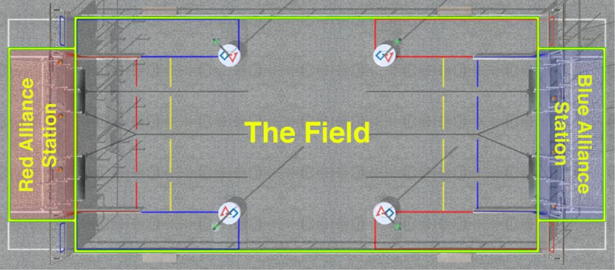
Optimizing Speed
~54 ft
~27 ft
~36 ft
2011 - LogoMotion

Slide 11
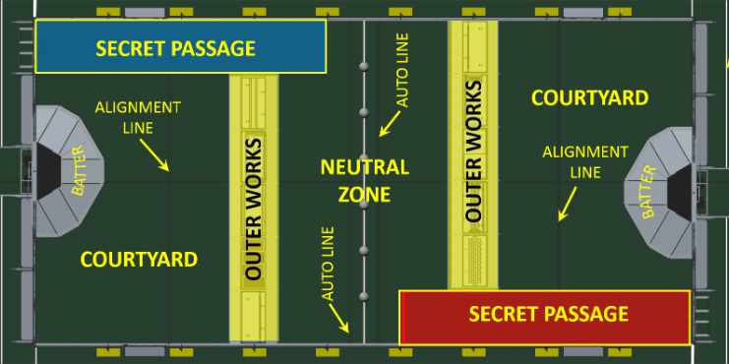
Optimizing Speed
~10ft
~27 ft
~36 ft
2016 - Stronghold

Slide 12
Optimizing Speed
COTS Options
Sonic Shifter and 3CIM4U drop in to KOP Chassis
Toughbox gear ratio can be changed
VexPro and WCP shifters can be adapted to KOP Chassis
Instructions available from VexPro
Other COTS chassis (VexPro Drive-in-a-Day, Versachassis, 221 Systems) have shifter and 3-CIM integration built in
Adapt a COTS gearbox to a custom chassis
Control-ability is a concern at higher speeds - your drivers will need practice
Notes:
Nick start here

Slide 13
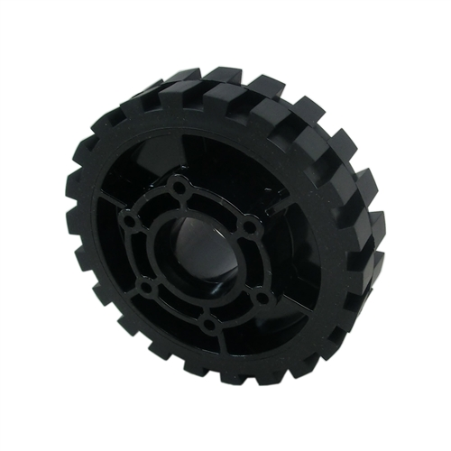
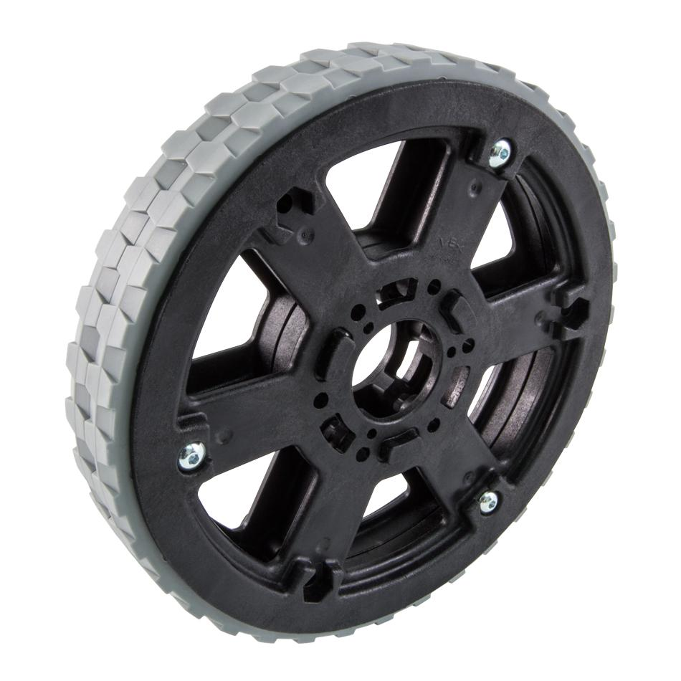
Optimizing Traction
Many COTS options (most compatible with prior KOP chassis)
Replaceable tread wheels
Plaction
VEXPro Traction Wheels
Permanently treaded wheels
Softer HiGrip Wheels***
Colsons
Adding higher-traction wheels help you win pushing matches
Too much traction can increase turning scrub, reducing turn speed and battery life
Too much traction can also make getting out of T-Bone situations more difficult

Slide 14
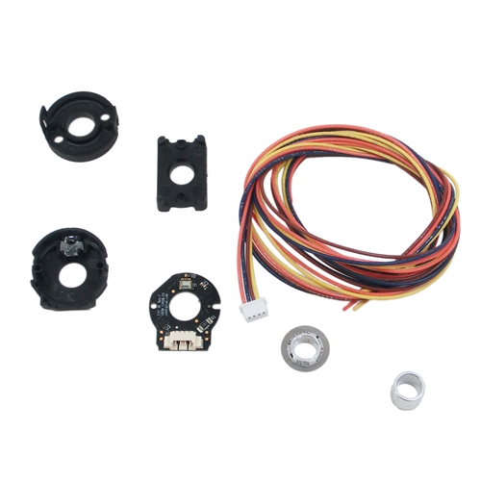
Sensor Integration
Adding sensors to your drivetrain are highly valuable for repeatable autonomous routines
Encoders on drive gearboxes or wheels
Many COTS gearboxes accept optical encoders
IMU (Inertial Measurement Unit) devices on RoboRIO
Basic Gyros
Providing real-world feedback through sensors will be more repeatable versus commands based on time
Example, drive forward for 100 ‘ticks’ versus 3 seconds

Slide 15
Expert: Advantage
What does an expert FRC drivetrain do?
Get the robot to where you want...
when you want
consistently
with more control
and better than your opponents
Different drivetrains, space/weight savings, motor selection, etc
Without sacrificing the fundamentals
“A drivetrain cannot win you a match, but it can lose you one”

Slide 16
Motor Selection
Typical drive motors for drivetrains
CIM
337 Watts
Case cooled
2.80 lb
miniCIM
215 Watts
Case cooled
2.15 lbs
775pro
347 Watts
Air cooled
0.80 lb
When to go beyond 4 CIMs in season
Proven that your 4 CIM drivetrain is your limiting factor
Thoroughly tested during off-season or previous season

Slide 17
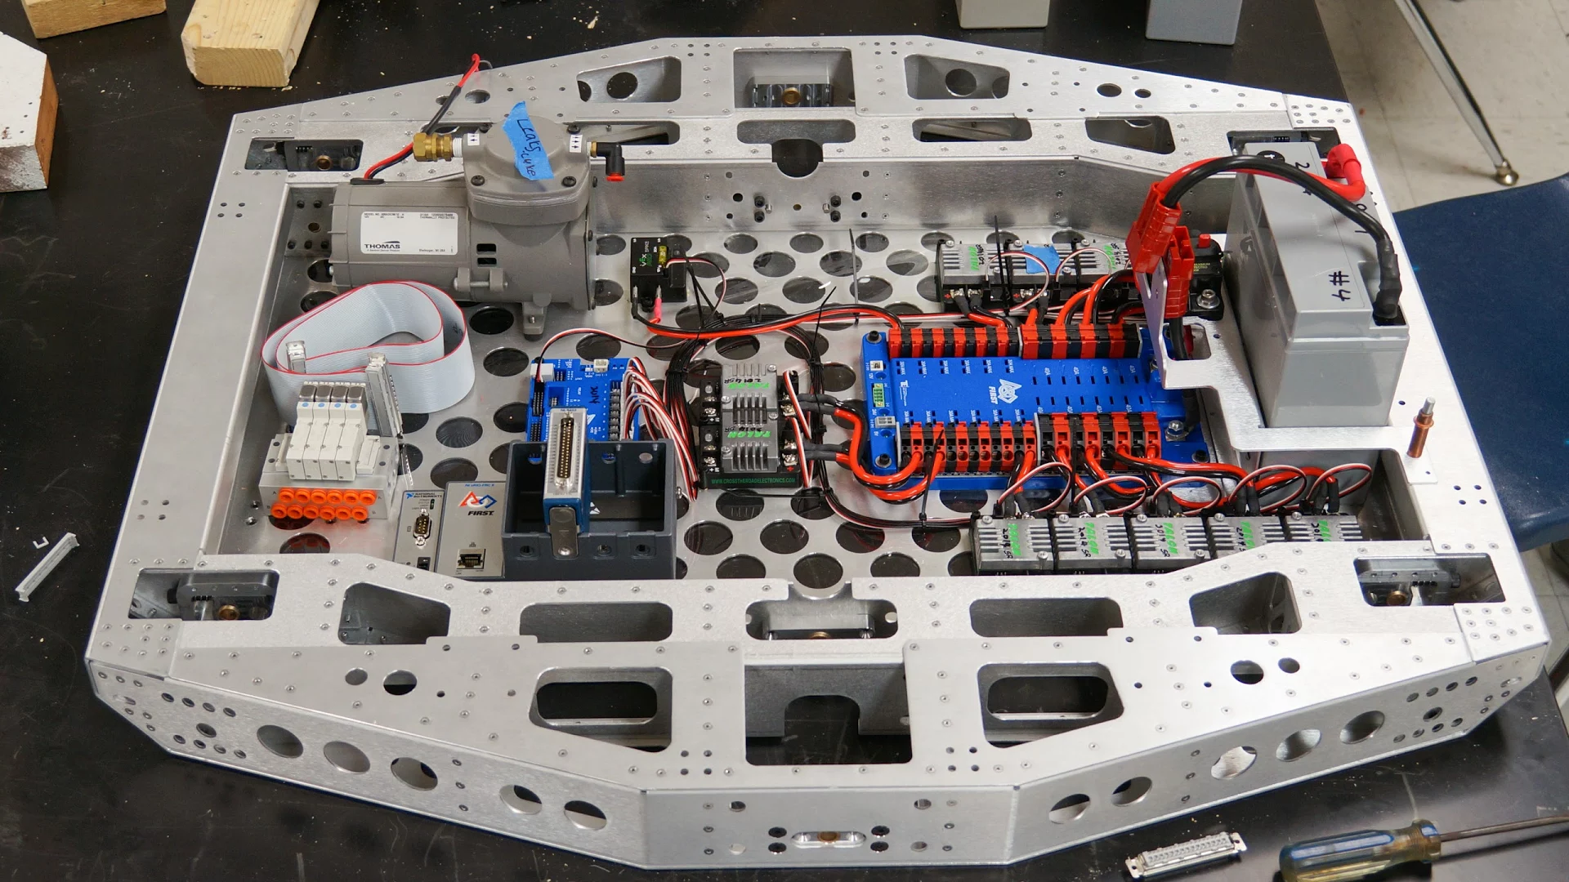
Space / Weight Savings
Sheet metal chassis
More customizable
Design and planning intensive
Welded chassis
Stiffer and lighter
Design and planning intensive
Non-rectangular frames
More area for given frame perimeter
More complicated
Chain-in-tube
More usable area inside frame perimeter
Difficult Maintenance
Pre-planning of attachments...you can’t just bolt/rivet into the frame rail anymore
971 (2014)

Slide 18
Non-Tank Drivetrains
There are a lot of types of drivetrains out there.
Swerve, Mecanum, Octocanum, H Drive, Track Drive, 4WD Omni
When should I choose a non-tank drivetrain?
1114 Presentation
Weighted Design Table Spreadsheet

Slide 19
QUESTIONS

