Slide 1
FTC Team Remote Scoring Webinar December 15, 2020

Slide 2
Team Scorekeeping
General Agenda
Firewalls and the FTC Scoring System
Reminder: Built in Match Timer
Reminder: Remote Scoring
Reminder: Documentation
Q&A

Slide 3
Firewalls & FTC Scoring
Some volunteers have tried to run test matches within a school environment
Experienced slow performance of the FTC Scoring system, missing graphics, no audio, etc.
In at least one case, the issue appears to have been caused by the school firewall
The IT department added firstinspires.org and ftclive.org to the firewall’s “approved list”
The problem was resolved after these additions were made

Slide 4
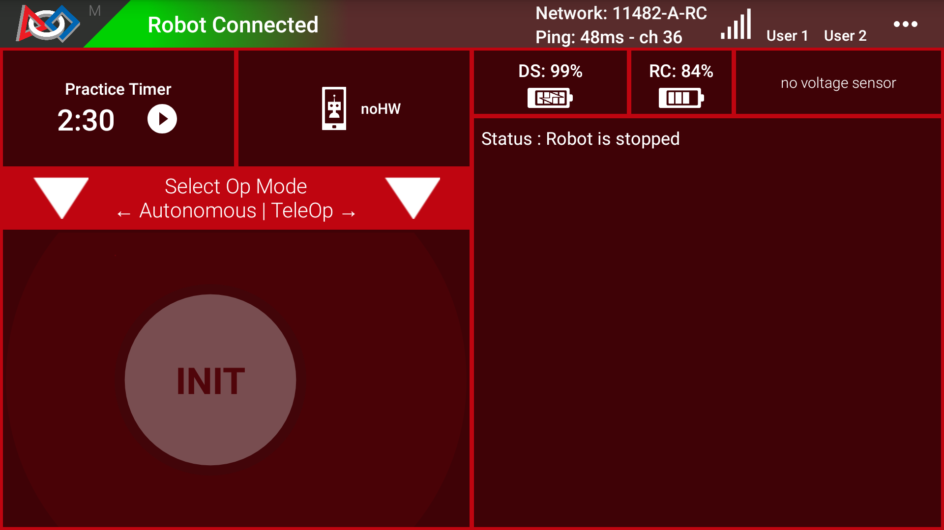
Built in Match Timer
Available on Driver Station (landscape mode)
Includes sound effects from FTC Scoring system
Useful if using paper scoresheets
Put DS into landscape mode, then restart app

Slide 5
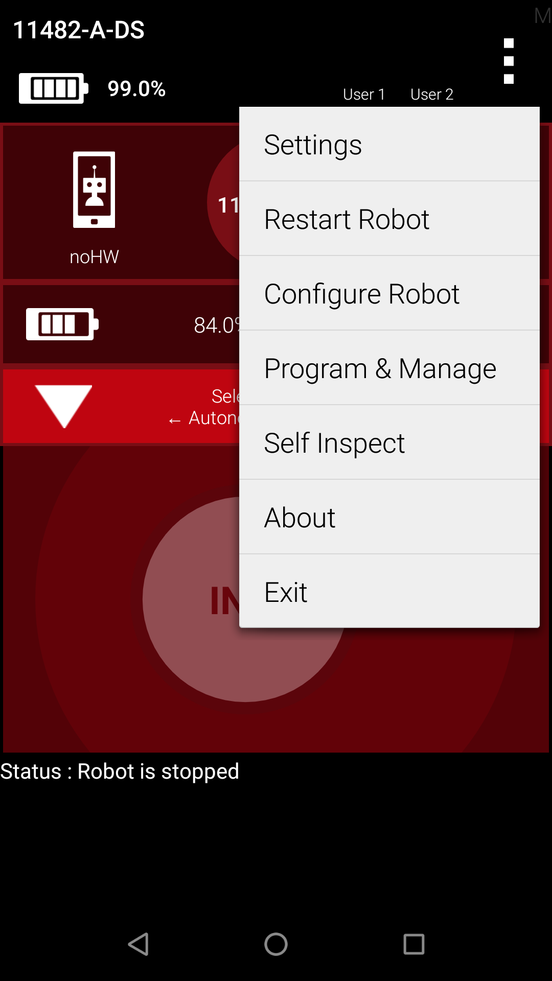
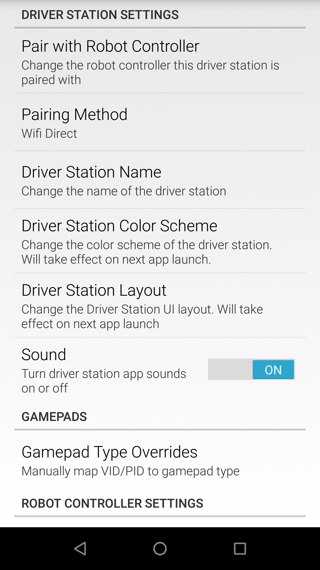
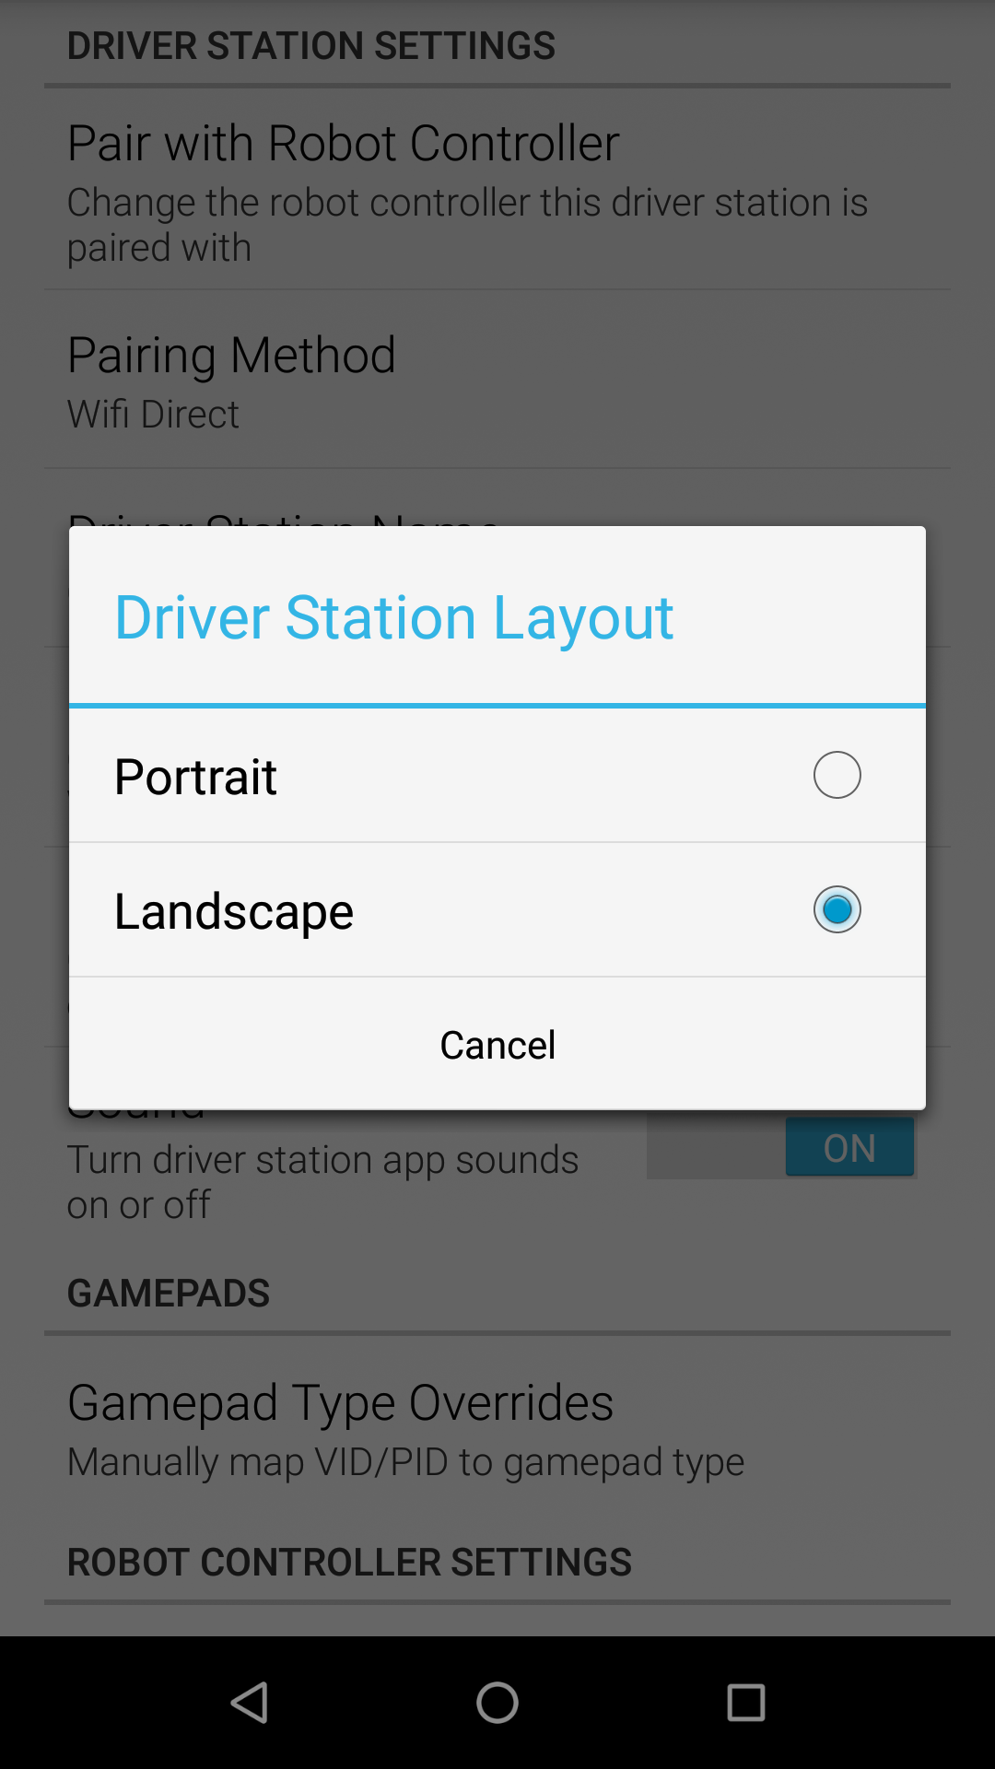
Switching to Landscape Mode

Slide 6
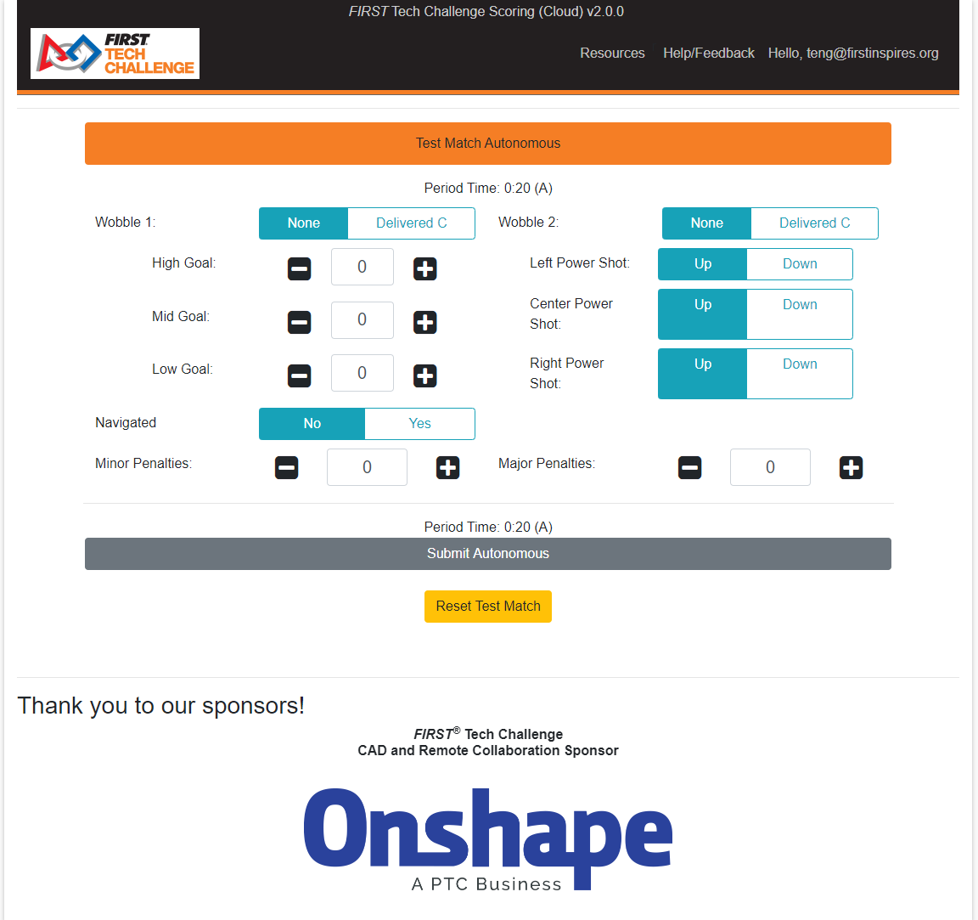
Reminder: Remote Scoring
ftc-scoring.firstinspires.org
Have you watched the YouTube Playlist?
Have you conducted a practice (test) match?

Slide 7
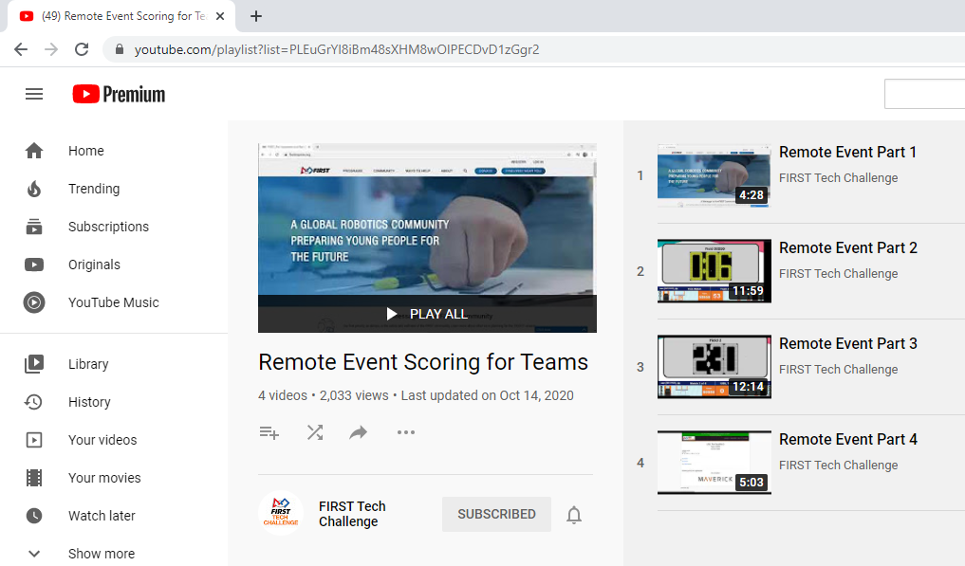
Reminder: Documentation
FTC Scoring Guide for Teams
FTC Scoring YouTube Playlist for Teams

Slide 8
Q&A Session

Slide 9
Thank you for Joining
The Team Technology Troubleshooting Webinar
We hope to see you all next month!

